Slide 1
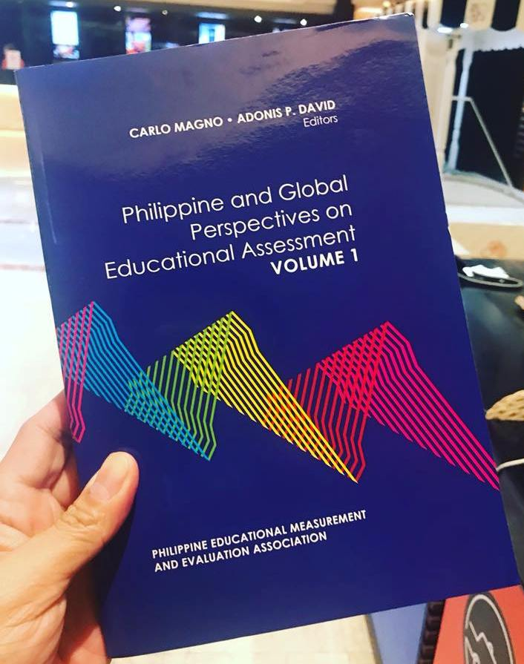
PHILIPPINE AND GLOBAL PERSPECTIVES ON EDUCATIONAL ASSESSMENT
Volume 1

Slide 2
The current volume showcases the development of educational assessment viewed from the lens of different but interconnected perspectives. Invited experts from the Philippines and other countries have contributed to show a glimpse of what assessment is and its direction.

Slide 3
This volume is divided into ten chapters: one introductory chapter and nine chapters of thematic and empirical essays that cover a broad range of issues and topics in classroom and school assessment, measurement, psychometrics, and high-stakes testing.

Slide 4
CHAPTER 2
Formative Assessment and School Improvement: Prospects and Challenges in the Development of Formative Assessment that Could Help Improve Student Learning Outcomes in Philippine Schools
Allan B. I. Bernardo

Slide 5
CHAPTER 3
Assessment in the Philippines’ Formal Education System
Esther Care

Slide 6
CHAPTER 4
Why Macao is Commended as an Economy of High-Performance and High-Equity amongst PISA 2015 Participating Economies? An Explanation from an Insider Perspective
Kwok-cheung Cheung, Soi-kei Mak,
Pou-seong Sit, Man-kai Ieong

Slide 7
CHAPTER 5
Methods for Measurement Invariance Testing for Contextual Scales in Large-Scale Educational Assessments
Jia He and Jessica Fischer

Slide 8
CHAPTER 6
Cognitive Diagnosis Modeling:
An Overview and Illustration
Kevin Carl P. Santos and Jimmy de la Torre

Slide 9
CHAPTER 7
How Are Sequences of Talk Related to Outcomes?
Statistical Discourse Analysis of Classroom Conversations
Ming Ming Chiu

Slide 10
CHAPTER 8
Can Students Value for Formative Assessment
Develop their Academic Self-Regulation and Grit?
Carlo Magno and Jose Carlos Ocampo

Slide 11
CHAPTER 9
Revisiting Learning Disability Identification
Approaches: An Argument for the Use of the
Dual-Discrepancy Model for Public Schools
Violeta Valladolid

Slide 12
CHAPTER 10
Exploring the Culture of Testing in the Philippines
Alejandro S. Ibañez, Karissa Danice L. O’Hara,
Mark Joseph A. Pangan, Jerome T. del Castillo,
Amina Aisa H. Boncales, and Maria Angeles Guanzon Lapeña

