Slide 1
ASSESSMENT FOR K TO 12 TRACKS: STEM
BERNADETH C. DARAN
Supervising Education Program Specialist

Slide 2
DepEd Policy Guidelines
Classroom Assessment (DO No. 8, s. 2015)
National Assessment (DO No. 55, s. 2016)
System Assessment (DO No. 29, s. 2017)

Slide 3
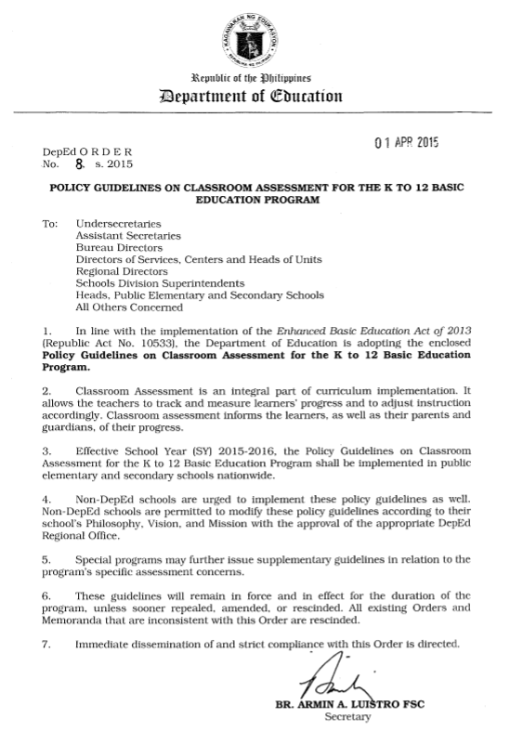
DepEd Order No. 8, s. 2015
Policy Guidelines on Classroom Assessment for the K to 12 Basic Education Program

Slide 5
Assessment in the K to 12 Basic Education Program recognizes:
Diversity of learners inside the classroom
The need for multiple ways of measuring their varying abilities and learning potentials
The role of learners as co-participants in the assessment process

Slide 6
What is Classroom Assessment?

Slide 7
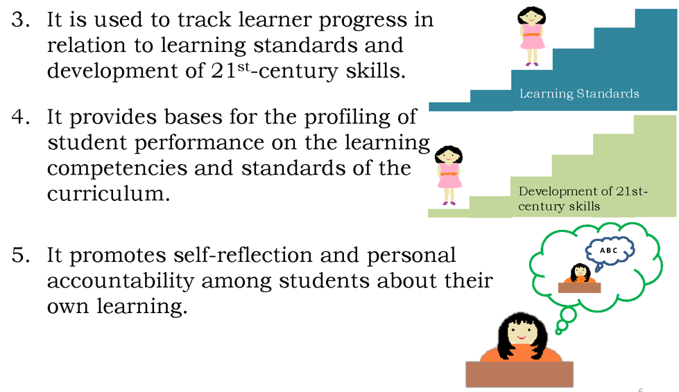
What is Classroom Assessment?

Slide 8
What is Classroom Assessment?

Slide 9
What is assessed in the classroom?
Content Standards
1. These cover a specified scope of sequential topics within each learning strand, domain, theme or component.
2. They answer the question “What should learners know?”
Performance Standards
These describe the abilities
and skills that learners are expected
to demonstrate in relation to the
content standards and integration of
21st century skills.
2. They answer the following questions:
What can learners do with what they
know?
How well must learners do their work?
How well do learners use their learning or understanding in different situations?
How do learners apply their learnings or understanding in real-life contexts?
What tools and measures should the
learners use to demonstrate what
they know?
Learning Competencies
Learning competencies refer to the knowledge, understanding, skills and attitudes that learners need to demonstrate in every lesson and/or learning
activity.

Slide 10
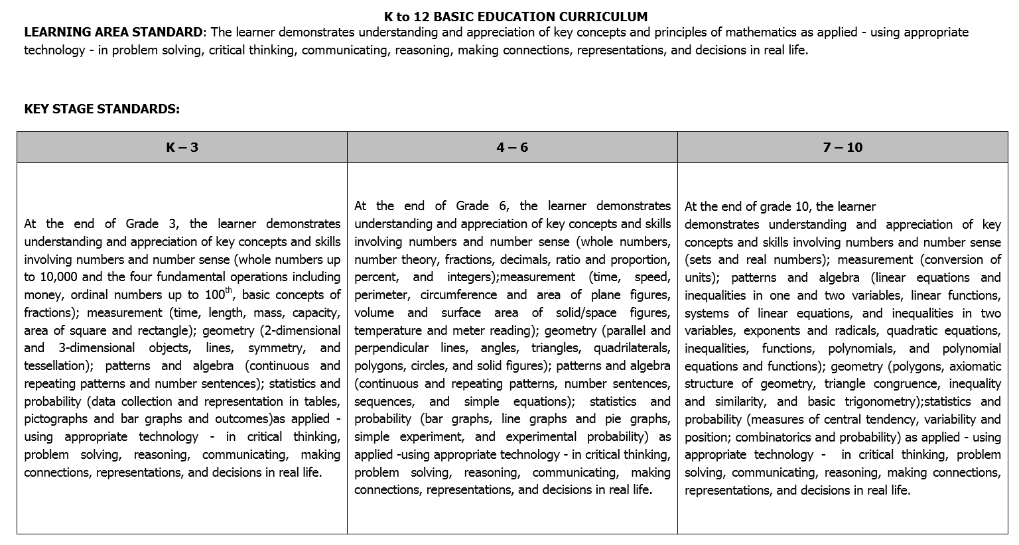
Sample CG in Mathematics

Slide 11
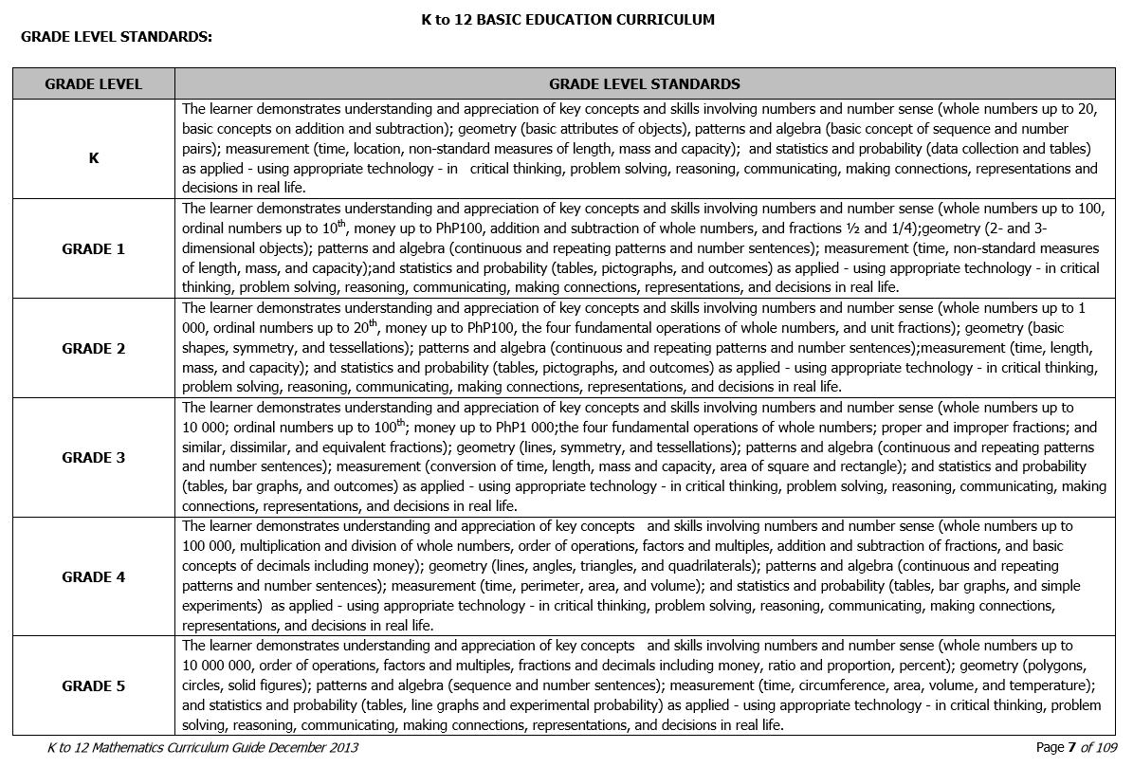
Sample CG in Mathematics

Slide 12
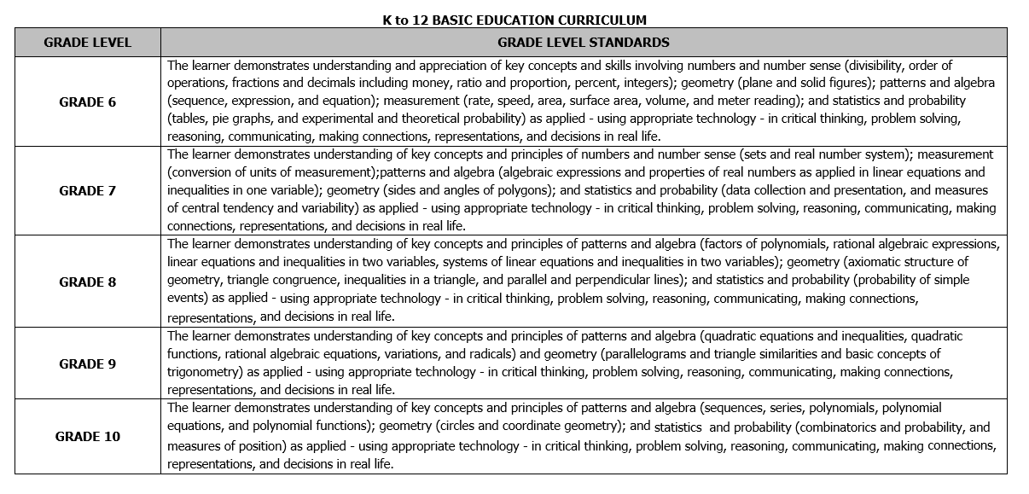
Sample CG in Mathematics

Slide 13
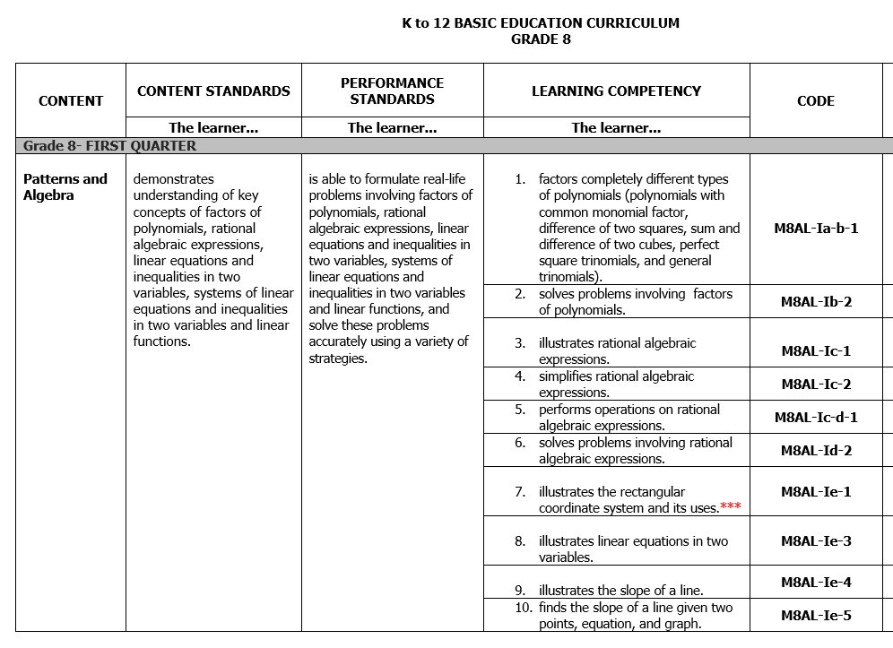
Sample CG in Mathematics

Slide 14
How are learners assessed in the classroom?
Formative Assessment
Summative Assessment

Slide 15
How are learners assessed in the classroom?
Formative Assessment
According to the UNESCO Program on Teaching and Learning for a Sustainable uture (UNESCO-TLSF):
Formative assessment refers to ongoing forms of assessment closely linked to the learning process
It is informal.
2. It provides immediate feedback to both learner and teacher.
3. It helps prepare learners for summative assessments.
4. It is recorded but not included as basis for grading.

Slide 16
When Formative Assessment may be conducted:
before the lesson
during the lesson
after the lesson

Slide 17
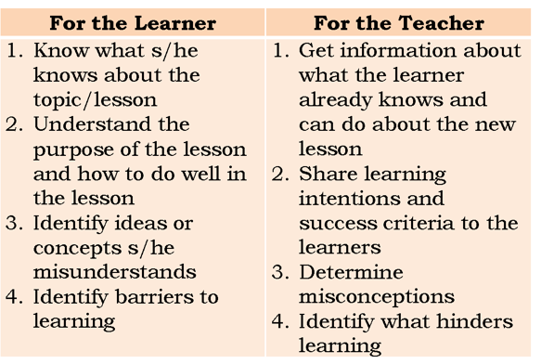
Purposes of Formative Assessment
before the lesson
during the lesson
after the lesson

Slide 18
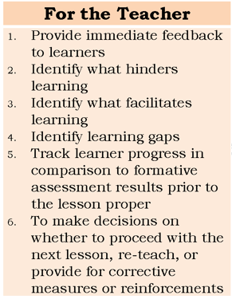
Purposes of Formative Assessment
before the lesson
during the lesson
after the lesson

Slide 19
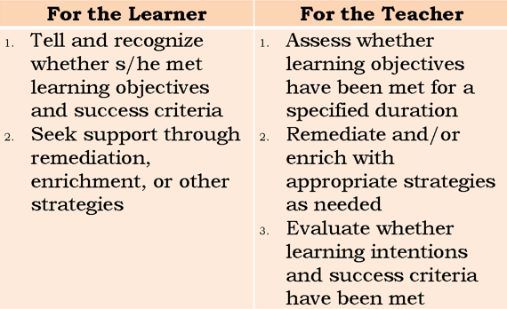
Purposes of Formative Assessment
before the lesson
during the lesson
after the lesson

Slide 20
How are learners assessed in the classroom?
Summative Assessment
Summative Assessment may be seen as assessment of learning which occurs at the end of a particular unit.
It usually occurs towards the end of a period of learning in order to describe the standard reached by the learner.
Judgement derived from summative assessment are usually for the benefit of people other than the learner (UNESCO-TLSF).
Results of summative assessment are recorded and are included in the computation of the final grade.

Slide 21
Components of Summative Assessment
Performance Tasks
Quarterly Assessment
Written Work
Ensures that students are able to express learned skills and concepts in written form.
May include essays, written report, long quizzes and other written output.
Allows learners to show what they know and are able to do in diverse ways.
Learners may create or innovate products or do performance-based tasks
Written output may also be considered as performance tasks.
Measures student learning at the end of the quarter
This may be in the form of objective tests, performance-bases assessment or a combination thereof.

Slide 22
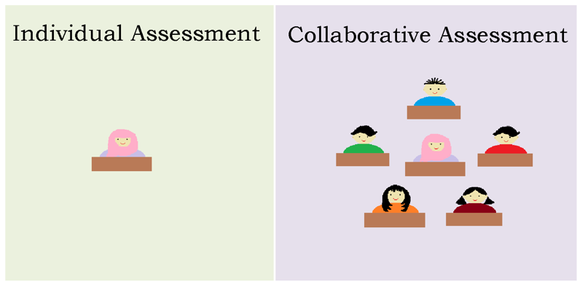
How are learners assessed in the classroom?

Slide 23
What is the Grading System?
Kindergarten
Checklists, anecdotal records and portfolios are used instead of numerical grades which are based on the Kindergarten curriculum guide
Grades 1 to 12
Learners are graded on 3 components every quarter: Written Work, Performance Tasks and Quarterly Assessment
These components are given specific weights which vary.
All grades will be based on weighted raw score of the learner’s summative assessments.
The minimum grade needed to pass a specific learning area is 60 which is then transmuted to 75 in the report card.

Slide 24
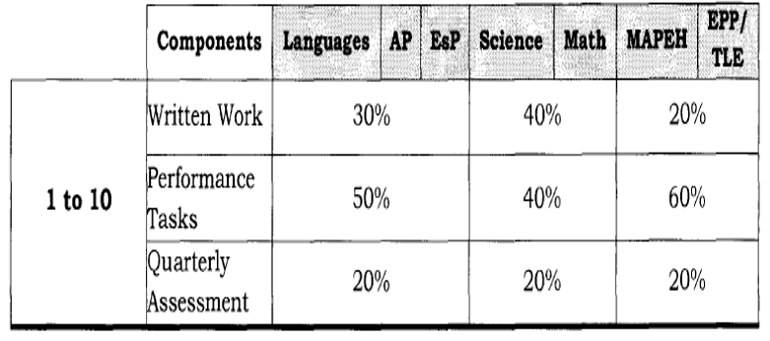
Weight of the Components for Grades 1-10

Slide 25
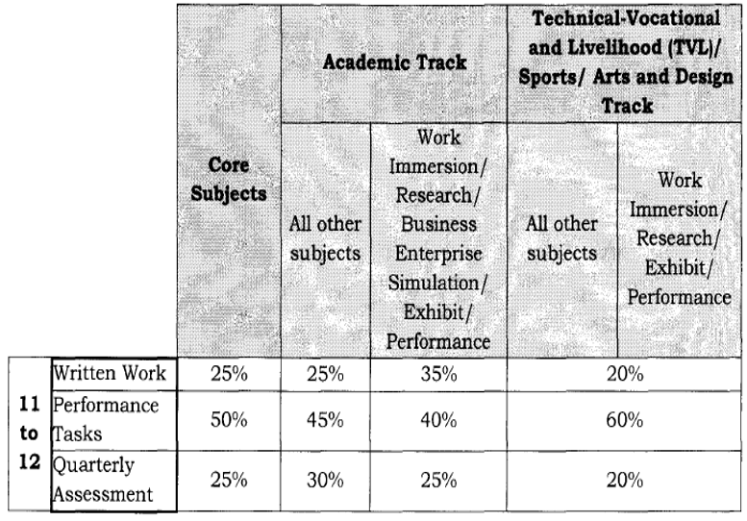
Weight of the Components for SHS

Slide 26
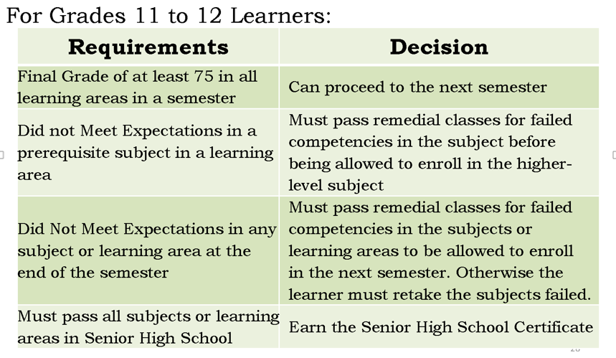
How are learners promoted and retained at the end of the School Year?

Slide 27
On Remedial Classes
Summative Assessments are also given during remedial classes. These are computed, weighted and transmuted in the same way as the Quarterly Grade.
The equivalent of the Final Grade for remedial classes is the Remedial Class Mark.
The Final Grade at the end of the School Year and the Remedial Class Mark are averaged.
If the Recomputed Final Grade is 75 or better:
If the Recomputed Final Grade is below 75:

Slide 28
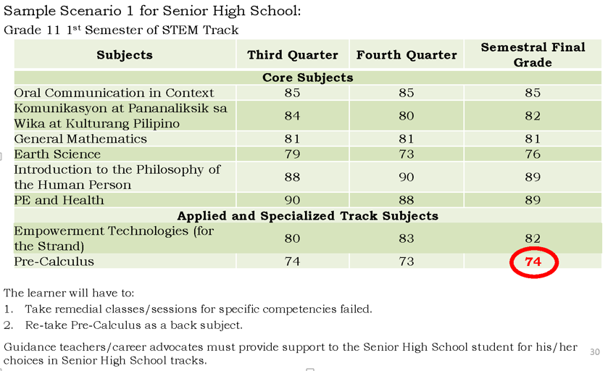
Sample Scenario 1

Slide 29
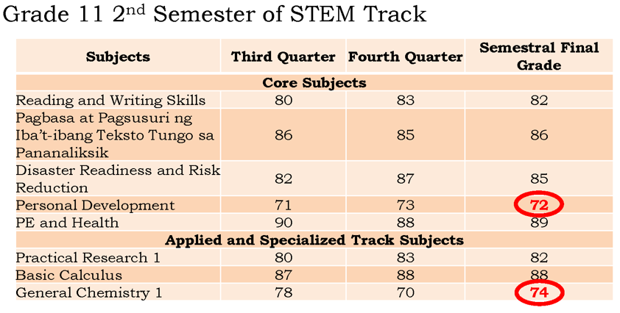
Sample Scenario 2

Slide 30
Scenarios

Slide 31
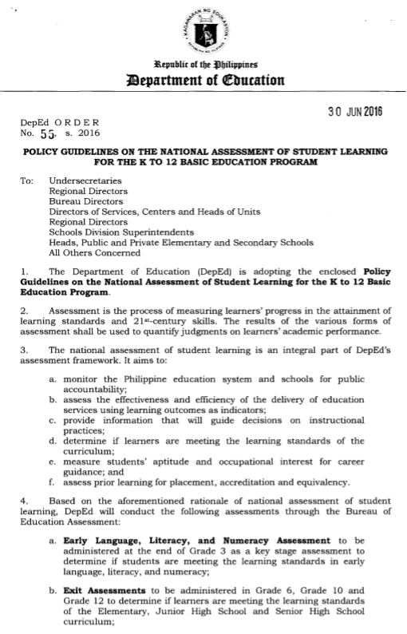
DepEd Order No. 55, s. 2016
Policy Guidelines on the National Assessment of Student Learning for the K to 12 Basic Education Program

Slide 32
Aims of National Assessment of Student Learning
Monitor the Philippine education system and schools for public accountability
Assess the effectiveness and efficiency of the delivery of education services using learning outcomes as indicators
Provide information that will guide decisions on instructional practices
Determine if learners are meeting the learning standards of the curriculum
Measure students’ aptitude and occupational interest for career guidance
Assess prior learning for placement, accreditation and equivalency

Slide 33
National Assessment of Student Learning
Early Language, Literacy and Numeracy Assessment (ELLNA)
Exit Assessments
Career Assessment
Accreditation and Equivalency Assessment
Grade Level Placement Assessment

Slide 34
Exit Assessments
To be administered in Grade 6, Grade 10 and Grade 12 to determine if learners are meeting the learning standards of Elementary, Junior High School and Senior High School curriculum
Not a requirement for graduation

Slide 35
Exit Assessments
Coverage
Grade 12 – 21st century skills and core SHS learning areas of Languages, Humanities, Communication, Mathematics, Science, Social Science and Philosophy
21st century skills: Information, Media and Technology Skills, Learning and Innovation Skills, Communication Skills, Life and Career Skills

Slide 36
Exit Assessments
Mode of Administration
Grade 12
stratified random sampling to represent all types of schools in the district, division and region
50% of the schools per track (public and private) shall be included in the sample

Slide 37
Career Assessment
To be administered in Grade 9 to determine learners’ aptitudes and occupational interests for career guidance
Results shall also be used for entry assessment to the specific SHS tracks/strands in all public and private schools
Administered annually every last Wednesday and Thursday of August

Slide 38
Criteria for entry to STEM
CRITERIA | Science, Technology, Engineering and Mathematics Strand
Scholastic Grades at Grade 10 | Final Grade no lower than 85 both in Math and Science
Career Examination Results | Percentile rank of 86 and above in the STEM subtest
Alternative Entry Requirements | Write-up of scientific inquiry process Draft experiment Other such summative assessments

Slide 39
Career Assessment
Domains:
General Scholastic Aptitude (GSA) – average of standard scores in Scientific Ability, Reading Comprehension, Verbal Ability, Mathematical Ability and Logical Reasoning Ability
Occupational Interest Inventory (OII) – inventory/checklist of occupational interests which provides an assessment on inclinations/preferences for comprehensive career guidance.
Aptitude for SHS Tracks – measures the innate ability or potential of a student to succeed in the SHS tracks. (Academic, TVL, Sports, Arts & Design)

Slide 40
Occupational Interest Inventory (OII)
The students are provided with a profile chart of their occupational inclinations and preferences thru the identified cluster occupations:
Cluster of Occupational Fields
Science Media & Communication
Natural Sciences Community Services
Aquaculture and Architecture and Construction
Agriculture/Forestry The Arts
Engineering Fashion: Garments, Hairstyle/
Business and Finance/Commerce Cosmetics/Parlor Services,
Professional Services Jewelry and Accessories
Personal Services Military and Law Enforcement
Computers and Technology Spiritual Vocation

Slide 41
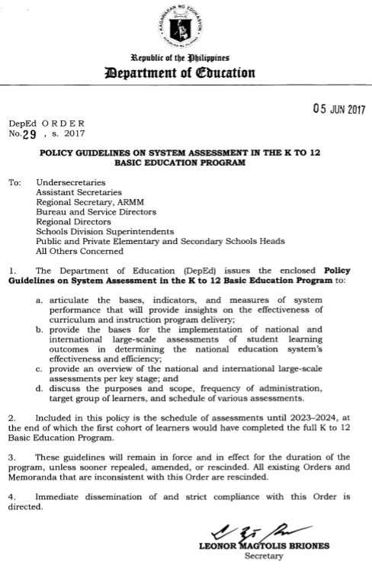
DepEd Order No. 29, s. 2017
Policy Guidelines on System Assessment in the K to 12 Basic Education Program

Slide 42
Purpose
Establish baselines for the basic education system and the implementation of the K to 12 curriculum
Monitor the implementation of the K to 12 curriculum
Measure effectiveness of instructional reforms that are part of the K to 12 basic education program
Generate reliable data for purposes of international benchmarking
Provide bases for the improvement of programs for learner development, curriculum implementation and school effectiveness
Provide evidence that will aid policy formulation, planning, and programming at the division, regional and national levels

Slide 43
National Assessments
Early Language, Literacy and Numeracy Assessment (ELLNA)
Early Grade Reading Assessment (EGRA)
Early Grade Mathematics Assessment (EGMA)
National Achievement Test (NAT)

Slide 44
International Assessments
Programme for International Student Assessment (PISA)
Trends in International Mathematics and Science Study (TIMSS)
Progress in International Reading Literacy Study (PIRLS)
Southeast Asia Primary Learning Metric (SEA-PLM)

Slide 45
Programme for International Student Assessment (PISA)
Goal: evaluate education systems worldwide by testing the skills and knowledge of 15-year-old students who are approaching the end of their compulsory education
Tests how students can apply their knowledge to real-life situations and problems, rather than testing their knowledge recall

Slide 46
Programme for International Student Assessment (PISA)
2012 – Mathematical Literacy with creative problem solving and financial literacy
2015 – Scientific Literacy with collaborative problem solving
2018 – Reading Literacy with Global Competence

Slide 47
Trends in International Mathematics and Science Study (TIMSS)
International assessment of mathematics and science that was first conducted in 1995
run by International Association for the Evaluation of Educational Achievement (IEA), an independent international cooperative of national research institutes and government agencies
Goal: to provide information that will assist countries to monitor and evaluate the success of their math and science education across time and across grades
Intention: to improve teaching and learning of math and science by providing information about student achievement in relation to different types of curriculums, instructional practices and schools.

Slide 48
Trends in International Mathematics and Science Study (TIMSS)
Achievement is reported
Across 4 international benchmarks
advanced, high, medium, low
By major content domains
Math: Number, algebra and geometry
Science: earth science, biology and chemistry
By cognitive domains
Knowing, applying and reasoning

Slide 49
International Assessments
Assessment | PISA | TIMSS | TIMSS Advanced
Occurrence | Every 3 years | Every 4 years | Sporadic
Content Area/s | Reading literacy, mathematical literacy, scientific literacy, global competence, creative problem solving, collaborative problem solving, financial literacy | Number, algebra, and Geometry in Mathematics, and Earth Science, Biology and Chemistry in science | Mathematics and Physics
Target Level/Age | Students aged 15.3 to 16.2 years old | Grade 4 (not less than 9.5 years old) Grade 8 (not less than 13.5 years old) | Grade 12
Testing Date | March – August | October – December | October – December
Data Release | After 1 year | After 1 year | After 1 year

Slide 50
