Slide 1
Trends in Assessment
HUMSS Track

Slide 2
Curriculum

Slide 3
The K to 12 Philippine Basic Education Curriculum Framework
Holistically Developed Filipino with 21st Century Skills
Being and Becoming a Whole Person
SKILLS
Information, Media, and Technology Skills
Learning and Innovation Skills
Communication Skills
Life and Career Skills
LEARNING AREAS
Language
Technology and Livelihood Education (TLE)
Mathematics and Science
Arts and Humanities
Curriculum Support System
Teachers
Materials, Facilities,
and Equipment
ICT
Environment
Assessment
School Leadership and Management
Schools Divisions Technical Assistance
Community-Industry Relevance and Partnerships
Monitoring and Evaluation System
Notes:
Holistically developed Filipino
21st century skills
Learning areas
Strong curriculum support system
Monitoring and evaluation system

Slide 4
K to 12 Curriculum addresses the requirements of RA 10533 and covers a wide range of important areas and topics
Features of the Enhanced Curriculum (RA 10533 Sec. 5)
Learner-Centered
Standards-Based
Culture-Appropriate
Global
Various Areas and Topics covered in the K to 12 Curriculum
Children’s Rights
Peace Education
Gender Awareness and Development
Disaster Readiness
Arts
Citizenship Education
Sports
Reproductive Health
Climate Change
Special Education
Financial Literacy
Entrepreneurship
Notes:
Top-half are from the law [discuss each quadrant]
BALANCE between the ideal, the meaningful, the logistically feasible
Allows for varied ways of delivery
ONE STOP SHOP and inclusive
Standards- and competence-based
Built around the needs of the learner and the community
Bottom half are topics/areas covered by other law and/or commonly asked by legislators

Slide 5
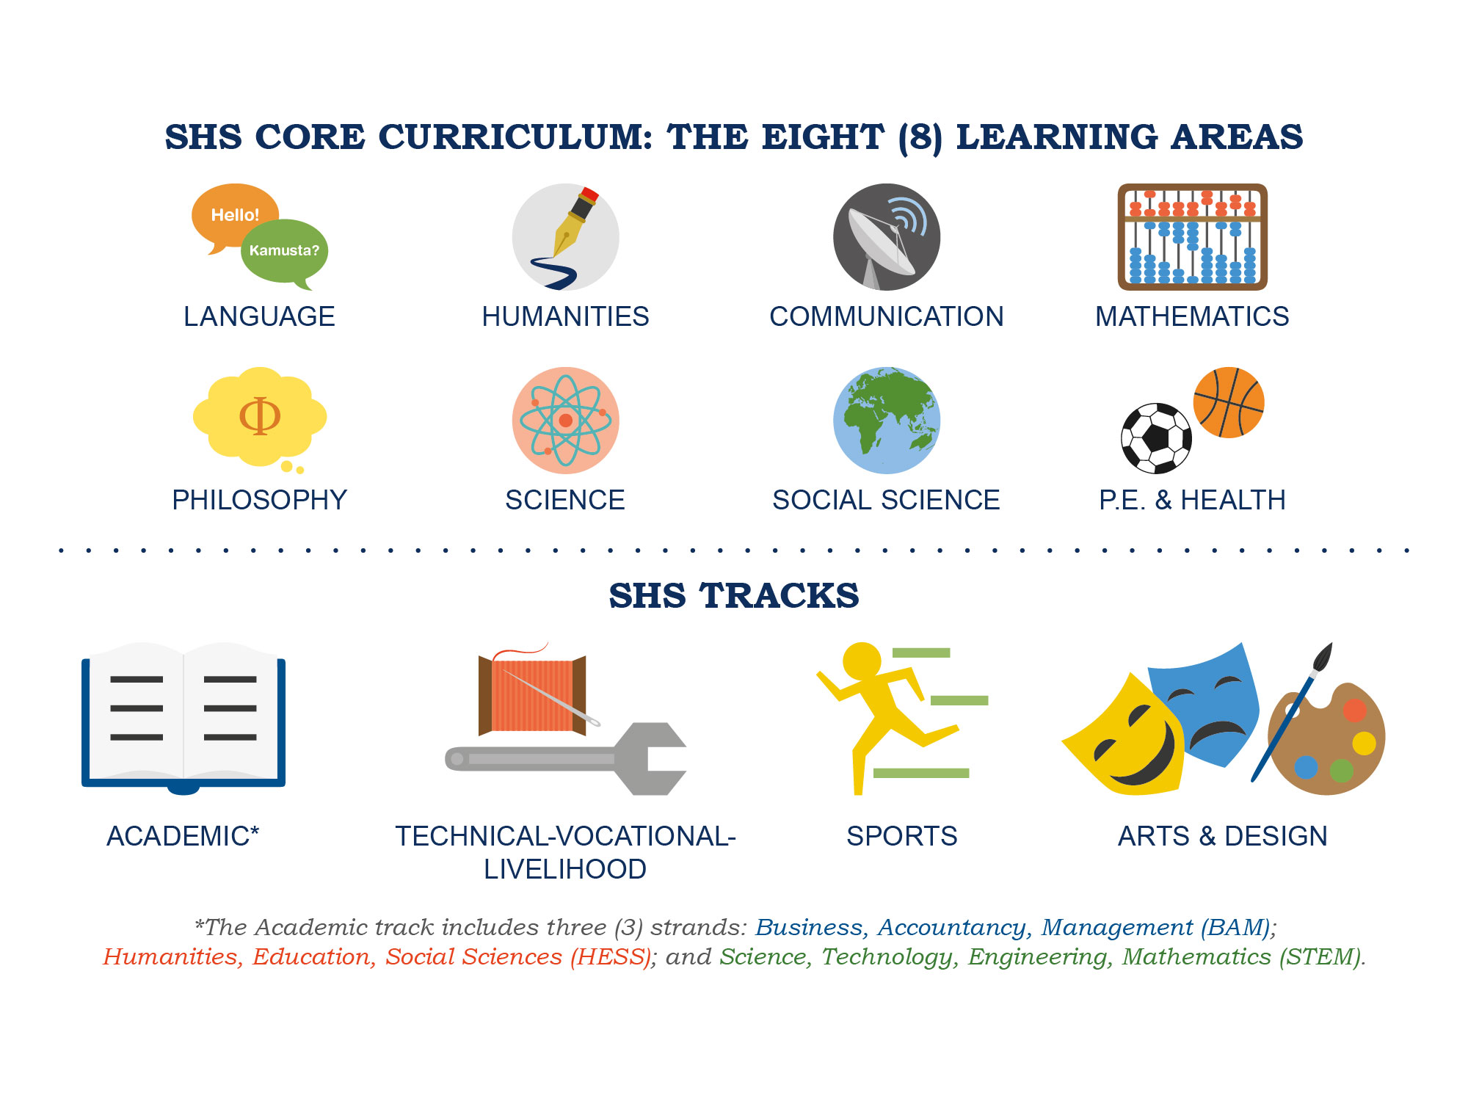
Senior High School Curriculum
*The Academic track includes four (4) strands: Accountancy, Business, Management (ABM); Humanities, Education, Social Sciences (HESS); Liberal Arts; and Science, Technology, Engineering, Mathematics (STEM).

Slide 6
Senior High School Subjects
Core Subjects
Applied
Track Subjects
Specialized Track Subjects
DEPARTMENT OF EDUCATION
Notes:
Core Subjects = same content and competencies for all
Applied Track Subjects = different content, same competencies
Specialized Subjects = different content different competencies based on tracks

Slide 7
Courses
15 CORE subjects -(for all)
  Same content; same competencies
16 TRACK subjects
  7 (CONTEXTUALIZED or APPLIED TRACKS)
    Subjects they can carry around
    Different content; Same competencies
  9 (SPECIALIZATION subjects)
    Different content, different competencies

Slide 8
HUMSS Track

Slide 9
CORE SUBJECTS
Language
  Oral Communication
  Reading and Writing
  Komunikasyon at Pananaliksik sa Wika at Kulturang Pilipino
  Pagbasa at Pagsusuri ng Iba’t-Ibang Teksto Tungo sa Pananaliksik
Humanities
  21st Century Literature from the Phil and the World
  Contemporary Phil Arts from the Region
Communication
  Media and Information Literacy

Slide 10
CORE Subjects
Mathematics
  General Math
  Statistics and Probability
Sciences
  Earth and Life Science
  Physical Science
Social Science
  Personal development
  Understanding Culture, Society and Politics
Philosophy
  Intro to the Philosophy of the Human Person
PE and Health
  PE and Health

Slide 11
CONTEXTUALIZED (APPLIED) TRACK SUBJECTS
( Academic, Voc Tech, Sports, Arts and Design Tracks)
English for Academic and Professional Purposes
Research in Daily Life 1
Research in Daily Life 2
Pagsulat sa Filipino sa Piling Larangan
Empowerment Technologies (E-Tech)-ICT for Professional Tracks
Entrepreneurship
Research Project

Slide 12
SPECIALIZATION SUBJECTS (Humanities and Social Sciences HUMSS STRAND)
Creative Writing
Creative Non Fiction: The Literacy Essay
World Religions and Belief Systems
Trends, Networks and Critical Thinking in the 21st Century
Philippine Politics and Governance
Community Engagement, Social Participation and Citizenship
Discipline and Ideas in the Social Science
Discipline and Ideas in the Applied Social Science
Work Immersion

Slide 13
Trends in Assessment
(HUMSS Track)
H-U-M-S-S
F-I-T- TO- A-C-T

Slide 14
H-armony
U-nderstanding assessment AS learning, FOR learning and OF learning
M-ultiple measures
S-etting Standards
  - ummative Assesment
S-upport system for the 21st C
skills/outcome
-elf Reflection

Slide 15
F-ormative Assessment
I-ndependent Practice
T-eam Assessment

Slide 16
T-rack learner’s
progress
O-bjective

Slide 17
A-uthentic Assessment
C-ommunication
T-argets

Slide 18
H-U-M-S-S

Slide 19
H
H-armony
  Adherence and Consistency with the Content and Performance Standards
  Principle of Constructive Alignment

Slide 22
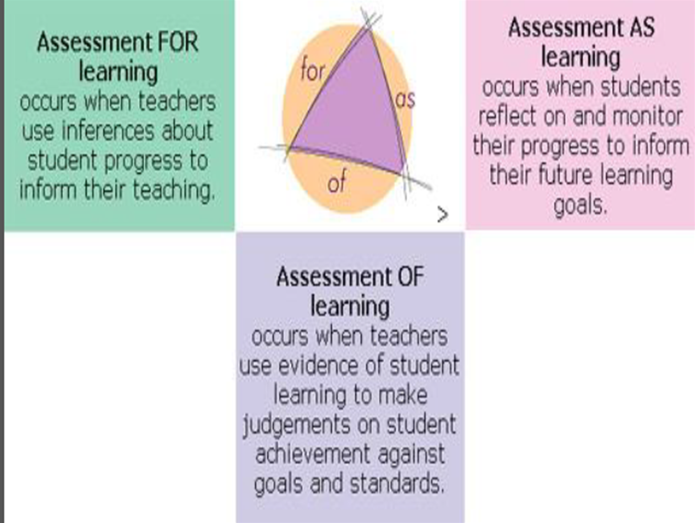
U-nderstanding assessment AS learning, FOR learning and OF learning

Slide 23
M-ultiple measures
  Balance of different assessment methods
  Multiple Ways of assessing learning to measure varying abilities and learnings

Slide 24
Classroom Assessment Strategies
Selected Response
Constructed Response
Performance Assessment
Informal Assessment
Multiple Choice
True or False
Matching Type
Fill-in the blanks
Essay
Short Answer (Sentences, Paragraphs)
Flowchart
Diagram
Graph
Concept Map
Drawing/Illustration
Table
Matrix
Presentation (Group, Individual)
Movement
Science lab/experiment
Math investigation
Dramatization or
Role Play
Simulation/Enactment
Project
Debate
Making models
Recital
Athletic skill
Exhibition
Telling/Retelling stories
Oral Discourse
Oral Questioning
Interview
Observation
Checklist
Rating scale
Journal writing
Process Description
Peer Review
Portfolio

Slide 25
S-etting Standards
  Principle of High Expectations
  Assessment should set a standard aligned with instruction that will challenge the students to aim for higher achievement
  -ummative Assessment

Slide 26
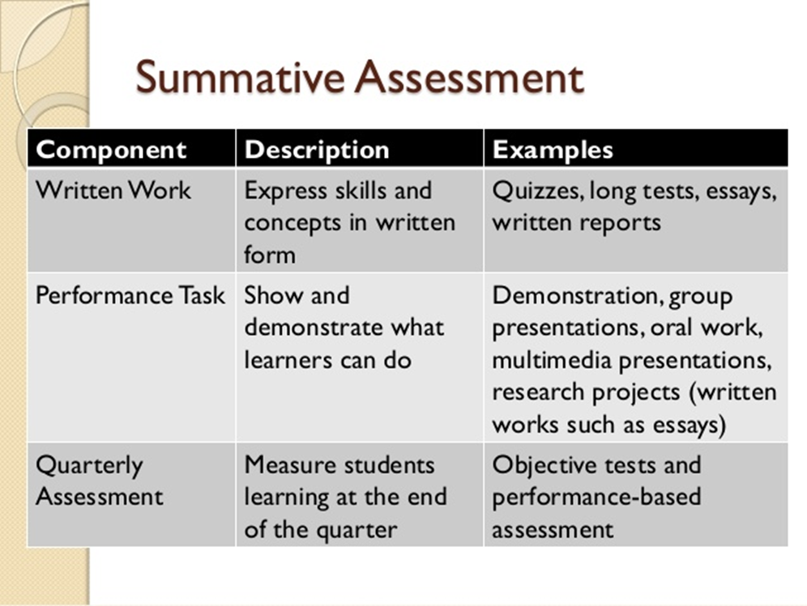

Slide 27
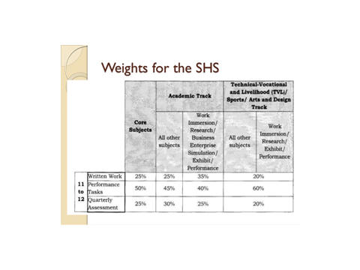

Slide 29
S
S-upport system for the 21st C skills/outcomes
  Integral Part of the Teaching-Learning Process to develop 21st C skills and Higher Order Thinking Skill
  -elf Reflection

Slide 30
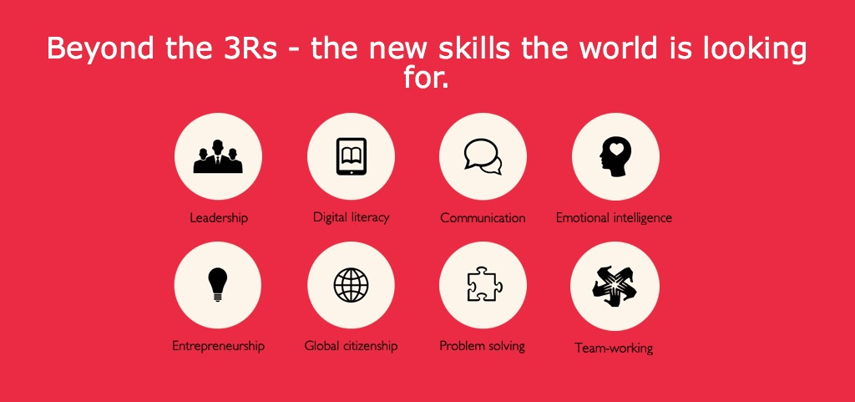
http://thelearningcurve.pearson.com/2014-report-summary/

Slide 31
F-I-T

Slide 32
F-ormative Assessment
I-ndependent /Guided Practice
-individual Assessment
T-eam Assessment

Slide 33
Formative Assessment
P-I-E

Slide 35
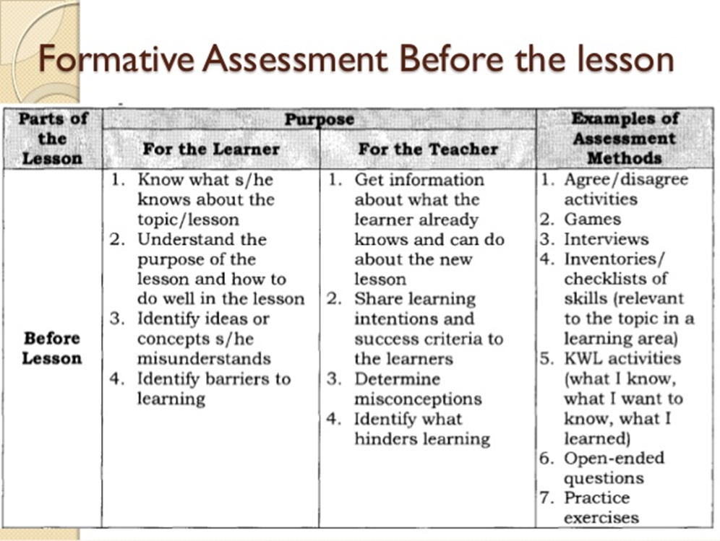

Slide 36
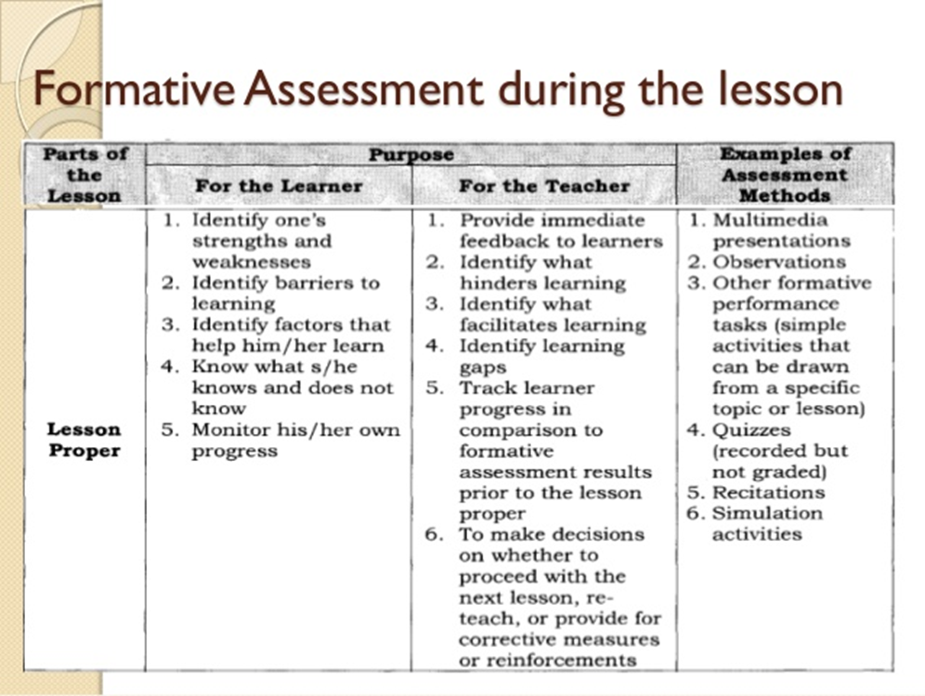

Slide 37
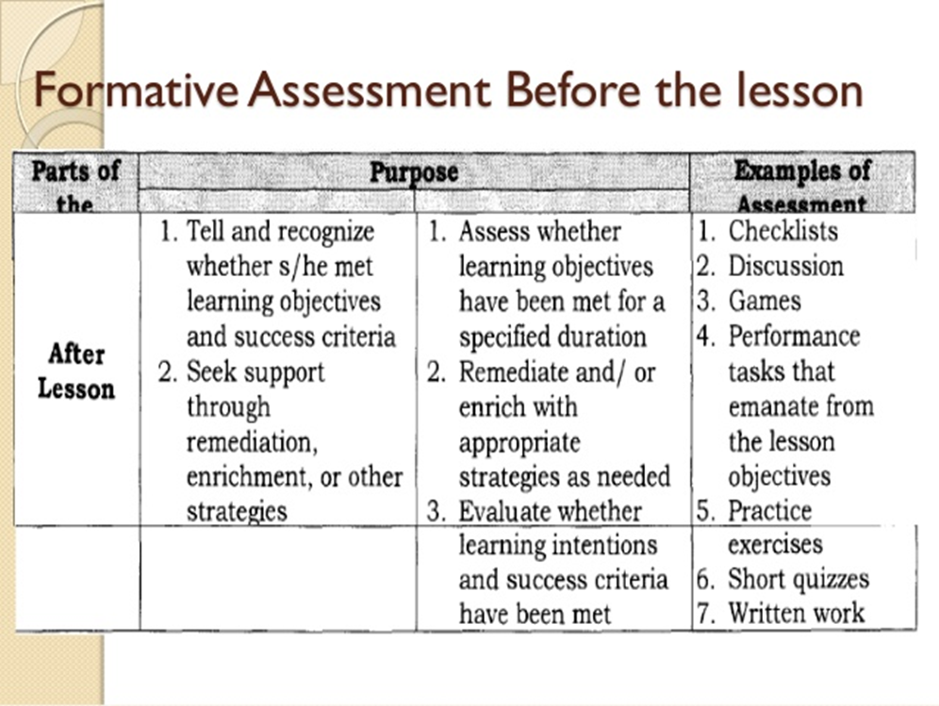

Slide 38
T-O

Slide 39
T-rack learner’s progress
  O-bjective Assessment should be done objectively without biases and prejudices

Slide 40
A-C-T

Slide 41
A-uthenticity
  Assessment should reflect real-life situations
C-ommunication
  Assessment targets, standards, and results should be communicated to learners
T-argets
  Assessment should allow continuous learning until one gets successful in attaining targets of increasing significance

Slide 42
DEpEd Order No.8 s. 2015

Slide 43
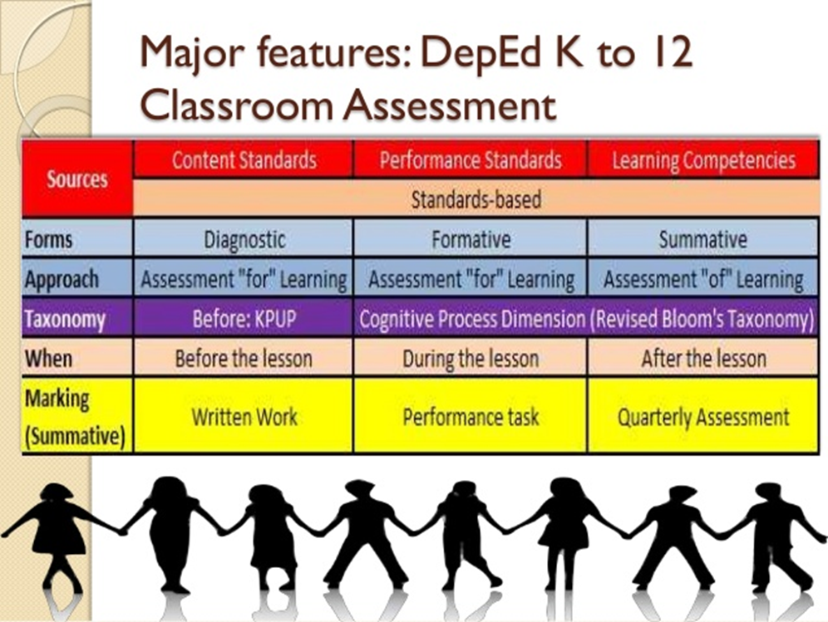

Slide 44
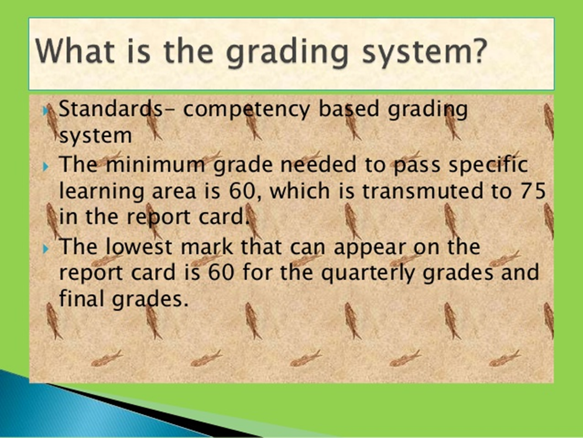

Slide 45
