Slide 1
Innovations and Issues in Assessment in the HEI
Rita B. Ruscoe
Philippine Normal University
Notes:
To change the image on this slide, select the picture and delete it. Then click the Pictures icon in the placeholder to insert your own image.

Slide 2
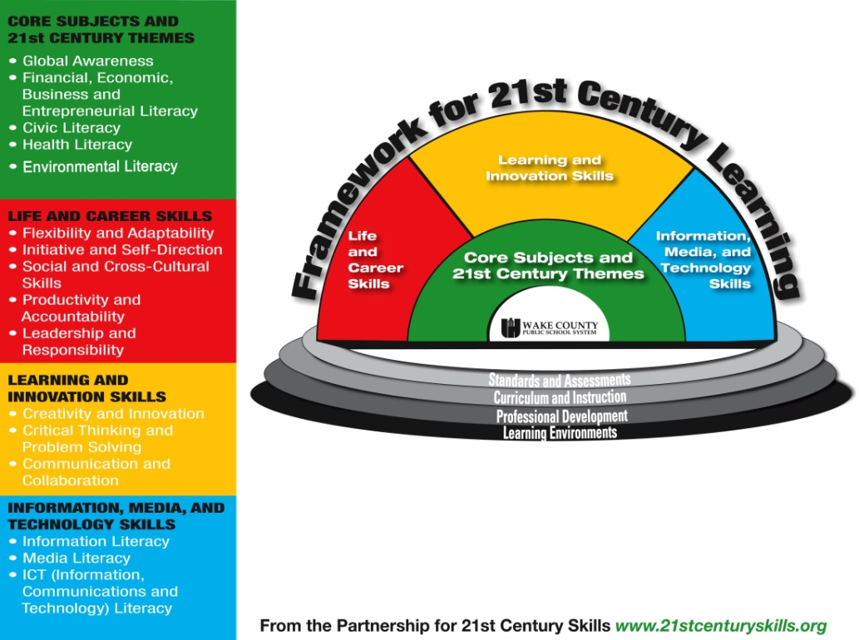
The Changing Landscape of Higher Education
Higher Education Institutions

Slide 3
Mapping the Contours of Innovations in Higher Education
Accountability (National, Institutional, Faculty levels)
Relevance
( National Development Goals, Local Context, HEIs MVG)
Responsiveness ( Partnership of HEIs with Stakeholders)
Quality Assurance (Standards, outcomes)
Efficiency and Effectiveness
(Implementation, Delivery)
ACADEMIC/ CURRICULAR PROGRAMS

Slide 4
CHALLENGES TO CURRICULUM IMPLEMENTATION ( Teacher Education Institutions)
Curriculum
INTENDED
Curriculum
ACTUAL
Curriculum
ACHIEVED
Universities ( TEIs) as gatekeepers of teacher education and implementor of mandated existing programs and curriculum ( CMO 30)
Policies on certification and licensing (RA 7836-Teachers Professionalization Act and RA 9293 as amended)
CHED Memorandum Order (CMO) No. 46, series 2012, entitled “Policy-Standard to Enhance Quality Assurance (QA) in Philippine Higher Education through an Outcomes-Based and Typology-Based QA”

Slide 5
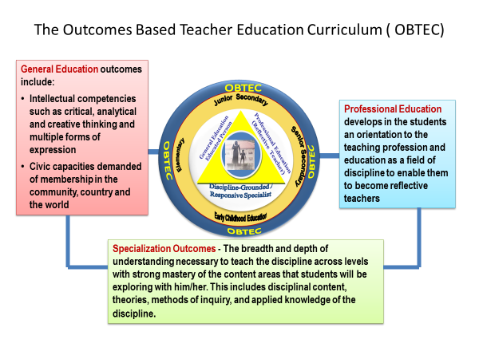
The PNU OBTEC Experience

Slide 6
The Philippine Normal University Institutional Outcomes
PNU is committed to producing:
Innovative Teachers who are:
Excellent in their discipline and at par with the best graduates of Teacher Education in the world
Responsive and deeply rooted in one’s heritage, sensitive to cultural diversity and appreciative of different value systems
Empowered and committed to social transformation
Education Leaders who are competent with knowledge, skills, attitudes, values and ethics to lead and manage high quality education programs
Research Scholars who are proficient in ground breaking cross-disciplinary inquiries
Notes:
Just for a review… ( you may want to ask participants first if they can remember the PNU Institutional outcomes, before you present this slide).

Slide 7
The Outcomes Based Teacher Education Curriculum/ Program is committed to producing teachers who are:
Discipline grounded, professionally competent and innovative practitioner
Reflective Specialist
Humane, Ethical and moral person
Transformative Educator
Critical, creative and responsible educational technology expert.
OBTEC
Junior Secondary
Elementary
Senior Secondary
OBTEC
OBTEC
Discipline-Grounded /
Responsive Specialist
Early Childhood Education
OBTEC
Notes:
Ask Them what the Program outcomes are- What kind of teacher do we need to develop?

Slide 8
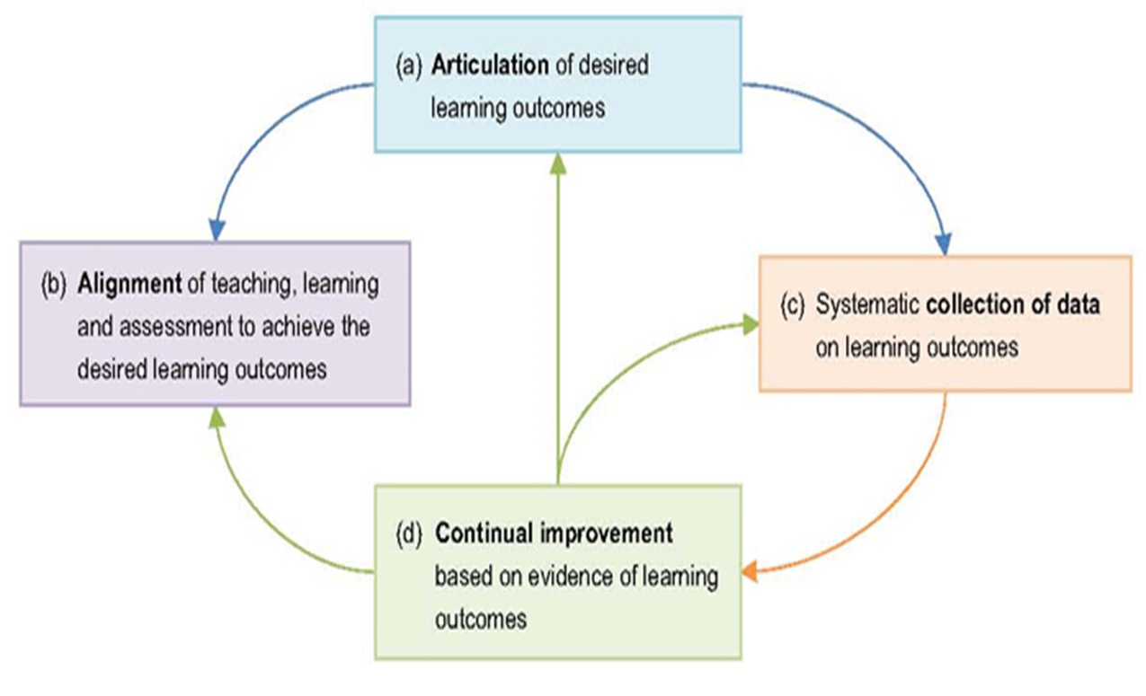
Challenges to Effective Curriculum Implementation

Slide 9
OUTCOMES BASED ASSESSMENT OF ACADEMIC PROGRAMS
How can faculty use what they learn from program assessment to improve their programs ?
What are the outcomes—skills, knowledge, and other attributes—that graduates of the program should attain?
outcomes—skills, knowledge, and other attributes—that graduates of the program should attain?
To what extent is the program enabling its graduates to attain the outcomes?

Slide 10
USING THE PHILIPPINE PROFESSIONAL STANDARDS FOR TEACHERS AS A FRAMEWORK FOR OBTEC ASSESSMENT

Slide 11
How can PNU Outcomes-based Teacher Education Curriculum (OBTEC) be assessed using the Philippine Professional Standards for Teachers?
What tools are needed to assess the alignment between PNU OBTEC and the Philippine Professional Standards for Teachers?
What mechanisms should be put in place to ensure: (i) the success of the assessment process using the Standards; and (ii) the use of assessment results in the enhancement of the PNU OBTEC?

Slide 12
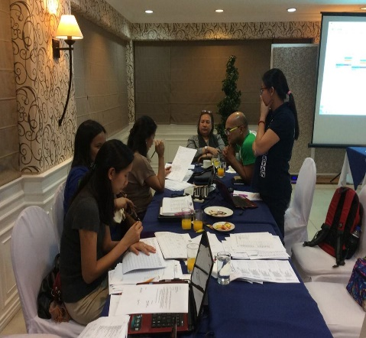
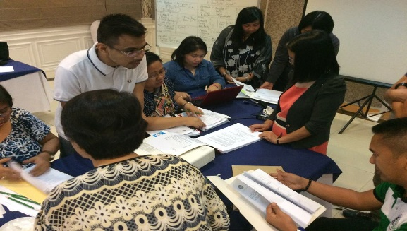
Mechanisms for Quality Audit of Pre-service Teacher Education Curriculum
Development of a Learning Outcomes Assessment Plan ( LOAP)
Begin with the review of the PPST and the OBTEC program outcomes.
Map the standards vis-à-vis the general education, professional education, and specialization courses.
Do the basic and differentiated audit using the heat maps.
Review and refinement of syllabus to check alignment

Slide 13
Checking the alignment of OBTEC outcomes vis-à-vis the Philippine Professional Standards for Teachers
Prof Ed courses | Science | Social Science | Languages
One-way analysis :looking only whether each Prof Ed program outcomes are reflected in the PPST standards and not vice-versa Program outcomes were aligned with the PPST. (This may be expected since the Prof Ed course outcomes is anchored on the NCBTS framework.) | Two-way analysis: checking both the alignment of the outcomes against the PPST standards and the domains in which the outcomes are represented Most of the program outcomes are represented in the PPST standards but there are also specific program outcomes which are not found in the PPST (research component of the program outcomes). | The PPST standards were reflected more in the Values Education program than in the Social Science program. | Checking the alignment of the program outcomes against the PPST standards posted a realization that OBTEC program outcomes seem to be too difficult for a beginning teacher, on the perspective of PPST standards.

Slide 14
Mechanisms for Quality Audit of Pre-service Teacher Education Curriculum
2. Development of tools for assessing attainment of outcomes at the course, specialization, program and institutional levels.
Collecting direct evidence of student learning outcomes
Standardized test for Collegiate Learning Assessment?
Course embedded assessment
Portfolio Assessment
Development and carrying out of institutional surveys for effective assessment of institutional learning outcomes
Systematize and institutionalize learning outcomes assessment methods

Slide 15
Learning Outcomes Assessment
Development of Institutional Learning Outcomes Plan (LOAP)
Development of Strategies for Institutional learning Outcomes Assessment
Development of Program Learning Outcomes Assessment
Development of Specialization Learning Outcomes Assessment
Development of Course Learning Assessment
Institutional Outcomes
Program Objectives
Program Outcomes
General Ed. Outcomes
Specialization. Outcomes
Pofessional Ed. Outcomes
Program Specialization Outcomes
Program Specialization Outcomes
Program Specialization Outcomes
CLO
CLO
CLO
CLO
CLO
CLO
CLO
CLO
CLO
CLO
CLO
CLO
CLO
CLO
CLO

Slide 16
Development of Institutional Learning Outcomes Plan (LOAP)
Objective: strengthen the systematic collection, review and use of outcomes data for Continual Quality Improvement (CQI)
Step 1- Deliberation and Identification of strategies for learning outcomes assessment ( Institutional, Program, Specialization Level)
Step 2 – Presentation and Approval of the LOAP c/0 UCMIMO
Step 3 – Dissemination of LOAP

Slide 17
Development of Strategies for Institutional learning Outcomes Assessment
Collecting direct evidence of student learning outcomes
Standardized test for Collegiate Learning Assessment
Course embedded assessment
Portfolio Assessment
Development and carrying out of institutional surveys for effective assessment of institutional learning outcomes
Systematize and institutionalize learning outcomes assessment methods

Slide 18
3. Development of Program Level Outcomes Assessment
All Faculties, institutes and School need to pilot their LOAP to collect data on the extent to which program and specialization learning outcomes are achieved.
Interim report on LOAP on the implementation and continuous refinement of LOAP shall be made and reported to CTD and VP academics.
An overall review of the complete cycle of OBTEC Piloting should be conducted after each year and after the four year term. Continuous refinement should be done every year.

Slide 19
Development of Program Level Outcomes Assessment
The Faculties/ Institutes/ School develops the Specialization Learning Outcomes Assessment Plan (F-S-LOAP)
Format, content, criteria and procedures of the Plan should be approved by the College , Faculty, School and Institutes
Both CTD-P-LOAP and F-S-LOAP should be presented and approved by the College and VP MANCOM
All Faculties, institutes and School need to pilot their LOAP to collect data on the extent to which program and specialization learning outcomes are achieved.
Interim report on LOAP on the implementation and continuous refinement of LOAP shall be made and reported to CTD and VP academics
An overall review of the complete cycle of OBTEC Piloting should be conducted after each year and after the four year term. Continuous refinement should be done every year.
The College ( CTD) develops the Program Learning Outcomes Assessment Plan ( CTD-P-LOAP)

Slide 20
Development of Course Level Outcomes Assessment
Source: Concept Map Illustrating the main ideas put forward by Biggs on Constructive Alignment, (Houghton, 2004). Repro Centre for Engineering and Design Education. Implementing Outcomes-Based Education in Chemistry and Chemical Engineering. European Chemistry and Chemical Engineering Education Network www.ec2e2n.net

Slide 21
Levels of Achievement for Outcomes/ Competencies
BASIC KNOWLEDGE Recognition and understanding of facts, terms, definitions, descriptions, relationships
APPLICATION OF KNOWLEDGE Use of knowledge in ways that demonstrate understanding of concepts or terms, their proper use, and limitations of their applicability
CRITICAL ANALYSIS Examination and evaluation of information as required to judge its value to a design solution and to make decisions
EXTENSION OF KNOWLEDGE Extending knowledge beyond what was received, creating new knowledge, making inferences, transferring knowledge to usefulness in new areas of application

Slide 22
Increasing Level
 | Basic Knowledge | Application of Knowledge | Critical Analysis | Extension of Knowledge
Lesson Planning
Classroom management
Instructional materials development
Conduct of Research
Understanding content
Theories in the discipline

Slide 23
Enhancing program quality for achieving learning outcomes
Levels of Assessment | Areas of Outcomes Assessment | Strategies for Assessment | Concerned Unit | Assessment Output (Evidence)
Institutional / (PNU) - Program Educational Outcomes | Institutional Outcomes and Program Educational Outcomes | Standardized test for Collegiate Learning Assessment? Course embedded assessment Portfolio Assessment institutional surveys for Systematize and institutionalize learning outcomes assessment methods | VP Academics
Collegiate (CTD) - Program outcomes | Teacher Education Program to include Gen. Ed and Prof. Ed |  | CTD
Faculty / Institute/ School-Specialization Outcomes | Specialization- CK. PK, PCK, TPCK, Practicum |  | Faculty, Institutes, Schools
Individual / Cluster Faculty- Course Learning Outcomes | Specific courses |  | Individual faculty or cluster of Faculty teaching the course

Slide 24
Outcomes | Performance Indicators | Evidence of Achievement | Performance Standards
Manifest awareness of current trends and issues in S & T and their importance to society Actively respond to current socio-cultural issues as affected by science and technology Demonstrate rational understanding of current developments in science and technology and its effects on human activities exhibit values and attributes to arrive at relevant solutions to problems concerning STS | Create a photo essay that tackles one of the following topics: • Biological warfare • Chemical warfare • Nuclear warfare • Biochemical warfare • Bioterrorism 2. Participate in debates on issues of population dynamics 3. Create a portfolio and poster presentation regarding environmental issues tackled in the immersion 4. Start a campaign or advocacy ad that stresses the importance of environmental awarenes | Photo Essay Debate Portfolio/Poster Presentation Campaign/ Advocacy act | Rubric for Photo Essay Presentation: • Content Relevance – 40% • Originality – 30% • Creativity – 20% • Neatness – 10% TOTAL – 100% Rubric for Debate: • Logical Reasoning – 30% • Extent of Research – 20% • Topic Coherence and Relevance – 20% • Ideas and Viewpoints – 20% • Articulation – 10% TOTAL – 100%

Slide 25
Performance Indicator and the Evidence of Performance | Indicator | Evidence | Standard
 | Create a brochure on various ecosystems (aquatic and terrestrial) Critique a paper and defend a position that tackles humans and their interactions with the environment Create a video presentation on the principles of environmental science Create an advocacy or campaign ad that manifests environmental awareness and concern in the university | Brochure Critique paper and oral defense Video presentation output Clean Up Drive | Rubric for Brochure: Content – 40% Creativity – 20% Originality – 20% Presentation – 20% TOTAL – 100% Rubric for Reaction Paper/Critique Content – 40% Organization – 30% Relevance – 30% TOTAL – 100% Rubric for Oral, visual, and other Multimedia Presentation: Content – 30% Originality – 20% Relevance – 20% Presentation – 20% Class Evaluation – 10% TOTAL – 100% Rubric for Advocacy or Campaign Ad Participation – 40% Commitment – 40% Journal Reflection – 20% TOTAL – 100%
Consultation Period | Subject to change and availability

Slide 26
Measurement of Outcomes and Attainment of CQI
Strategies | Purpose
Practicum Training Survey | Gauge students’ performance by the Partner School ; Survey looks into how the partner school rate the student teachers in terms of the fulfilment of attributes that are related to the PO. From these results, attributes in which the students are lacking can be identified and the corrective measures can be devised This information is then used to improve the teaching methods and curriculum content in the next semester
Dialogue with Stakeholders/ Partners | Collaborative work with partners ( research institutes, Dep Ed-TEC, CHED partner schools) in the form of curriculum review and feedback from the stakeholders/partner school; technical visits; lecture forum with resource persons coming from the field; roundtable discussion per year to discuss issues regarding teacher education program Inputs are discussed and implemented at the College/F, I, S level to ensure that the quality of the program is constantly improved.

Slide 27
Strategies | Purpose
Tracer Study/ Alumni Panel | Alumni Panel members are those who have gone through the program and thus have a very clear idea on how effective the program was in training them for their current jobs. The Alumni Panel therefore can directly pinpoint the shortcomings in the program content and advise the college/ FIS on the current needs and demands in the field at the same time. Tracer Studies/ Alumni Panel are the keys in ensuring that the content of the program is up to date and conform to the needs in the field.
Student Self-Survey | At various stages throughout the semester, the students are requested to carry out a self-survey on the level of their understanding of the CO. Results from such surveys can be used to gauge the teachers’ effectiveness on a particular course. In addition, at the end of each course, the students are also asked to rate the lecturers in terms of overall teaching effectiveness such as communication skills, confidence level and appearance. These results form a CQI basis for the delivery skills of the teacher and effectiveness of the course syllabus

Slide 28
Measurement of Outcomes and Attainment of CQI
Strategies | Purpose
Analysis on Student Performance Through Formal Assessments | For this purpose, sample data and results of formal assessments, such as final exam results, test, project, and lab reports, are gathered for all courses. The analysis on these data is carried out to obtain the student performance or achievement for each of the CO and PO. Typical analysis ( by EPRDC?) is then provided to the relevant academic staffs and coordinators, who can use the information to improve on any shortcomings of the attainment. By analyzing the shortcomings (based on the CO attainment values) from one semester and devising appropriate action plans, the teacher can manage to improve the students’ results in the next semester. At the end of every semester, the FIS compiles the PO attainment data for all subjects and analyzes it to obtain the level of PO attainment for the particular semester.
Exit interview question
Faculty survey of students’ abilities
Performance on national licensure examinations

Slide 29
Categories of Assessment Strategies
Assessment Category | Representative Instruments
Written Assessments | Essay / Modified Essay Questions (MEQs) Short Answer Questions Completion Questions Multiple Choice Questions (MCQs) Extended Matching Items (EMIs) Progress Test/ Paper/ Critique Thesis/ Dissertation Project Report/ case Study reports Journals/ reflection paper
Practical/ Performance Based assessments | Practical Examinations Demonstration Teaching/ Micro Teaching Laboratory Experiments Simulations Role Modeling Oral presentations Panel presentation

Slide 30
Categories of Assessment Strategies
Assessment Category | Representative Instruments
Observation | Critic Teacher’s reports/ Demonstration teaching feedback Checklists Rating Scales Field reports Multi media Presentations
Portfolio and Other Products of performance | Portfolio, E- portfolio, Videos, CDs, Journals, Logbooks, Procedural Logs, Projects, Technology based Instructional Materials Simulations for Assessment
Peer and Self Assessments | Peer report Self report

Slide 31
Sources of Data that Provide Relatively Indirect Evidence
Alumni, employer, student surveys
Focus groups with selected students or alumni
Surveys of faculty concerning students’ abilities
Discussions at faculty meetings or retreats
concerning students’ abilities
Senior exit interviews
Percentage of students going to graduate
or professional schools
Enrollment and retention patterns
Job placement statistics
Reviews from accreditation agencies
Reports from external review committees

Slide 32
Innovations in Assessment
Assessment as valuing a range of different skills; students to perform consistently in a number of different skill areas collected over a long period of time. Use of wide range of different assessment strategies assesses a broader range of skills provide a more balanced and reliable assessment.
When averaged, it is more likely to be an accurate assessment of an individual student than a single examination mark arrived at by the teacher. The pressure on the student is more consistent over the duration of the course demanding a more disciplined approach on the part of the student.
Use of self-assessment which allow students to determine own learning goals, make their own decisions about whether these goals have been achieved; need to develop collaboratively individually tailored learning strategies which allow each student to achieve his/her learning potential.

Slide 33
Innovations in Assessment
Assessment viewed as an integral part of the teaching and learning process. Learning rather than assessment should be the end product of higher education. Students should learn through assessment not learn to be assessed. Assessment to be viewed as tools for Learning.
Formative assessment more likely to facilitate effective, well motivated student learning. Providing timely and constructive feedback allows misunderstandings to be detected and cleared up, and students are able to make improvements where necessary.
Use of formative assessment (the frequent, interactive assessment of student understanding and progress to identify learning needs and adapt teaching) as a way to build students’ skills for self-assessment and learning-to-learn, and to raise levels of achievement, particularly for low performing students.
Collaborative assessment a encourages the assessment of learners not just as individuals but also as individuals working in groups, and as groups of individuals.

Slide 34
Innovations in Assessment
Well defined/ designed standards allow for more effective learning; if standards are not well-designed, or if they lack specificity, teachers will have an incentive to teach to the test .
Shared accountability for achievement of established outcomes - responsibility of students to engage with their studies, the responsibilities of principals to provide curriculum leadership and of teachers to examine the basis for their teaching approaches.

