Slide 1
Aligning the ppst to deped’s hr systems

Slide 2

Alignment with DepEd’s Vision
Long-Term Vision
We dream of Filipinos who passionately love their country and whose values and competencies enable them to realize their full potential and contribute meaningfully to building the nation.
As a learner-centered public institution, the Department of Education continuously improves itself to better serve its stakeholders.
Long-Term Vision
We dream of Filipinos who passionately love their country and whose values and competencies enable them to realize their full potential and contribute meaningfully to building the nation.
As a learner-centered public institution, the Department of Education continuously improves itself to better serve its stakeholders.
Team Vision
By 2022, we will have nation-loving and competent lifelong learners able to respond to challenges and opportunities through the delivery of quality, accessible, relevant and liberating K to 12 Program by a modern, professional, pro-active, nimble, trusted and nurturing DepEd.

Slide 3
Sec. Briones’ 10 Point Agenda:
Agenda Item #4
“…undertake Capacity Building to be responsive to the aspirations and most urgent needs of the nation.”
Notes:
What we want is to ensure that teachers live out the standards. We want to ensure that every teacher knows and lives up to the standards.

Slide 4







Scope of DepEd’s Scale
26,941,656 learners
in public and private schools for SY 2017-2018 and ALS
67,421
public and private schools
800,000++
DepEd Employees
47,645 or 70 %
Public schools supervised
88 %
Teaching personnel
19,776 or 30 %
Private schools regulated
12 %
Non-teaching personnel
221 Schools Division Offices
1 Central Office
17 Regional Offices
Notes:
Learners – 26,941,656
Public – 22,096,820
Private – 4,065,515
ALS – 629,707

Slide 5
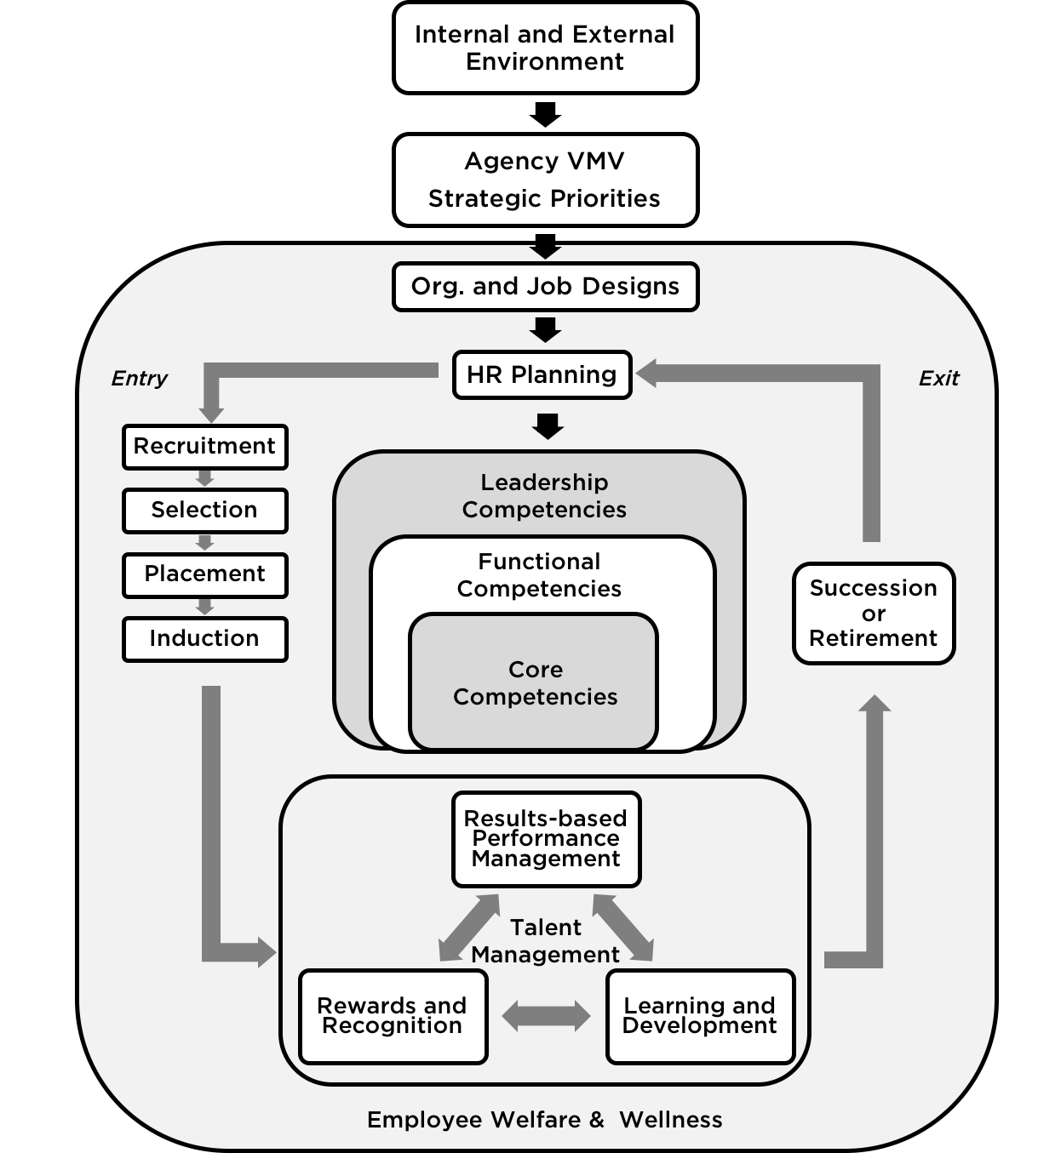
Bureau of
Human
Resource and Organizational Development
“
Taking care of people while maximizing organizational performance and health
“
Notes:
HR continuum tracks our teachers from their entry into the profession through the RSPI system, to how they work while within the department, through performance management, providing learning and development interventions, and providing rewards and recognition. It also looks into their personnel movements, through promotions, or transfers, and up until their retirement.

Slide 6

Long-Term Vision, Mission, and Values
Sec. Briones’ Team Vision and Priorities
Effective Organizational Units and Offices
Effective Employees
Quality Performance
Organizational Culture
Core Competencies
Governance
Functional Competencies
Structure, Systems, and Processes
Organizational
Excellence and Success
Leadership Competencies
Resource Management – Human Resources

Slide 7


The PPST set the standards for teacher practice.
It will change the face of Philippine Education.
Teacher: “How does this affect me?”
Notes:
DepEd adopts the PPST because it will standardize performance measures for teachers. Its an overarching framework for teacher quality, but the question will be how the standards will be operationalized, and how will it affect the grassroots?

Slide 8
We want our teachers to embrace wholeheartedly, and live out the Philippine Professional Standards for Teachers.
Notes:
What we want is to ensure that teachers live out the standards. We want to ensure that every teacher knows and lives up to the standards.

Slide 9
By ensuring that the PPST is imbedded into all HR Systems.
This is to ensure that the standards become part of our Teachers’ everyday lives.
Thus, the integration must be simple, seamless, uniform, and universal.
Notes:
In order to do that, the standards have to exist in all aspects of teacher life, including the HR continuum. Thus, to ensure that teachers embrace the standards, they have to be integrated in a way that is simple, seamless, uniform, and universal.

Slide 10
Integrating the PPST is integrating PPST aligned processes and tools into the HR Systems
Notes:
The way to integrate the standards into the systems is by ensuring that the operational mechanisms, specifically the tools used in the systems, are aligned to the PPST.

Slide 11
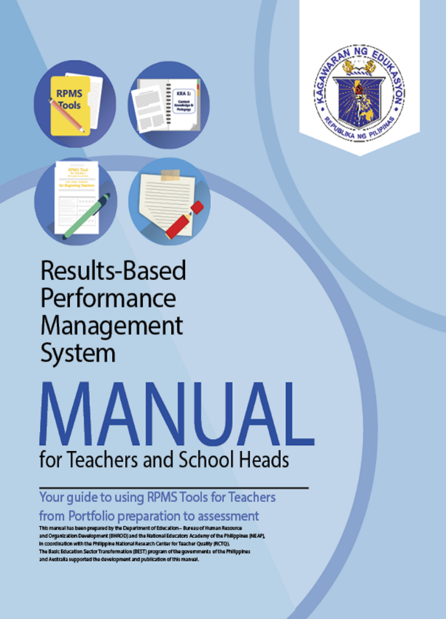

Notes:
There are three documents which enshrine the PPST, and which contain the PPST aligned tools which will be aligned to the HR systems.

Slide 12
PPST Tools
IPCRF
Portfolio
Assessment
Self-Assessment Tool
Classroom Observation
Features of Practice
Notes:
These are some of the tools of the PPST. These were integrated into the core HR Systems of DepEd.

Slide 13
PPST Tools
Describes the duties and responsibilities of teachers across career stages
Details the Key Result Areas (KRAs) for the realization of those duties and the specific objectives to attain the KRAs
Details the Means of Verification (MOVs) that serve as proof of the attainment of specific objectives
IPCRF
Portfolio
Assessment
Self-Assessment Tool
Classroom Observation
Features of Practice

Slide 14
PPST Tools
Gives numerical values (1-5 with 5 being the highest) to behavioral indicators, and submitted documents which corresponds to specific performance standards.
IPCRF
Portfolio
Assessment
Self-Assessment Tool
Classroom Observation
Features of Practice

Slide 15
PPST Tools
The Portfolio Assessment which forms part of the Means of Verification (MOVs) in the IPCRF detail the appropriate types and quality of documents necessary to show they have met the indicator.
The Portfolio assessment process involves teacher self-assessment and rater’s assessment of the Portfolio.
The Portfolio post-assessment focuses on the conduct of a teacher and rater conference on the results of the portfolio assessment process.
IPCRF
Portfolio
Assessment
Self-Assessment Tool
Classroom Observation
Features of Practice

Slide 16
PPST Tools
Document review which looks at key themes and documented displayed behaviors, and links them to specific performance standards.
IPCRF
Portfolio
Assessment
Self-Assessment Tool
Classroom Observation
Features of Practice

Slide 17
PPST Tools
The Self-assessment tool allows teachers to reflect on, and assess their own performance.
Its results will guide teachers and their raters on which indicators to improve on, and areas for coaching and mentoring.
IPCRF
Portfolio
Assessment
Self-Assessment Tool
Classroom Observation
Features of Practice

Slide 18
PPST Tools
Gives numerical values (1-5 with 5 being the highest) to self-perceived display of behavioral indicators of increasing complexity, which corresponds to performance standards.
IPCRF
Portfolio
Assessment
Self-Assessment Tool
Classroom Observation
Features of Practice

Slide 19
PPST Tools
The Classroom Observation Tool includes a rubrics which shows a continuum of level of performance for each career stage.
The form is meant to serve, through a scoring tool, to assess specific indicators as shown during teaching practice in a classroom setting.
IPCRF
Portfolio
Assessment
Self-Assessment Tool
Classroom Observation
Features of Practice

Slide 20
PPST Tools
Gives numerical values (1-5 with 5 being the highest) to display of behavioral indicators of classroom practices. The indicators are of increasing complexity, which corresponds to performance standards.
IPCRF
Portfolio
Assessment
Self-Assessment Tool
Classroom Observation
Features of Practice

Slide 21
PPST Tools
Sample illustrations of specific teaching practices that show how the Standards are put into action.
Shows types of expression of Knowledge, Skills, Attitudes, and Key Behaviors that are elaborative of the standards.
IPCRF
Portfolio
Assessment
Self-Assessment Tool
Classroom Observation
Features of Practice

Slide 22
PPST Tools
Lists in greater detail the behavioral practices which display specific performance standards. This will be used as a reference to the assessment tools earlier discussed.
IPCRF
Portfolio
Assessment
Self-Assessment Tool
Classroom Observation
Features of Practice

Slide 23
Standards on their own are abstract, and difficult to assimilate, if not integrated into the HR Systems.
Notes:
The way to integrate the standards into the systems is by ensuring that the operational mechanisms, specifically the tools used in the systems, are aligned to the PPST.

Slide 24
By integrating them into the HR systems, they are lived out in everyday practice.
Notes:
The way to integrate the standards into the systems is by ensuring that the operational mechanisms, specifically the tools used in the systems, are aligned to the PPST.

Slide 25
PPST & its Tools are integrated in the Teaching Lifecycle & Core HR Systems
Entry to the Profession
Performance Management
Career Progression
L&D
R&R
IPCRF
IPCRF
IPCRF
IPCRF
Portfolio Assessment
Portfolio
Assessment
Portfolio
Assessment
Portfolio Assessment
Self-Assessment Tool
Self-Assessment Tool
Self-Assessment Tool
Self-Assessment Tool
Classroom Observation
Classroom Observation
Classroom Observation
Classroom Observation
Classroom Observation
Features of Practice
Features of Practice
Features of Practice
Features of Practice
Features of Practice
Recruitment Selection Placement
Performance Management
Recruitment Selection Placement
Learning and Development
Rewards and Recognition
Notes:
Per each aspect of the HR continuum, as integrated into the core HR systems, most of not all of the tools are used. This way, the standards are integrated in a uniform way.

Slide 26
Recruitment Selection Placement and Induction
Merit Selection Plan
Merit
Fitness
Competence
Equal Opportunity
Transparency
Accountability
*The RSPI system is anchored on these Key Principles
*PPST
Notes:
The Merit Selection Plan (or the MSP) is currently being revised to reflect the principles of Merit, Fitness, Competence, Equal Opportunity, Transparency, and Accountability. The MSP applies not only to recruitment of teachers, but also their promotions. It safeguards the recruitment and selection process in the Department and ensures that the right people are hired and promoted for the right job at the right time. The PPST is found under the competence principle.

Slide 27
Recruitment Selection and Placement
PPST is used as the basis for all Human Resource Actions for Teachers.
The Assessments used will be based on the Demonstration Teaching/Classroom Observation Tool.
Performance Data for promotions will be based on the PPST aligned IPCRF.
PPST Aligned Portfolio Assessment will be used to ensure teachers meet even non classroom observable indicators.
IPCRF
Portfolio
Self-Assessment Tool
Classroom Observation
Features of Practice

Slide 28
Proposed Hiring, Promotion, and Reclassification Guidelines
30%
Education
Training
Experience
70%
Evaluative Assessments
Based on Rubrics
30%
Performance
(IPCRF)
25%
Classroom Observable Strands
(Classroom Observation Tool &
Self-assessment Tool)
15%
Non classroom Observable strands
(Portfolio Assessment &
Self-assessment Tool)
*assessments are based on the PPST
Notes:
The proposed hiring, promotion, and reclassification guidelines provide 70% for PPST based assessment. It uses the Classroom Observation Tool, Self-Assessment Tool, and the IPCRF.

Slide 29
Means of Promotion
Single Line Career Path Proposal:
PPST as the basis for Reclassification.
Reclassification as sole basis of promotion.
Full PPST assessment to move to a higher career stage
Beginning
Highly Proficient
Proficient
Distinguished
Full PPST assessment to move to a higher career stage
Within career stages: Reclassification and assessments through performance
Master Teacher I
Master Teacher V
Teacher VII
Master Teacher IV
Teacher VI
Master Teacher II
Teacher V
Master Teacher III
Teacher II
Teacher IV
Teacher I
Teacher III
Full PPST assessment to move to a higher career stage

Slide 30
Results-based Performance Management
VISION, MISSION, VALUES
(VMV)
WHAT
HOW
Strategic Priorities
Values
CENTRAL
REGIONAL
DIVISION
SCHOOLS
Competencies
Department/ Functional Area Goals
Core
Leadership
KRAs and Objectives
PPST
RPMS MANUAL FOR TEACHERS
DEPED RPMS FRAMEWORK
*The framework aligns efforts to enable DepEd to actualize its strategic goals and vision.
Notes:
The RPMS focuses on the alignment of the agency’s thrust with the day-to-day operation of the units and individual personnel. For Teachers, the PPST shall be used as the standard for their performance.

Slide 31
Performance Management
Performance Standards are laid out in the PPST.
These standards are translated into standardized Individual Performance Commitment and Review Forms per Career Stage.
This ensures equality in implementation of Performance Standards.
The standards ensure that teachers are measured on how they affect the teaching-learning process, and nothing else.
IPCRF
Portfolio
Self-Assessment Tool
Classroom Observation
Features of Practice

Slide 32
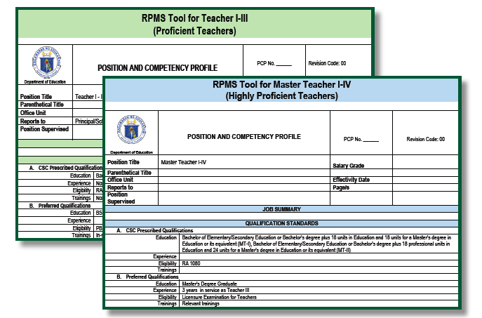
The RPMS Tool is standard for each career stage.

Slide 33
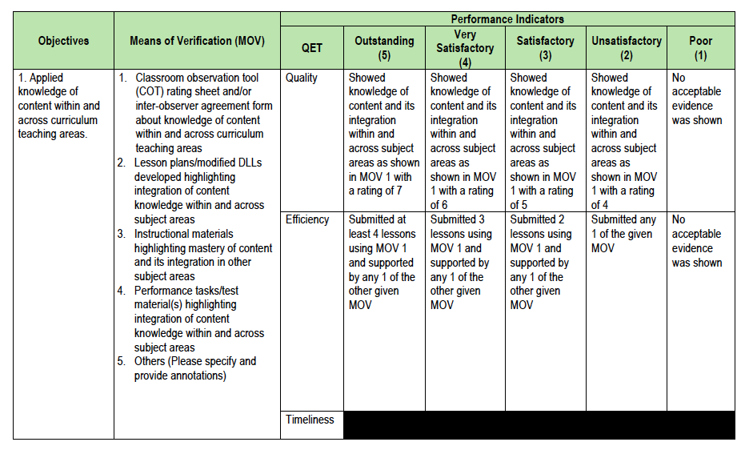
Classroom Observation Tool
The RPMS Tool is standardized
based on the PPST indicators.
Portfolio Assessment
Notes:
The IPCRF uses the classroom observation tool, and the portfolio assessment. Since the IPCRF is standardized across career stages, throughout the department, this will ensure that the measures of the PPST are applied uniformly for all teachers in DepEd.

Slide 34
Learning and Development
L&D Cycle
LEARNING NEEDS ANALYSIS
INTERVENTION DESIGN & DEVELOPMENT
MONITORING & EVALUATION
INTERVENTION DELIVERY
Results-based Performance Management System
PPST
Notes:
At the center of the Learning and Development system for teachers, is the PPST. This shall be the basis of their professional career development interventions.

Slide 35
L&D
IPCRF
L&D interventions are aligned with the Domains and Strands of the PPST.
L&D interventions are based on a Learning Needs Assessment which is based on the IPCRF-Development Plan generated from the Self Assessment Tool, and Classroom Observation Tool, found in the IPCRF.
Interventions are based on the PPST so the aspect of teacher practice that has to be improved/provided interventions for is pinpointed and well defined.
This ensures that individuals’ learning needs, and interventions provided to them are based on the same standards and fit with each other.
Classroom Observation
Features of Practice
Self-Assessment Tool

Slide 36
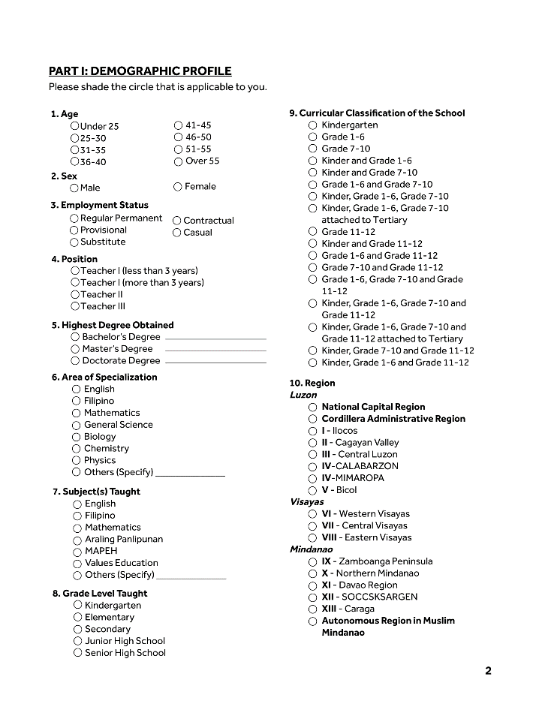
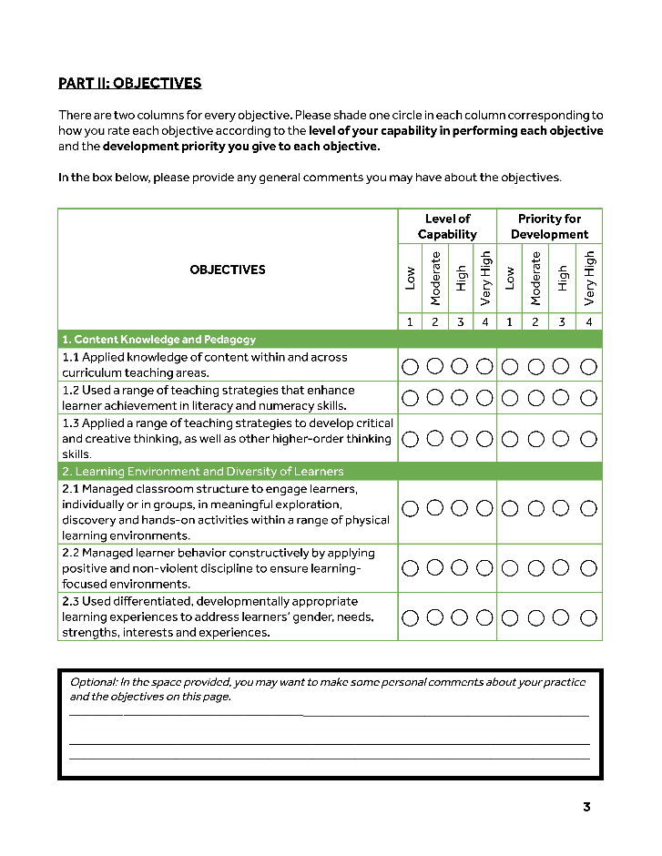

The IPCRF once rated, details which indicators were met, and which were not.
These can inform the teacher and the rater as to the strengths and weaknesses of the teacher with regards to the PPST strands.
The teacher will then accomplish a Self-assessment Tool.

Slide 37
The teacher prepares a Development Plan based on the results of the Self Assessment Tool
The teacher can reflect in the plan as development needs the objectives that rated “Low” in terms of level of capability, or “High” or “Very High” in terms of priority for development.

Slide 38
The teacher discusses the Development Plan with the Principal.
The teacher and the Principal come to an agreement about the final Development Plan.

Slide 39
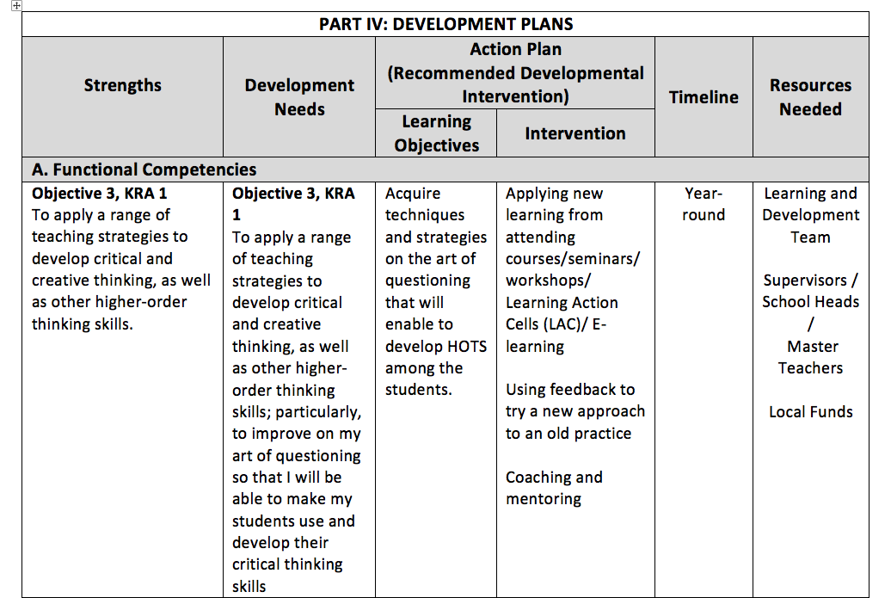
The IPCRF-DP should also be based on the IPCRF, so the language of the PPST is uniform throughout.

Slide 40
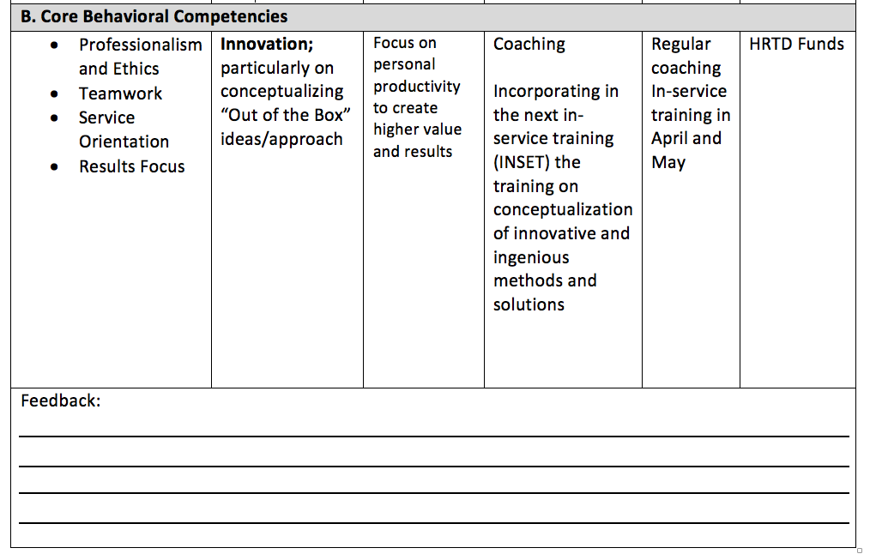

Slide 41
R&R
IPCRF
R&R mechanisms will be aligned with the Domains and Strands of the PPST.
R&R mechanisms will be based on the IPCRF or Key Behaviors set in the PPST.
This ensures that R&R mechanisms are supportive of meeting the standards.
This also ensures fairness in the evaluation of teachers for Rewards and Recognition.
Portfolio
Self-Assessment Tool
Classroom Observation
Features of Practice

Slide 42


