Slide 1
Measurement and Evaluation in Education: Future Directions
Maria Angeles Guanzon Lapeña, MA, RPsy, RPm
Global Resources for Assessment,
Curriculum, and Evaluation Inc. (GRACE)
Notes:
Good morning.
I will point out trends observed in my practice as Chief Technical Adviser of GRACE, an educational assessment firm that has experience in collaborating with other Asian countries’ educational assessment initiatives. These trends that I have observed point to directions we could be taking in the future.

Slide 2

Notes:
Actually, the future we speak of is already at our doorsteps. And educational institutions like DLSU are taking the bull by its horns trying to keep abreast with the impending future.
Look what I saw yesterday, popping up in my Facebook newsfeed: a new course to be offered in the coming academic year 2019-2020.
With a BS in Interactive Entertainment, major in Game Development, a college graduate could embark on a career as programmer (computer, gameplay, tools, artificial intelligence, mobile applications) or as game sound engineer

Slide 3
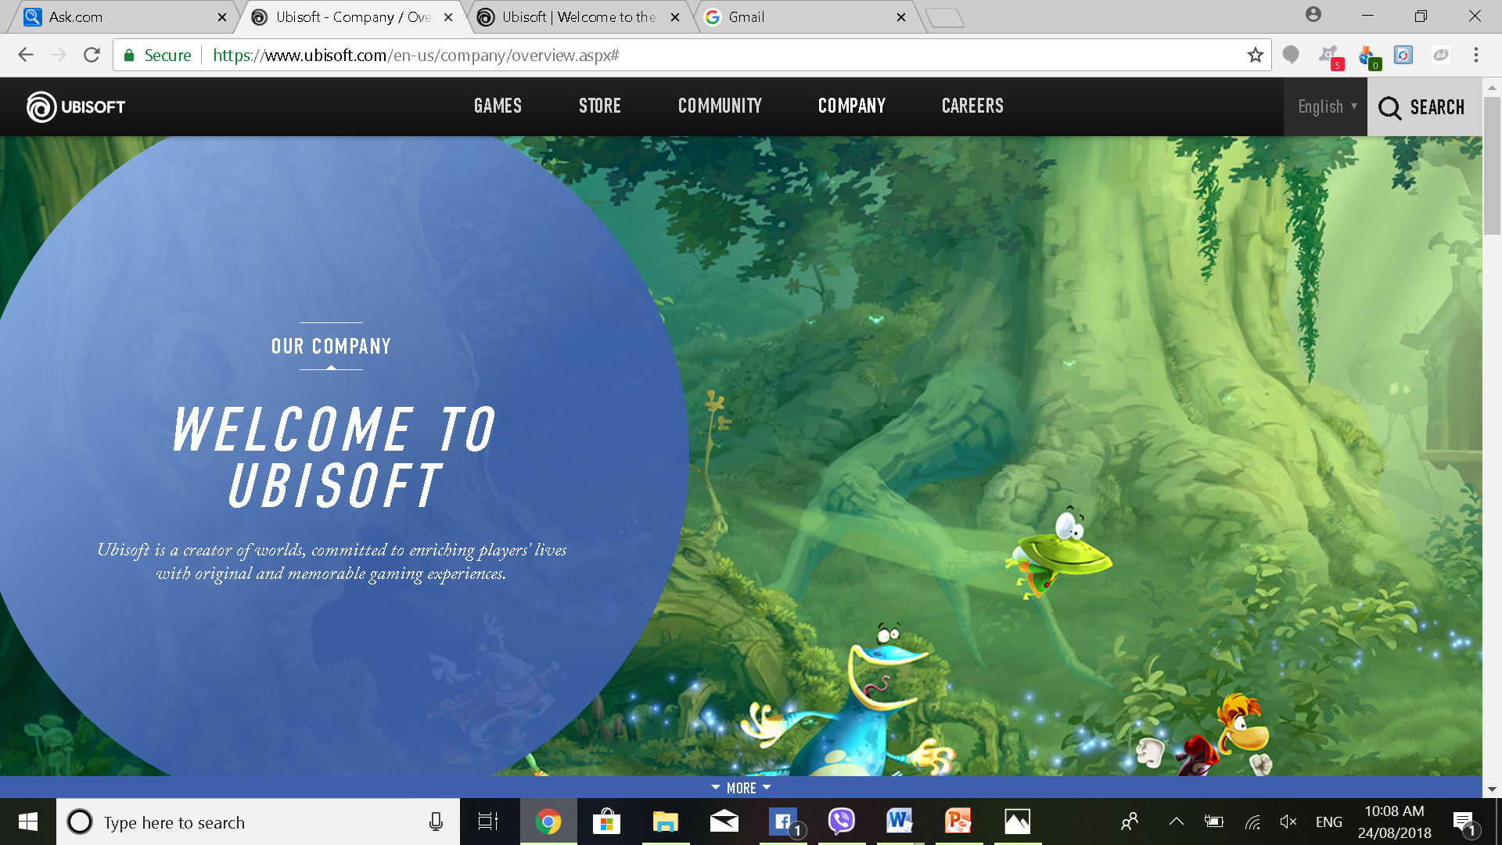
Notes:
There are 3 main job families of Ubisoft jobs: a) Programming (located in France), b) information and knowledge management (located in Canada and Romania), and of course, 3) information systems (located in Romania).

Slide 4
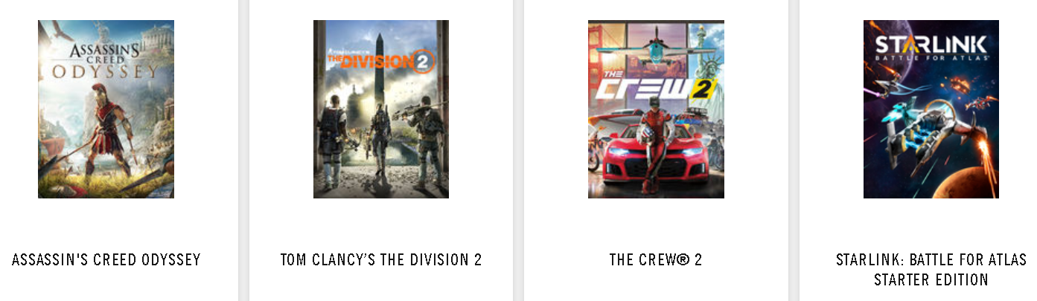

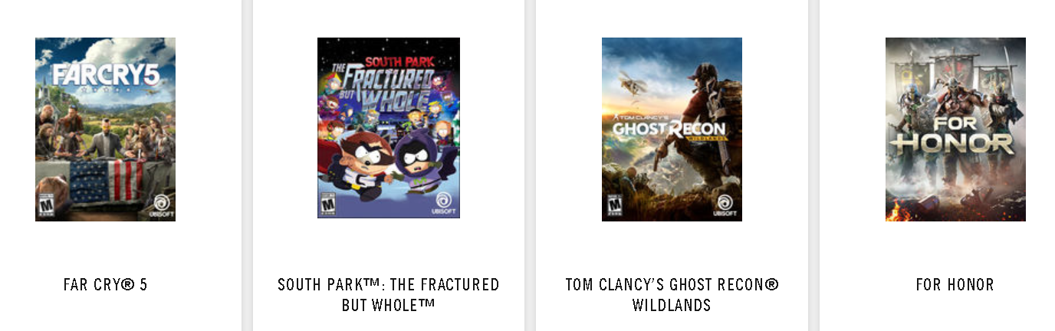
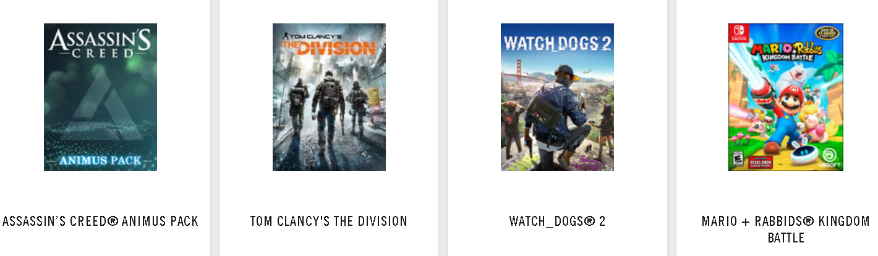
Notes:
Watch Dogs, Splitter Cell Splash List, and Assassin’s Creed are among their popular brands (some of you might know these video games).

Slide 5
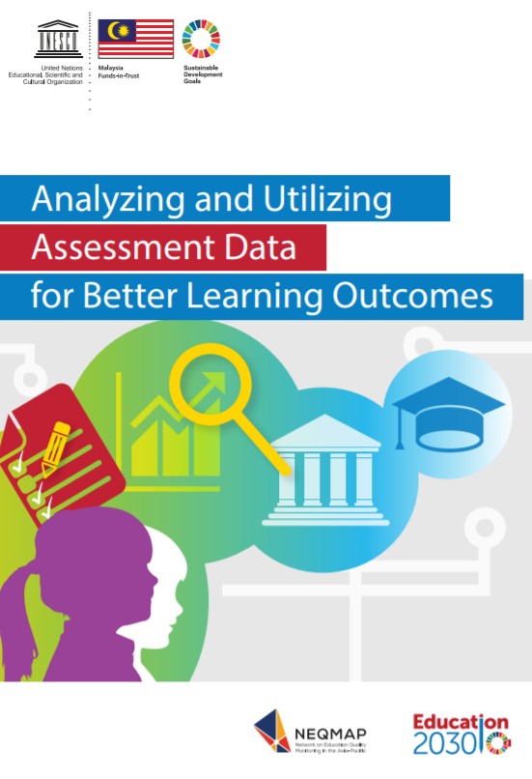
Notes:
UNESCO’s NEQMAP has been conducting workshops for its member associations, seeing the handwriting on the wall, so to speak. NEQMAP’s members have been meeting regularly in response to felt capacity building needs among them. Recent capacity building initiatives have been along the lines of big data management and contextual data analysis.

Slide 6
CONTEXTUAL DATA ANALYSIS FRAMEWORK
Bronfenbrenner’s Ecological Systems Theory:
The development of an individual is influenced by the entire ecological system where he or she grows.
Notes:
Applying the contextual data analysis framework to my task on hand (that is, to fearlessly forecast what educational assessment’s future directions might be), let me refer you to Urie Bronfenbrenner’s ecological systems theory; he says that the development of an individual is influenced by the entire ecological system where he or she grows.
Paraphrasing him, the educational development of a learner is influence by the ecological system where the learner grows.
A change in one subsystem has the potential to change the other subsystems.

Slide 7


CHRONOSYSTEM
MACROSYSTEM
Laws
EXOSYSTEM
Technology
MESOSYSTEM
Culture & Customs
MICROSYSTEM
Values
Student
Teachers
Peers
Counselors
Community
Family
Private Sector
Relatives
Religion
School
Schoolmates
Economic State
Public Sector
Belief Systems
Lifestyles
SOCIAL NORMS
Notes:
Here is a diagrammatic representation of Bronfenbrenner’s Ecological Systems Theory
The entire ecological system where a learner grows consists of 5 subsystems.
Microsystem (Individual)
Mesosystem (Interpersonal)
Exosystem (Community/Institutional)
Macrosystem (Structural)
Chronosystem

Slide 8
Structural
Community/Institutional
Interpersonal
parents
teachers
social
settings
siblings
Individual
The Student
classmates
policies
political
friends
neighbors
economic
Notes:
Many of the students we had FGDs with claim that testing “serves as an assessment of teachers teaching styles and approaches used;” “it is also a reflection of how teachers teach the students.” Parents shared the same sentiment in the FGDs we conducted with them; they view test results as reflective not just of their child’s performance but as a barometer of teaching effectiveness. This typical association between the effectiveness of the teachers and the learning of their children based on the test results or scores in examinations exacerbates the practice of “teaching-to-the-test” phenomenon. Teachers are left with no choice but to frame their teaching in accordance with the topics covered in the examinations especially if it involves high-stakes assessments. “Teaching-to-the-test” phenomenon, is not new in the discourse of assessment, but how it is experienced and articulated in various contexts reveals a lot about how it happens on the ground (Klinger, et al., 2007).

Slide 9
Individual
Identifies biological and personal history factors that increase the likelihood of becoming a learner.
Some of these factors are age, education, income, or learner history.
Physical and mental health, needs of the student, disability, sex of the child (versus gender which is a social construct).
Notes:
The microsystem comes into play in assessing an individual student’s learning:
Identifies biological and personal history factors that increase the likelihood of the student becoming a serious learner.
Some of these factors are age, education, income, or learner history.
Physical and mental health form part of the individual student’s context, to include health needs of the student, disability, and sex of the child (versus gender which is a social construct).

Slide 10
Interpersonal
Examines close relationships that may enhance a culture of educational assessment that is of good quality.
A person's closest social circle (peers, partners, and family members) influences their behavior and contributes to their range of experience.
Parent/child, teacher/student, peer-to-peer, siblings, neighbors
Notes:
The mesosystem of the interpersonal context of the learner is the next system overlay. Here,
Close relationships that may enhance a culture of quality educational assessment need to be studied.
A person's closest social circle (peers, partners, and family members) influences learners’ behaviors and contributes to their range of experience.
Close relationships are those that exist between parent and child, teacher and student, peer-to-peer, siblings, and neighbors.

Slide 11

Four Questions to Answer when
Communicating with Parents
How did my child do?
What types of skills or knowledge does his or her performance reflect?
How did my child perform in comparison to other students in the school, district, province, and if available, the nation?
What can I do to help my child improve?
National Education Goals Panel (1998)
Notes:
Consider for instance, the parent-child relationship.
When a parent goes for consultation with a teacher regarding his or her child’s marks or grades, there are 4 questions that are typically in the parent’s mind.
How did my child do?
What types of skills or knowledge does his or her performance reflect?
How did my child perform in comparison to other students in the school, in the division, in the province, and if available, in the whole country?
What can I do to help my child improve?
The third question shows us that parents see assessment as normative. But educational assessment, when aligned to policies promulgated by the Department of Education (DepEd) and the Commission on Higher Education (CHED), must be criterion-based.

Slide 12
Department of Education
Order No. 8 s. 2015
Notes:
The exosystem referred to in Bronfenbrenner’s ecosystem overlays would include the influence and impact of policies promulgated by government institutions like the Department of Education (DepEd) and the Commission on Higher Education (CHED).
Learning competencies that are stipulated for students at each of the grade levels for each of the subjects taught (English, Mathematics, Science, Filipino, and Araling Panlipunan, for instance) must be achieved by the end of the school year. It is not about whether the performance of a student is above or below the average level achieved by his or her classmates that matters, but whether the student does or does not proficiently demonstrate a targeted competency.

Slide 13
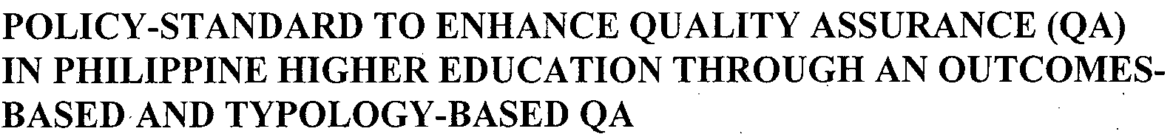
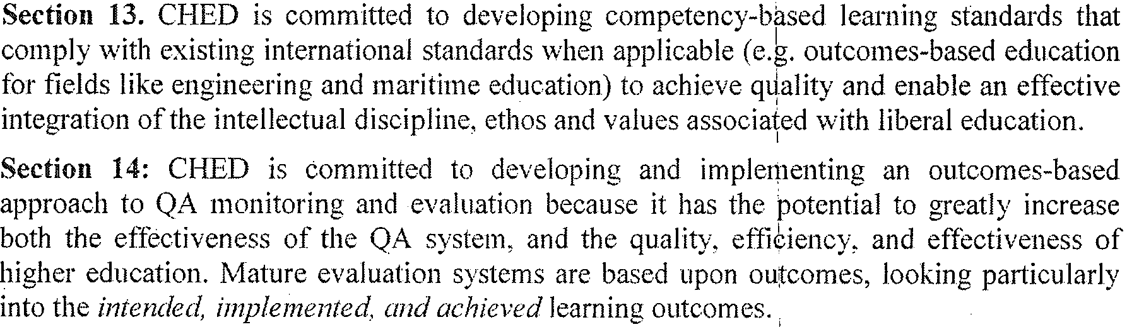
Commission on Higher Education
CMO No. 46 s. 2012
Notes:
Read the slide

Slide 14
Intentional and Integrated
Student-Focused Interventions
70% Attendance Rate for
Low SES Students
Bully
Proofing
Program
Mentoring
Students
EVIDENCE
POSITIVE AND NEGATIVE
CONTINGENCY MANAGEMENT
(token economies, tangible
rewards, behavioral contracting)
Sutven, R.P., Ford, J.P., Flaherty, C. (2010).
Data-Driven Priorities
and
Evidence-Based Practice
Small
Group
Individual
Counseling
Classroom
Guidance
Behavior
Management
Study
Skills
Group
Phone
Contact
Notes:
Here, activities are prioritized based on critical school data. An effort was made to determine what the outcome literature had to say about impacting attendance rates for low SES students.
Using a data-based decision making model, school counselors might work with others to identify promising programs that have been found to lead to improved attendance outcomes for students.
In this example, school counselors used the ovid psychinfo journals database and the search terms “student attendance” and “programs” and found research that indicated improved outcomes for student attendance when positive and negative contingency management approaches (token economies, tangible rewards, behavioral contracting) were used.
In Sutven, Ford, and Flaherty’s review article, the authors presented tentative evidence to suggest that attendance improved when these student-focused approaches were implemented: classroom guidance, small group, individual counseling, study skills group, behavior management, bully-proofing program implementation, phone contact, and individual mentoring.
Sutven, R.D., Ford, J.P., & Flaherty, C. (2010). Truancy interventions: A review of the research literature. Research of Social Work Practice, 20(2), 161-171.

Slide 15
Embrace Response to Intervention (RTI) as a means to increase achievement for all students.
Notes:
Interventions like the ones I just described might have been driven by an RTI program in that school. In a world where all learners are considered important, schools must embrace Response to Intervention (RTI) as a means to increase achievement for all students.

Slide 16
Community/Institutional
Explores the settings, such as school, workplace, health centre and neighborhood, in which social relationships occur and seeks to identify the characteristics of these settings that are associated with educational testing and measurement
Factors that include the health, economic, educational and social policies that help to maintain economic or social inequalities between groups in society
Social and cultural norms that support educational measurement and assessment as acceptable.
Religion, but these vary by context—could be
structural or institutional
Notes:
The macrosystem is the cultural system in which the learner resides. In the basic education sector, for instance, the DepEd is the institution that drives the learning and teaching lives of students and instructors.
So, when DepEd instructed schools to shift from KPUP to Krathwohl and Anderson’s Revised Bloom’s Taxonomy, schools on the ground had to comply.

Slide 17
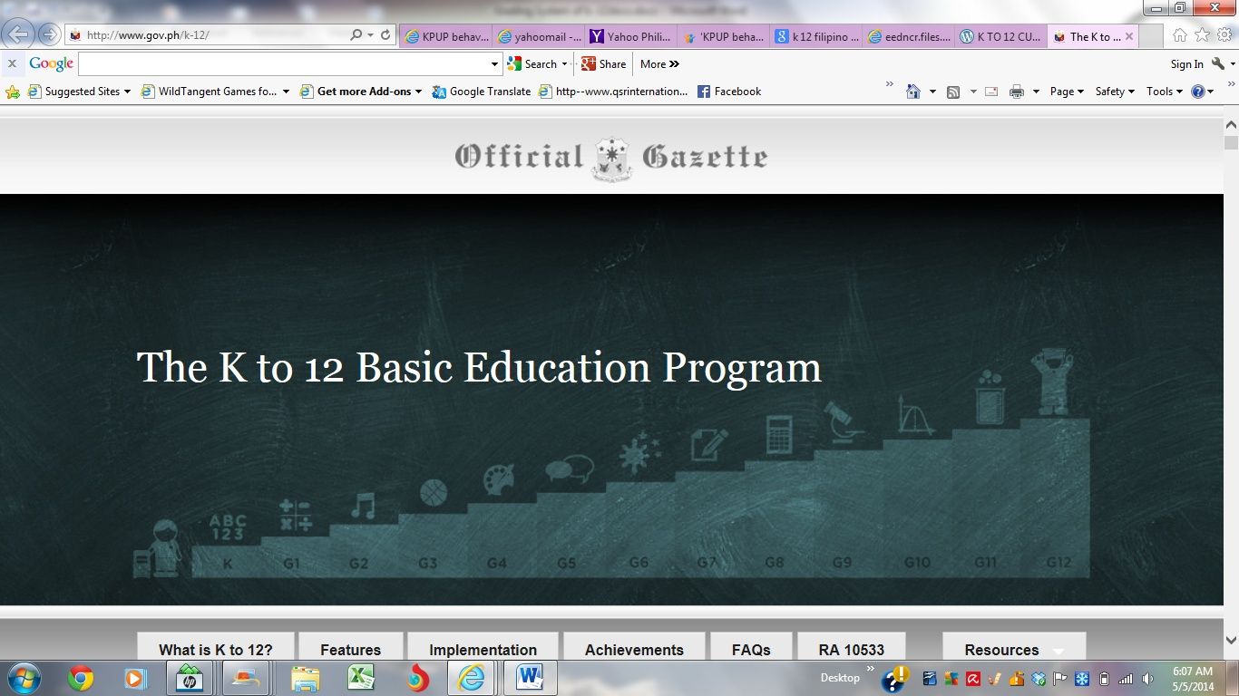
Aligning Our Assessment Strategies

Slide 18
Department of Education
Order No. 8 s. 2015

Slide 19
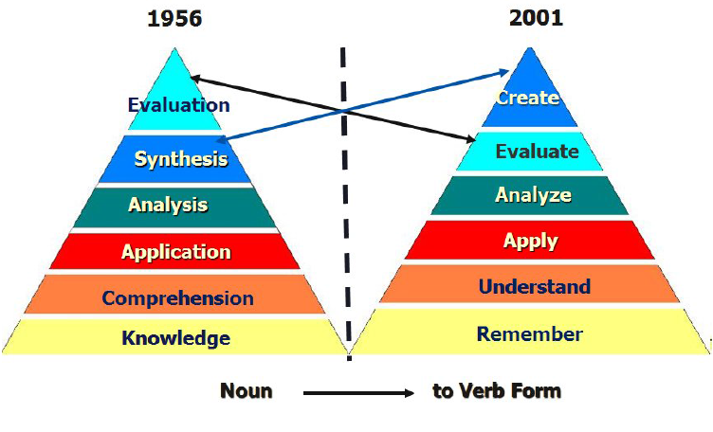
Notes:
Krathwohl and Anderson were reviewed, and the underscoring of learning having to be in an active mode was recognized.

Slide 20
Types of Knowledge
Factual
Conceptual
Procedural
Metacognitive
Notes:
Krathwohl and Anderson also pointed out that all types of knowledge have to be gained by 21st century learners.
[Factual Knowledge is knowledge that is basic to specific disciplines. This dimension refers to essential facts, terminology, details or elements students must know or be familiar with in order to understand a discipline or solve a problem in it.
Conceptual Knowledge is knowledge of classifications, principles, generalizations, theories, models, or structures pertinent to a particular disciplinary area.
Procedural Knowledge refers to information or knowledge that helps students to do something specific to a discipline, subject, or area of study. It also refers to methods of inquiry, very specific or finite skills, algorithms, techniques, and particular methodologies.]
Factual, conceptual, and procedural knowledge can already be located in the 1956 Bloom’s Taxonomy. But not metacognitive knowledge.
Metacognitive Knowledge is the awareness of one’s own cognition and particular cognitive processes. It is strategic or reflective knowledge about how to go about solving problems, cognitive tasks, to include contextual and conditional knowledge and knowledge of self.

Slide 21
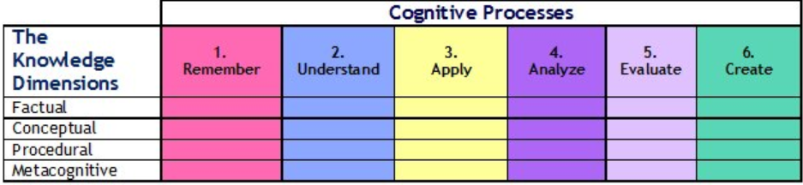
Template Table of Specifications
(per Content Domain)
ENGLISH or Araling Panlipunan Grade 10
(create domain/metacognitive knowledge):
Write a paragraph describing election day in 2022.
Draw your mind map for the paragraph you wrote.
Notes:
Here is a sample “create” task tapping into the “metacognitive knowledge dimension” for English or Araling Panlipunan 10 students:
Write a paragraph describing election day in 2022. Draw your mind map for the paragraph you wrote.
Mind mapping is a good tool for people to be able to reflect on plans made or actions taken. For complex tasks like writing composition in subjects where students are expected to articulate their ideas (for example, English, Filipino, and Araling Panlipunan), a mind map gives a student insight into his or her ability to organize thoughts and articulate ideas.
There are many free software available for mind mapping, and in some parts of the world, much has been written about how mind mapping has taught people to learn how to learn (see for example the works of Jose Andres Ocaña).

Slide 22
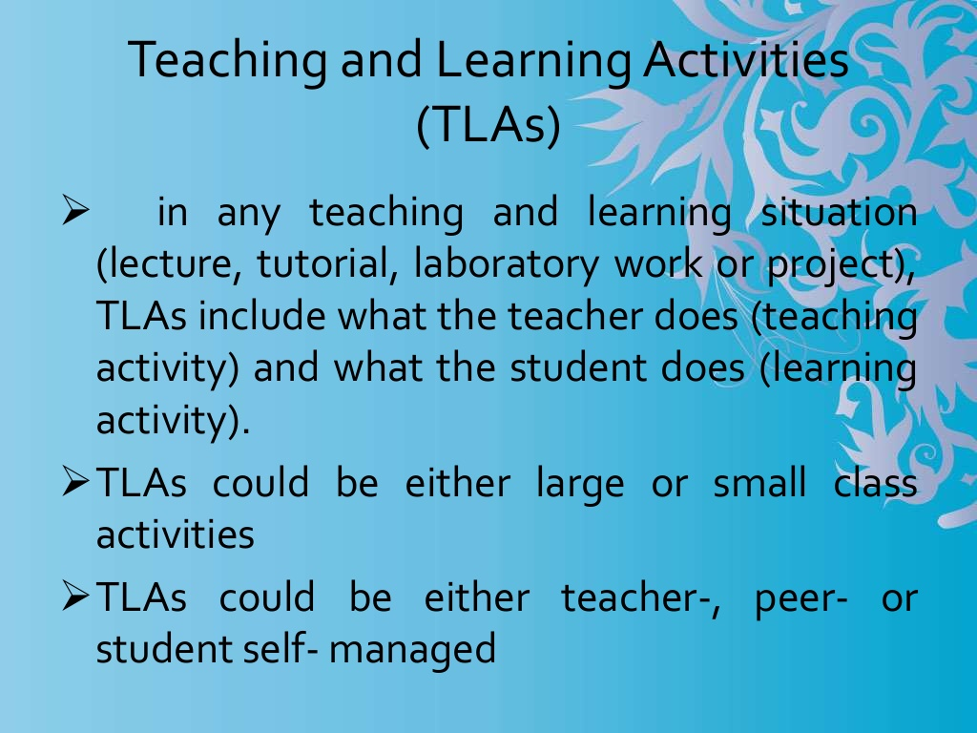
Notes:
An outcomes-based syllabus would have had to have been made to guide the assessment where such an item could have been included in an English Grade 10 classroom test.
An OBE-based syllabus needs to have TLAs and ATs.
TLAs are teaching and learning activities. Basically what the teacher does and what the student does, in either large or small class activities, managed by either the teacher, the students themselves, or a classmate.

Slide 23
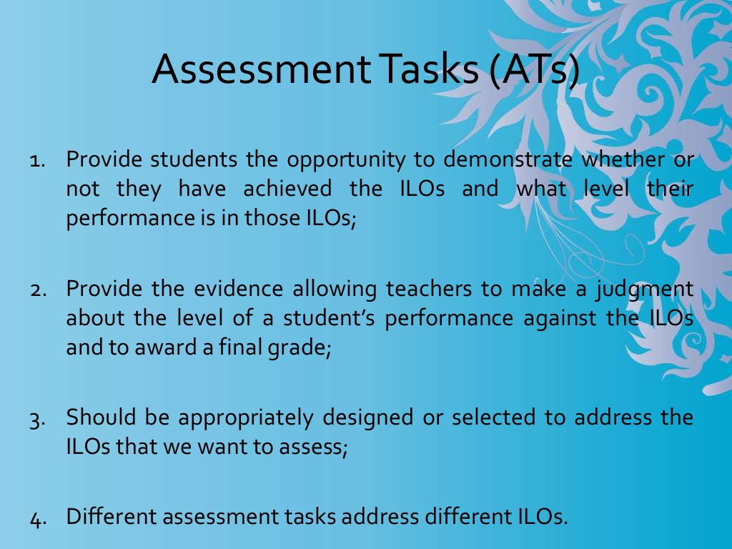
Notes:
ATs or Assessment tasks enable students to show whether they have achieved the intended learning objectives (ILOs), and to what level they can perform and show that they have learned targeted objectives/

Slide 24
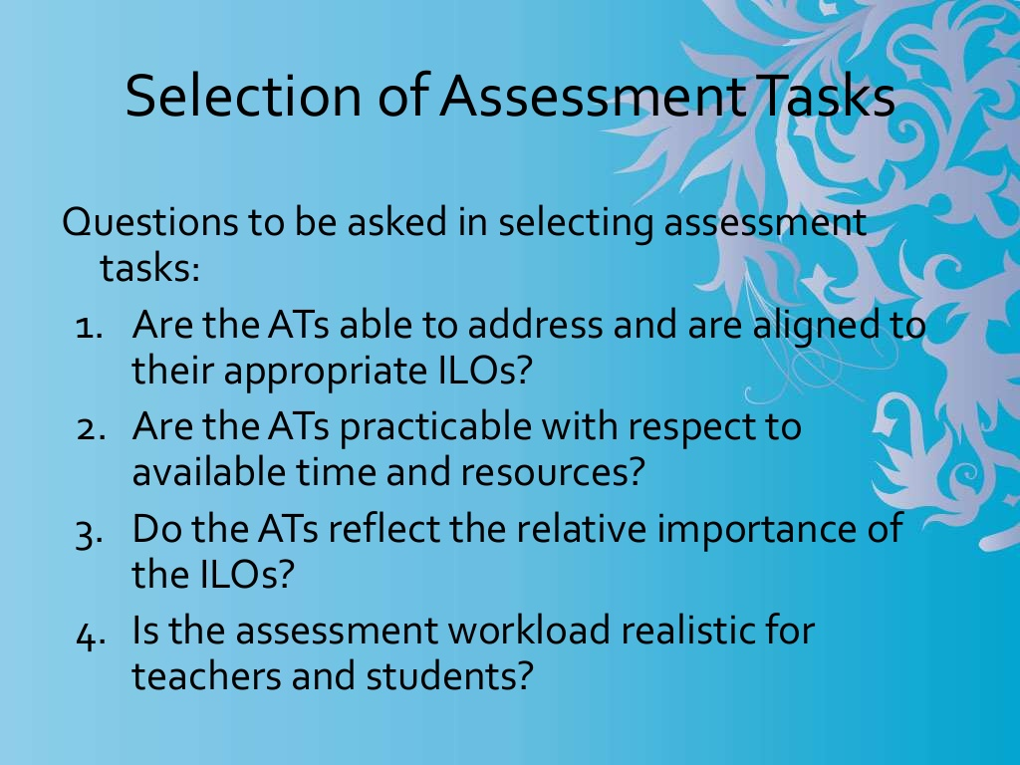
Notes:
ATs are carefully designed or selected.

Slide 25
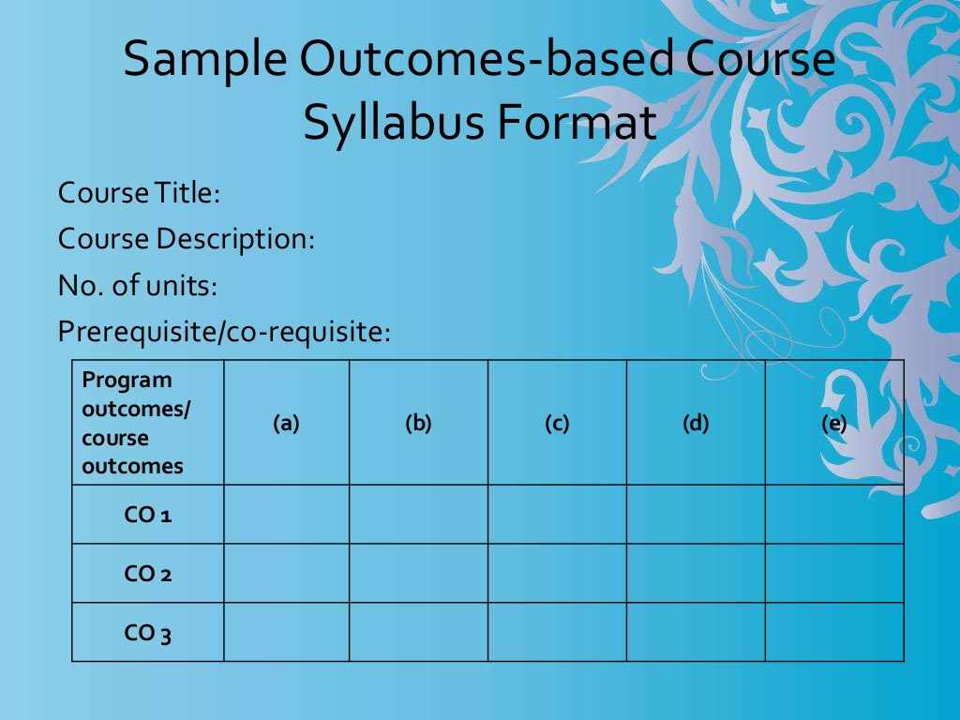
Notes:
In grid format, a syllabus would look like this: basic course information above the grid, followed by program and course outcomes used as labels of the grid’s rows.

Slide 26
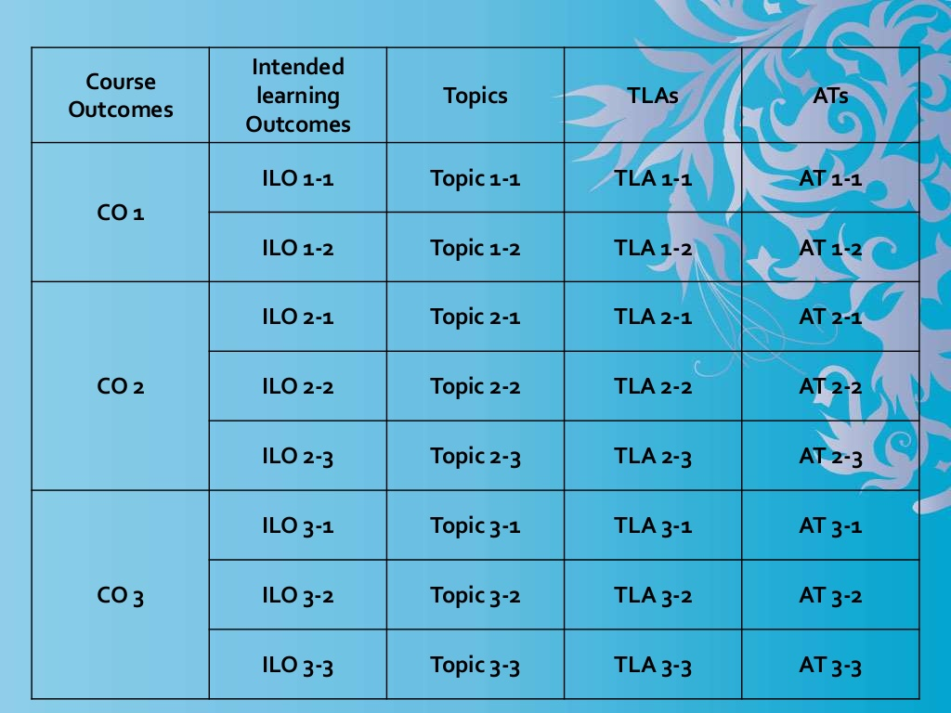
Notes:
The columns that follow are reserved for more detailed information about each of the course outcomes: ILOs or Intended Learning Outcomes, Topics, TLAs or Teaching and Learning Activities, and ATs or Assessment Tasks.

Slide 27
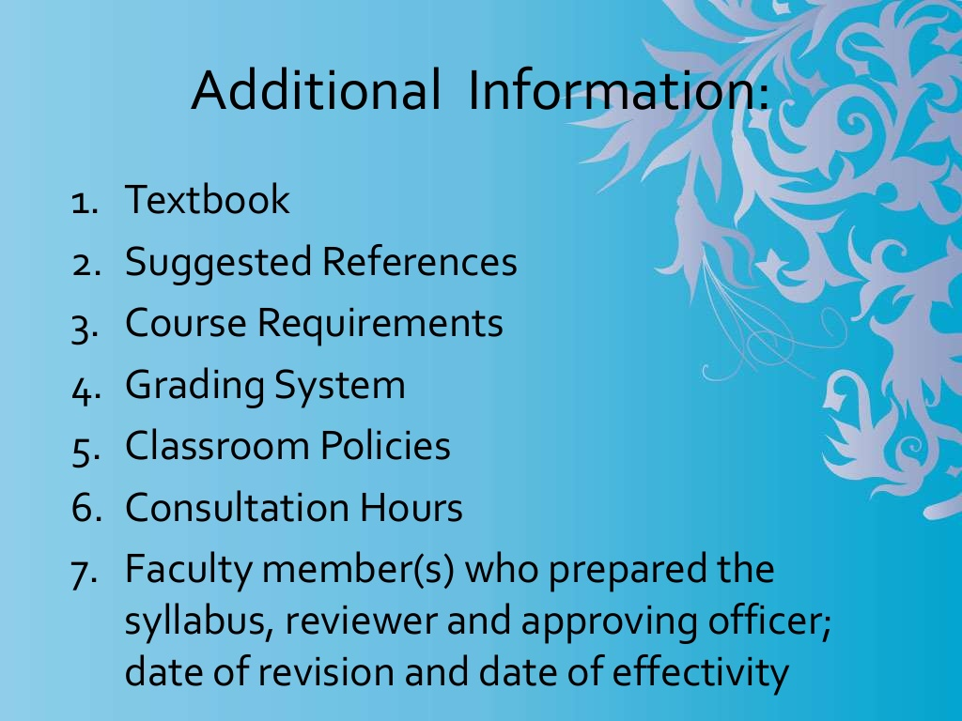
Notes:
Additional syllabus information may be provided below the grid. Many faculty members of HEIs chafe at the level of detail such OBE-based syllabi require. But even if they hem and haw, in the end, there is compliance, because CHED bases its audit on evidence of colleges’ and universities’ using Outcomes Based Evaluation in its quality assurance efforts and initiatives.

Slide 28
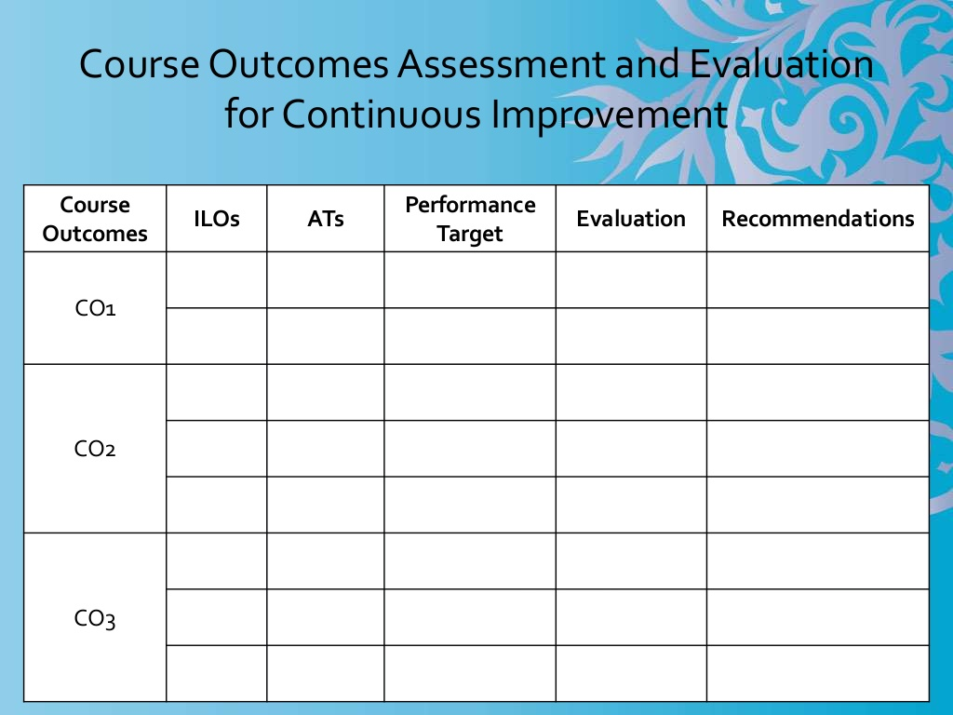
Notes:
Because continuous improvement is a basic tenet of quality assurance, course outcomes need to be assessed and evaluated. This grid would naturally and logically flow from the syllabus grid inputs.

Slide 29
Structural
Looks at the broad societal factors that help create a climate in which educational assessment and evaluation is encouraged or inhibited
Gender, migration, economic inequality, globalization
Environment (social, political, economic), situation of a country—its context
Notes:
The fourth subsystem in Bronfenbrenner’s ecological systems theory is the macrosystem. In a world where education is a primary goal, educational assessment and evaluation is important.

Slide 30
SDG 4
We commit to providing inclusive and equitable quality education at all levels – early childhood, primary, secondary, tertiary, technical and vocational training. All people, irrespective of sex, age, race, ethnicity, and persons with disabilities, migrants, indigenous peoples, children and youth, especially those in vulnerable situations, should have access to life-long learning opportunities that help them acquire the knowledge and skills needed to exploit opportunities and to participate fully in society. We will strive to provide children and youth with a nurturing environment for the full realization of their rights and capabilities, helping our countries to reap the demographic dividend including through safe schools and cohesive communities and families.
Notes:
Governments, including our Philippine government, will be held accountable for meeting sustainable development goals set for 2030. Countries committed to providing inclusive and equitable quality education at all levels.

Slide 31
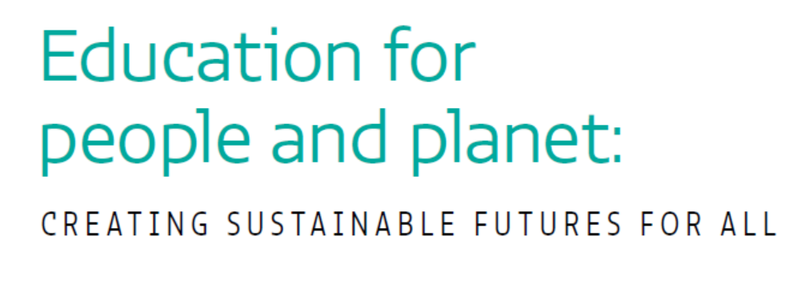
Sustainable Development Goals SDG4
Notes:
In the foreword to the 2016 Global Education Monitoring Report written by Irina Bokova Director-General of UNESCO, she said “the ultimate goal of this agenda is to leave no one behind. This calls for robust data and sound monitoring.”

Slide 32
“The ultimate goal of this agenda is to leave no one behind. This calls for robust data and sound monitoring.”
Irina Bokova
UNESCO Director-General
Notes:
In the foreword to the 2016 Global Education Monitoring Report written by Irina Bokova Director-General of UNESCO, she said “the ultimate goal of this agenda is to leave no one behind. This calls for robust data and sound monitoring.”

Slide 33
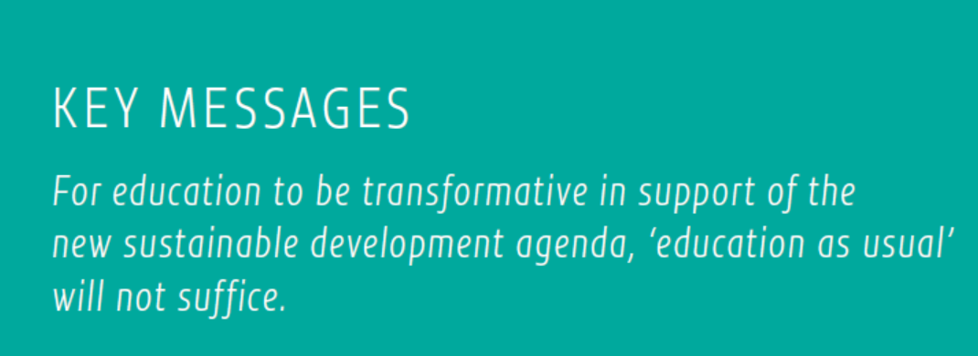
SDG 4
Notes:
Imagine, for instance, a class of a DLSU professor in 2020, where 25% are on full scholarship. A class of 40 would have 8 scholars.
By and large, in the Philippine setting, many would-be learners do not have access to the educational system. And if they do have access, through scholarships, they may still be marginalized because of their not having access to education necessities such as access to the internet. It would be wrong for DLSU teachers to assume that all of their students have access to the internet 24/7, and assign exercises needing internet access even at odd hours of the night. The scholars of DLSU would probably have to leave the safety of their homes to use computers at some internet café where they would be at risk of being victimized by those who exploit the vulnerability of our youth.

Slide 34
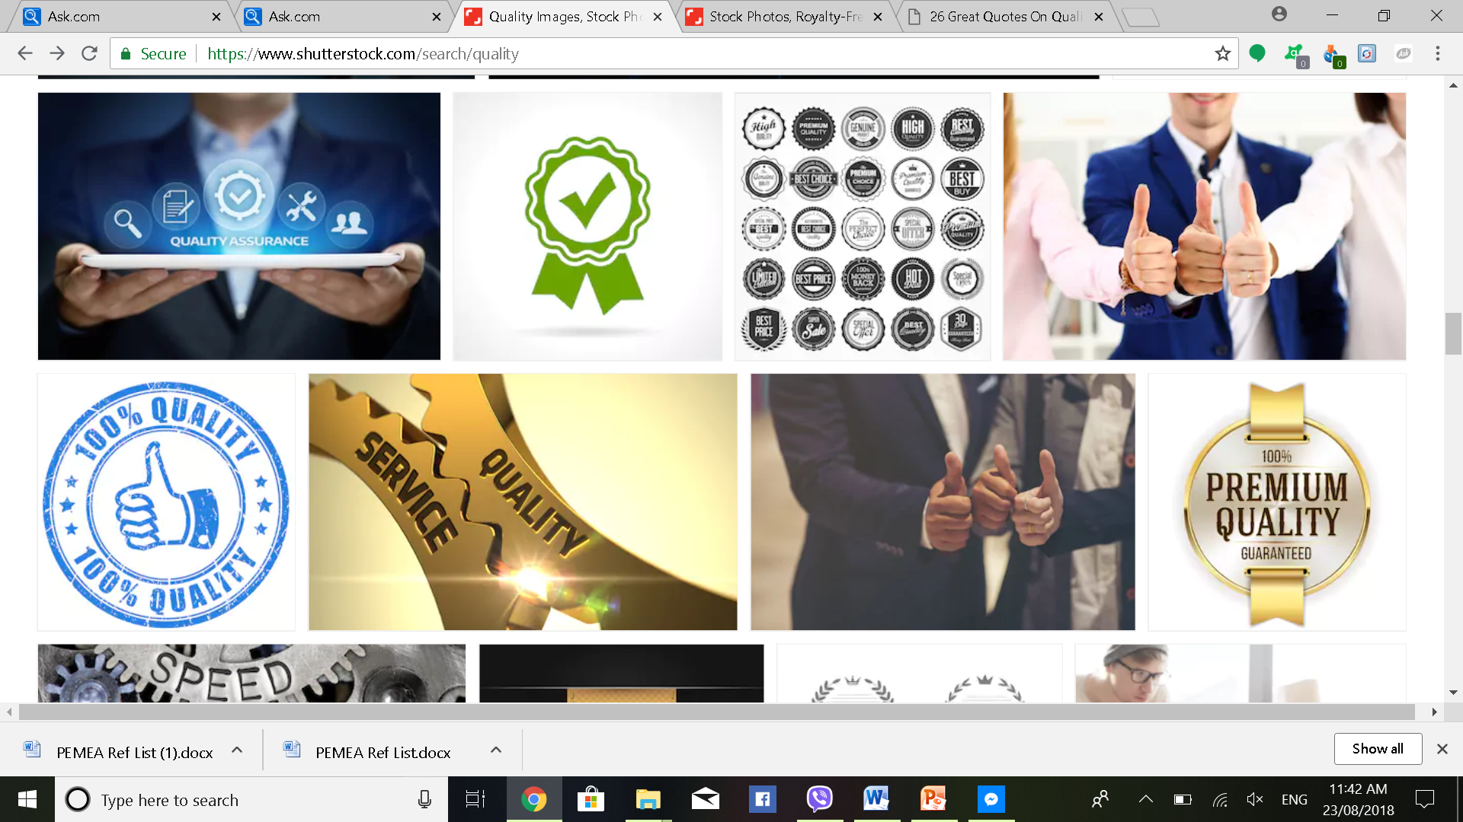
“Quality is never an accident; it is always the result of high intention, sincere effort, intelligent direction and skillful execution; it represents the wise choice of many alternatives.” – William A. Foster

Slide 35
Plans for Assessment Associations

Slide 36
Capacity-building
Training needs analysis via an online survey (with professional psychologists , psychometricians , and educational assessment specialists as target survey respondents), and/or via an FGD and/or a RTD
Conduct of seminars and training workshops for continuing professional development of psychological and educational assessment practitioners, with provision of CPD points:
  Authentic Assessment and Rubrics Making for the Educational Setting
  Theoretical and Practical Applications of Item Response Theory (IRT) using RStudio and Xcalibre software
  Search for Content Domain in Test Development using NVIVO software for qualitative data analysis
  Developing Behavioral Interviews for Recruitment in the I/O Setting
  Revisiting Special Test Development Concerns, such as:
    Artistic Inclination
    Hardiness and Resilience
    Integrity
    Entrepreneurship

Slide 37
Research and Development
Dissemination of an updated list of psychological and educational measures that have been scientifically:
  translated and have empirical evidence of translation equivalence
  adapted and modified, with strong validity and reliability indices for test adaptation versions
  completely developed for the Philippine setting, from start (search for content domain) to end (norms development), and have accompanying test manuals
Recognition for research efforts
  Awarding of certificates of appreciation to Filipino authors of scientific articles on psychological and educational assessment accepted for publication in PJP, DIWA, PEMEA, and other scientific local journals
  Awarding of plaques of appreciation to Filipino authors of scientific articles on psychological and educational assessment accepted for publication in top-tiered ISI or Scopus publications

Slide 38
Networking
Establishment of cyberspace infrastructure for networking among psychological and educational assessment groups in ASEAN.

Slide 39
References

Slide 40
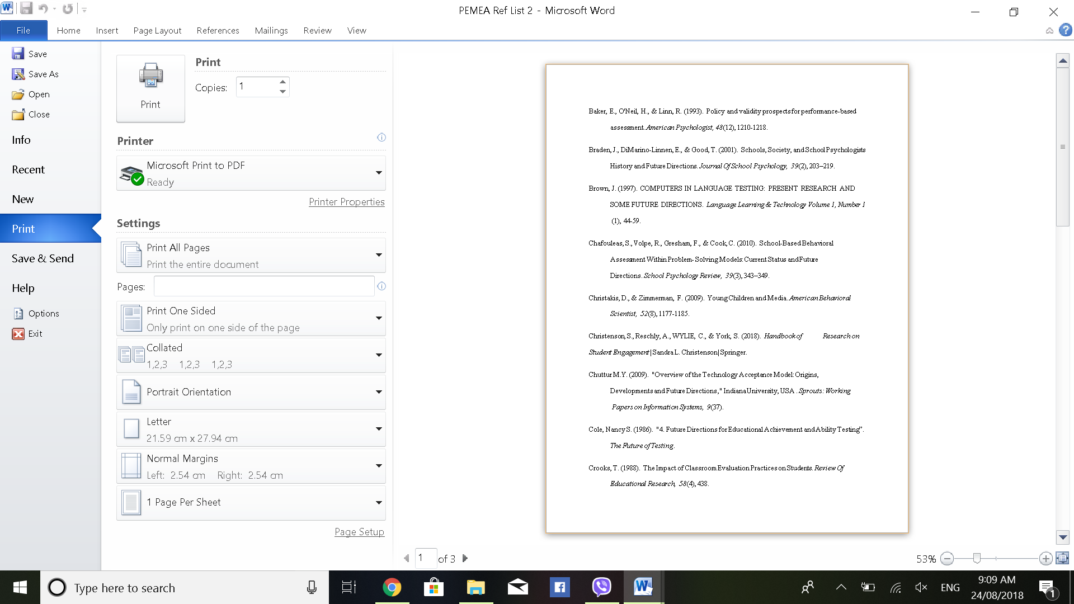

Slide 41


Slide 42
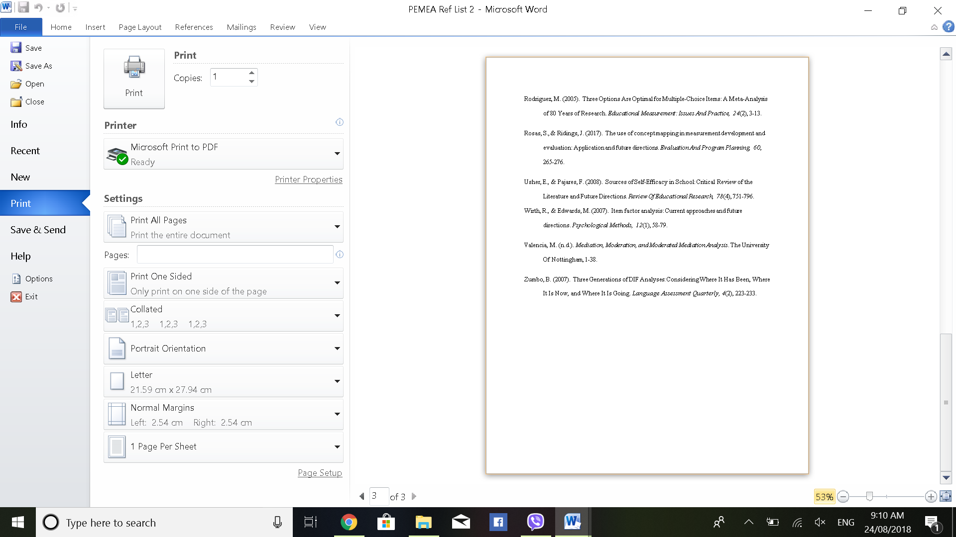

Slide 43
Future Directions
Learning Competency-based Assessment
Standards-based Assessment
Informed Decision-making
Assessment of Students’ Learning to Learn
Quality Assessment
Notes:
In summary, let me reiterate that among the clear trends I have observed is the movement towards authentic assessment. Policies prioritizing performance-based assessments are becoming a pattern among countries due to the recognition of a more constructivist approach in assessment. This shift is also anchored on the adoption of the 21st century framework followed in education. The shift in policy, however, is not smoothly translated on the ground. Schools are still encouraged to focus more on task-based assessment activities and there seems to be a lack of professional development and capacity building to do performance-based assessments. Teachers are struggling to construct valid and reliable tasks and rubrics. A second trend that has been observed is the rise of standards-based assessments as against standardized testing. The focus on standards is a major pattern that is seen globally linked to the emergence of outcomes-based paradigms. The shift is triggered by global factors such as the emphasis on skills-oriented labor that is geared towards the fulfillment of labor market needs. We professionals in the area of educational assessment and evaluation should make a case for assessing students’ learning being both a science and an art; a science that requires precision and an art that needs creativity.

Slide 44
THANK YOU!

