Slide 1
PEMEA Fellow Awardees

Slide 2
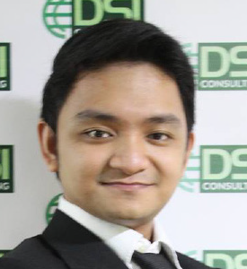
Alejandro Ibanez
MR. ALEJANDRO IBANEZ is the Assistant Director of the Global Resources for Assessment Curriculum and Evaluation, Inc. (GRACE), an assessment and research firm involved in local and international engagements in the areas of research and assessment. He is an active member of professional organizations such as the Philippine Sociological Society (PSS), Pambansang Samahan sa Sikokolohiyang Philipino (PSSP), and a current member of the Board of Trustees of the Philippine Educational Measurement and Evaluation Association (PEMEA). He is about to finish his Masters degree in Sociology at the University of the Philippines Diliman. His research interests are social science methodologies, sociological theories, IP epistemology, educational research, assessment, evaluation, among other things.

Slide 3
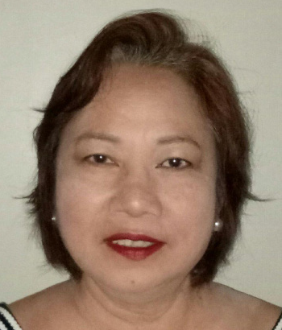
Dr. Remedios Fuentes
DR. REMEDIOS D. FUENTES is the current Dean of the Graduate School of Education (GSE) of the New Era University. She finished three master’s degrees (MA in College Teaching, MAEd in Filipino, MAEd in Special Education) and a Doctorate in Education, Major in Educational Management. Being in the teaching profession for the past 32 years, she has been adviser to countless students in the Master’s and Doctoral levels at the New Era University.

Slide 4
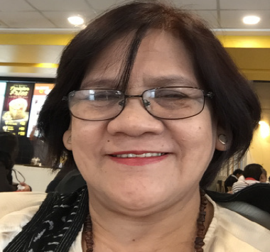
Dr. Eliza Valdez
Currently, the Director, Center for Institutional Testing and Evaluation of New Era University, DR. ELIZA M. VALDEZ specializes in education and business. She is a holder of Doctorate Degree in Education (Research and Evaluation ) which she obtained from UP Diliman, MBA, and a candidate for a Doctorate Degree in Business Administration.

Slide 5
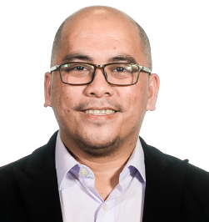
Louie Cagasan
LOUIE CAGASAN JR is currently a Research Assistant at University of Hong Kong for the project Learning and Assessment for Digital Citizenship. He was the project lead for the Formative Assessment research of Assessment, Curriculum, and Technology Research Centre (ACTRC), and had worked as research officer on various projects of the Centre. His research has focused on educational assessment, measurement of individual differences, and impact of culture on educational and psychological processes.

Slide 6
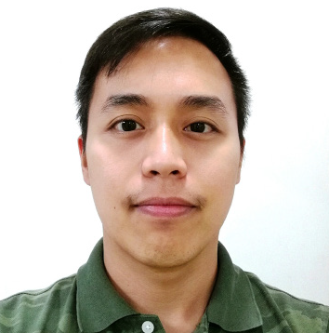
Arian Anderson Rabino
MR. ARIAN RABINO heads the Office of Learning Assessment at the Center for Learning and Performance Assessment of De La Salle-College of Saint Benilde. In this capacity, he oversees institutional psycho-educational researches primarily in the areas of learner-centered teaching-learning, and instrument development and validation. He also teaches Research Methods in Arts Management and Practical Research for Arts Management in the School of Design and Arts at the same institution. Ian took his MA Education Research (Merit) at Newcastle University in the UK, MS Clinical Psychology (Candidate) at De La Salle University in Manila, and his BS Psychology from the University of Santo Tomas in Manila.

Slide 7
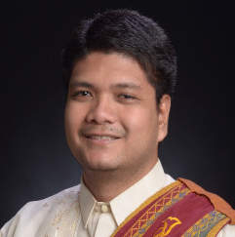
Kevin Carl Santos
KEVIN CARL SANTOS is currently a Post-Doctoral Fellow at the Faculty of Education, The University of Hong Kong. He is also an Assistant Professor at the School of Statistics, University of the Philippines-Diliman. His areas of interest includes cognitive diagnosis modeling, person fit analysis, use of copulas, and sampling designs.

Slide 8
Dr. Julie Tiberio Valencia
DR. JULIE TIBERIO VALENCIA is the current Director of the Office of Student Discipline, New Era University, Quezon City. She finished my Master of Arts in Teaching Mathematics at the University of the Philippines and Doctor of Education at New Era University.She teaches Assessment of Learning, Statistics, Research and other Mathematics related subjects.

