Slide 1
Assessment Systems in Southeast Asia: Models, Successes and Challenges
Educational Research Unit,
SEAMEO INNOTECH

Slide 2
“The systematic assessment of student learning outcomes is essential to monitoring quality and providing the information that leads to improvement. -Middle States Standard XIV

Slide 3
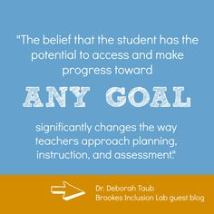
"We plan. We develop. We deliver. We assess and evaluate the results of the assessment. We revise, deliver the revised material, and assess and evaluate again. Perfection is always just out of reach; but continually striving for perfection contributes to keeping both our instruction fresh and our interest in teaching piqued." -E.S. Grassian

Slide 4
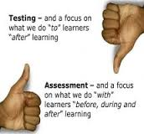
ASSESSMENT

Slide 5
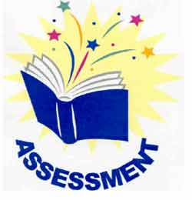
as the process that teachers use to assign grades to students in particular subject assignments
refers to the standardized testing imposed in schools (Marzano, 2006; Stiggins & Chappus, 2005)
as any activity intended to gather information to be used to provide feedback in order to modify teaching and learning activities in the schools or improve instruction and students’ performance (Black and William,1998 in Cohen and Hill, 2000)

Slide 6
For SEAMEO member countries
agree that assessment is a process and procedure of collecting and understanding data or information from students in a range of activities aimed at improving teaching-learning process and making decision and judgment on students’ learning outcomes

Slide 7
“The important question is not how assessment is defined but whether assessment information is used… -Palomba & Banta

Slide 8
Large Scale and School-Based Assessment Results to Development

Slide 9
Common Purposes of Assessment
Level of attainment of each learner
Effectiveness of teaching
Monitor student achievement and progress to improve quality of teaching
Determine the extend to which goals and objectives are achieved
assess readiness of learners for the next step
Appropriately place the students in the curricular program
Select student who will enter high level of education
Improve school for external and internal quality assurance

Slide 10
Assessment has to
Satisfy its intended purpose
Anchor on education strategic plan and or Agenda
Curriculum and standard of a nation
Philippines K to 12
Brunei SPN21 (Sistem Pendidikan Negara Abad ke-21)

Slide 11
Commonly assessed core subjects
English & National Languages
Mathematics & Science
Social Studies

Slide 12
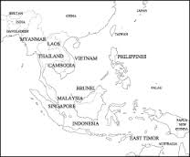
Governing bodies for student learning assessment
Examination Board
GenDept of Educ Testing & Accreditation
Bureau of Educational Testing
NETRC
Cambodia ExaminationOffice, Dept. of Gen.Sec. Ed.
Brunei Examination Department & Dept of Schools
Malaysia Examination syndicate
Singapore Examination Board
The Board of National Education Standards and Center
For Educational Assessment
National Direction of Cur & Eval

Slide 13
Professional Development
Programs on Assessment
1.Pre service teacher training
2. In-service teacher training
3. Seminar, Conferences & Workshops
5. Monitoring by supervisors
6. Access to online resources

Slide 14
Resources available for teachers for professional development
Student learning competencies
Student performance standards
Textbooks, workbooks, etc.
Use of scoring rubrics; and test item banks or test data

Slide 15
Assessment Strategies in the classroom and SBA
1.Worksheets and seatwork
2.Assignments and projects
3. Oral quizzes and recitation
4. Observation and checklist
5. Anecdotal records
6. Portfolio assessment
7. Performance assessments and demonstration
8.Peer assessment
9, self-assessments
10, team assessments

Slide 16
Elements of good practices among SEAMEO member countries
well-defined purpose of assessment strategies
Well-trained examination personnel
Credibility and integrity is in place
Provision of sufficient fund for testing
Use of reliable and valid assessments

Slide 17
Conceptual Paradigm of Assessment: Balancing Assessment Purposes
Assessment as Learning (AaL) is the use of on-going self-assessment by students in order to monitor their learning (WNCP, 2008). Philippines, Singapore and Thailand
-learners or students are the critical corrections between assessment and learning (Earl & Katz, 2006).
Assessment of Learning (AoL) or summative assessment - to determine the current standing of students’ achievement against learning outcomes defined in the curriculum and in some cases, how they are placed in relation to others (Earl, 2005; Harlen, 2008). Brunei Darussalam, Indonesia, Malaysia, Myanmar, Philippines, Singapore, Thailand and Vietnam
Assessment for Learning or AfL - aimed to determine progress in learning by giving tests and other tools to measure learning while the instructional program or process on going (Murray, 2006; Sparks, 2005). Brunei Darussalam, Cambodia, Indonesia, Malaysia, Philippines and Singapore

Slide 18
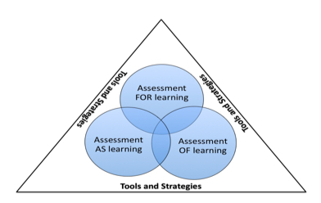
89,526,124
Conceptual Paradigm of Assessment: Balancing Assessment Purposes

Slide 19
Elements of Good Assessment Practices
Well-defined Purposes of Assessment Strategies
Well-trained Examinations Personnel
Credibility and Integrity of Testing Personnel
Sufficiently Funded by the Government
Reliable and Valid Assessments

Slide 20
Success factors for reforms and improvement strategies
Presence of testing and
Examination professionals and experts
Stable organizational structure that promotes sustainable programs, including research and development
Supportive government and related agencies to implement national assessment systems particularly in: funding, human resource, leadership
Well defined assessment frameworks and implementation mechanism: policies, legislation and laws
Institutionalize monitoring and evaluation programs
Positive public perception
and attitude and confidence
towards examination systems
And the implementing agencies
Strong collaboration with internal and external examination bodies
Well programmed professional development programs for examination and assessment personnel at various levels
Commitment of teachers to implement national examinations and SBA
Students’ high regard for the assessment
system and strong compliance to all guidelines,
policies and regulations

Slide 21
Issues and Challenges that Trigger Development
Threats to integrity in assessment
Questionable validity and reliability of some measures
Vague purposes of some assessments and school testing programs
Poor management of some examination activities
Lack of experts in the field of educational assessment
Over-reliance on high-stakes national examinations that sometimes results in test-driven instruction

Slide 22
Future Directions
1. Develop a program to reduce examination pressures
2. Create an assessment system that is responsive to the diverse needs of students
3. Develop an assessment system that covers a wide range of curriculum objectives and learning outcomes
4. Balance the purposes of assessment

Slide 23
Future Directions
5. Implement a program capacity building and professional development program in the region
6. Establish a stronger network of Assessment experts
7. Develop SEA metrics for assessing student achievement at the primary and secondary levels
8. Introduce a technology aided assessment system
9. Develop an assessment policy framework with assured funding support from the government

Slide 24
Thank You!

Slide 25
SlidesCarnival icons are editable shapes.
This means that you can:
Resize them without losing quality.
Change fill color and opacity.
Change line color, width and style.
Isn’t that nice? :)
Examples:

