Slide 1
PEMEA: HOW IT ALL BEGAN
Rose Marie Salazar-Clemeña, PhD, Rpsy, RGC
President
Asian Psychological Services and Assessment, Inc.
Vice-President for Academic Affairs
Divine Word College of Legazpi

Slide 3
background
In 1985, the IEMES came into being.
Institute for Educational Measurement, Evaluation, and Statistics

Slide 4
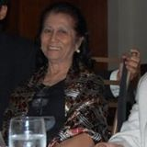
Leticia M. Asuzano, PhD
Former Chair,
DLSU Graduate Guidance Department
President,
CEM

Slide 5
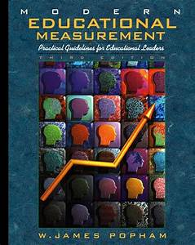
Iemes vision
A critical mass of trained professionals especially equipped with knowledge and skills in educational measurement and evaluation

Slide 6
Master of Science in Educational Measurement and Evaluation
(MSEDMEV)
Counselor Education Department
DLSU College of Education
Rose Marie Salazar-Clemeña, PhD
Chair
a rigorous 12-month program (3 trimesters, 1 summer) for fulltime students

Slide 7
iemes
Co-Directors:
Dr. Leticia M. Asuzano
Dr. Rose Marie Salazar-Clemeña
Financial Support:
Fund for Assistance to Private Education

Slide 8
MSEDMEV BATCHES
1985-1987
1990-1996
1999-2002
9 batches
N = 131 students

Slide 9
Msedmev grad’s mission

Slide 11
Ay 2007-2008
Planning for the 1st National Conference on Educational Measurement and Evaluation
AIM: To provide a venue for assessment practitioners and professionals to converge and discuss the latest trends, practices, and technologies in educational measurement and evaluation in the Philippines.

Slide 12
August 6-7, 2008
1st National Conference on Educational Measurement and Evaluation (NCEME)
THEME:
“Developing a Culture of Assessment in Learning Organizations”

Slide 13
August 6-7, 2008
1st National Conference on Educational Measurement and Evaluation (NCEME)
TARGET:
Establishment of a national organization of educationists, researchers, teachers, and assessment and evaluation practitioners

Slide 14
national organization of edmev practitioners
Core Group:
MSEDMEV Graduates of the IEMES
PHILIPPINE EDUCATIONAL MEASUREMENT AND EVALUATION ASSOCIATION (PEMEA)

