Slide 1
COMPETENCY-BASED ASSESSMENT IN THE DEPARTMENT OF EDUCATION
Presented at the International Conference for Educational Measurement and Evaluation
Jen Hotel, Manila
23 August 2018

Slide 2
Human capital is becoming the main asset of an enterprise and more often than not, a determinant of its competitive advantage.
Competency-Based Human Resources Management: The Lifelong Learning Perspective (2014)

Slide 3
OUTLINE
Overview of DepEd Strategic HR Management
Competency Assessment in the Department of Education
Highlights of the Principals Test
Challenges and Way Forward

Slide 4
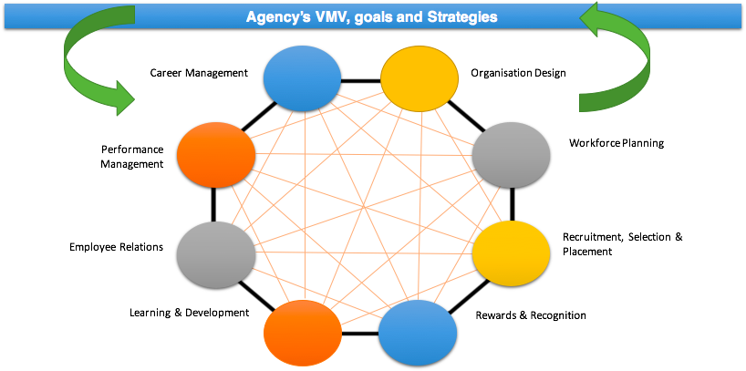
DEPED STRATEGIC HR MANAGEMENT
Source: BHROD, DepEd

Slide 5
Competency standards inform various HR processes to support strategic HR Management
Competency
RSPI
Perf. Mngt.
L and D
Rewards and Recognition

Slide 6
The successful performance of duties and functions depends heavily on personnel COMPETENCIES.
Knowledge
Attitude
Skills

Slide 7
PERSONNEL COMPETENCY ASSESSMENTS IN THE DEPARTMENT OF EDUCATION
Educational Management Test
Principals Test
Behavioral Event Interviewing
PPST-Based Teacher Assessment

Slide 8
“The school shall be the heart of the formal education system. It is where the children learn.”
- RA 9155

Slide 9
“Schools shall have a single aim of providing the best possible basic education for all learners… Schools and learning centers shall be empowered to make decisions on what is best for the learners they serve.”
- RA 9155

Slide 10
A School Head must possess a range of competencies critical to the delivery of quality, accessible, relevant and liberating basic education.
Competent, Committed, Accountable SHs
School Leadership
Parental Involvement and Comm. Partnership
School Management and Operations
Personal and Personal Attributes and Interpersonal Effectiveness
Instructional Leadership
Creating a Student- Centred Learning Environment
HR Mngmt and Prof. Dev.

Slide 11
THE PRINCIPALS TEST

Slide 12
TEST DEVELOPMENT PROCESS
Analysis of the Competencies (Domains, Strands, Indicators in the NCBSSH)
Identification of Knowledge, Skills and Attitude
Development of Test Objectives
Development of Test Items

Slide 13
From 2009 until 2013, the passing rate was set at 90 percentile rank.
Year | 2009 | 2010 | 2011 | 2012 | 2013
No. of Test Takers | 6,924 | 9,778 | 11,778 | 14,567 | 13,618
No. Passers | 693 | 924 | 1,024 | 1,454 | 1,301

Slide 14
The Department of Education is moving towards competency-based standards assessments.
2015 | 2016 | 2017
Overall score not lower than 70% with no score lower than 68% in any domain | Overall score of not lower than 70% | At least 70% in each of the three (3) domains clusters (School Leader, Instructional Leader, School Manager)

Slide 15
2015 PT Passing Score at 68%
Domain | No. of Items | Passing Score (68%)
School Leadership | 46 | 31
Instructional Leadership | 41 | 27
Creating a Student-Centered Learning Environment | 27 | 18
Human Resource Management and Professional Development | 29 | 19
Parental Involvement and Community Partnership | 11 | 7
School Management and Operations | 23 | 15
Personal and Professional Attributes and Interpersonal Effectiveness | 23 | 15

Slide 16
No. of Passers from 2015-2017
Year | 2015 | 2016 | 2017
Passing Score/Rating | Overall score not lower than 70% with no score lower than 68% in any domain | Overall score of not lower than 70% | At least 70% in each of the three (3) domains clusters
No. of Examinees | 18,574 | 17,455 | 20,653
No. of Passers | 2,194 | 388 | 5,111
Percentage | 11.81% | 2.2% | 24.75%

Slide 17
Consistently, School Leadership, Instructional Leadership, and School Management and Operations have the lowest % of passers.
DOMAINS | 2015 (18,570 examinees) | 2016 (17,455 examinees) | 2017 (20,653 examinees) | Ave.
School Leadership | 19.82% | 29% | 17% | 21.94%
Instructional Leadership | 63.27% | 24% | 29% | 38.76%
Creating a Student-Centered Learning Environment | 75.11 | 51% | 62% | 62.70%
Human Res. Mngt. And Prof. Devt | 65.42% | 66% | 56% | 62.47%
Parental Involvement and Community Part. | 72.94% | 53% | 45% | 56.98%
Sch. Mngt and Ops. | 41.38 | 6% | 39% | 28.79%
Per./Prof. Attributes and Inter. Effectiveness | 90.67% | 43% | 85% | 72.89%

Slide 18
Differences in passing percentages reflect differences in passing scores

Slide 19
Central Luzon is the only region that is consistently among the top 5 regions with the highest passing percentage while ARMM is consistently registering the lowest passing percentage.

Slide 20
SUMMARY OF MAJOR FINDINGS
Overall, the passing rate has been dismal for the period 2015-2017
Of the 7 domains, Personal and Professional Attributes and Interpersonal Effectiveness and Human Resource Management and Professional Development have the highest % of passers while, School Leadership, and Instructional Leadership School Management and Operations have the lowest % of passers
Need to investigate variables that may be associated with performance in the principals test (number of years in the service, position held, level of education, etc.)

Slide 21
CHALLENGES TO ASSESSMENT
Multiple-Choice Test is too limited to capture the competencies; triangulation may be needed
Setting the standard passing score can be a challenge. Two considerations
the need to qualify only high potential applicants
the need to provide school leaders in schools

Slide 22
POLICY IMPLICATIONS
To continue with the written objective test?
Are there other better ways to do personnel assessment for recruitment, selection and hiring?
Triangulate?
How to better select and prepare personnel for leadership role?
Learning and development?

Slide 23
“In most cases, being a good boss means hiring talented people and then getting out of the way”
- Tina Fey (American actress, comedian, writer, producer, playwright)

