Slide 1

Principles of Assessing Outcomes in the Teacher Education Programs
Carlo Magno, PhD.
crlmgn@yahoo.com

Slide 2

Big Ideas
Session 1: Outcomes need to be clear and observable so that assessment becomes possible.
Session 2: How do we integrate assessment following the four OBE principles?

Slide 3

Outcome
Integrating assessment of outcomes with instruction in various delivery modes.

Slide 4

Features of OBE Assessment
(S1) Clarity of focus: having specific outcomes gives a strong sense of purpose to everything teachers and students do.
(S2) Design down, deliver up: when planning curriculum, educators start with the outcomes and work backwards; when planning instruction, teachers teach what students need to learn to demonstrate the outcomes.
(S1) High expectations: OBE departs from traditional education in its assumption that all students can learn well—although not in the same way and not necessarily on the same day.
(S2) Expanded opportunities: Students must be permitted to demonstrate their learning in different ways, and they must have numerous opportunities to demonstrate the outcomes, not just one. Spady calls this “grading in pencil

Slide 5

Design down, deliver up
Principle 1: Assessment should be well aligned with students’ outcomes reflecting the standards of the teaching profession.

Slide 6
Assessment is Standards-Based
Align the kind of assessment task you write based on given standards.
Course Outcome | Assessment
Students who uses the findings of a research study before selecting an effective method of instruction when planning a lesson. (facilitating learning) | A performance task will be done by students where they will plan a lesson for K to 12. They will rationalize each part of the teaching method by mentioning the research findings behind it to a classmate. The planning and rationalizing should: Criteria: Have a logical theory Correct use of the theory Realistic set of methods/steps

Slide 7
Students who can use print media as a way to disseminate information about scientific findings. (educational technology) | A performance task will be created by the students where each group is going to create a short newsletter containing recent development in science. Criteria: Parts of the newsletter is complete Each article is organized, accurate and clear. The layout is visually appealing

Slide 8
Students will recommend appropriate tasks for ADHD students based on the action research conducted. (special education) | The students will conduct an action research to test appropriate tasks for ADHD students. The action research will include recommendations for teachers and school heads. Criteria: Three or more recommendations are provided The recommendations are relevant to the findings The recommendations are specific

Slide 9
What form of assessment is needed for the outcomes?
Teacher Ed Outcomes | Form of assessment
Make a lesson plan for a specific subject in a level anchored on the MELC. | Performance or written?
Make a syllabus using the framework in the CG for the K to 12. | Performance or written?
Write items based on the MELC. | Performance or written?
Construct a rubric for a performance task in a selected competency in PE | Performance or written?
Demonstrate in class inquiry-based instruction | Performance or written?
Test the effectiveness of project-based learning based through an action research | Performance or written?
Propose a training program for science teachers | Performance or written?

Slide 10
Exercise: Constructive alignment
Outcome: Write objectives under the remembering cognitive skill.
Assessment Task:
The students will choose a learning competency in the curriculum guide under the remembering skill. They will place it in a lesson plan to make the rest of the parts.

Slide 11
Exercise: Constructive Alignment
Outcome: Demonstrate the 5Es for a science lesson to a class of grade 6 students.
Performance task
Final Output: A video presentation illustrating the use of 5Es for a lesson on balance of nature.
Task: Each segment of the 5E appears on the screen when it is already shown. The students in the video are interacting with the teacher during the lesson
Criteria: Accuracy of 5E implementation, 5Es were demonstrated, clarity of the inquirydeveloped.

Slide 12
Exercise: Constructive Alignment
Outcome: Design a module to teach grade 10 students on balancing equation of compounds.
Assessment Task: The students used google classroom and placed in the classwork the exercises to be answered, pages in the book that will be read. After reading, the teacher gave a set of excercises where the students will balance an equation.

Slide 13







Expanded Opportunities for Learning
P2: Formative assessment needs to scaffold students in the summative assessment
P3: Assessment should become more like instruction
P4: Assessment results needs to be used by teachers to help students learn better
P5: Assessment is not used to threaten and intimidate students.
P6: The teacher needs to engage in a PLC to engage in better assessment
P7: Assessment is a technical competency

Slide 14

Assessment Principles
Principle 2: The formative assessment needs to scaffold students in the summative assessment.

Slide 15
What is Formative Assessment?
WHAT IS NOT FA?
WHAT IS FA?
Formative Assessment is not an instrument, or event.
It is not used for grading!
It is not used as a punishment for students if they misbehave.
Collection of practices that all leads to student learning improvement.
Tool for the teachers to determine what they need to do to move the learner forward.
A technique to help the students optimize learning
(Black & William, 2003; Stiggins, 2002)

Slide 16
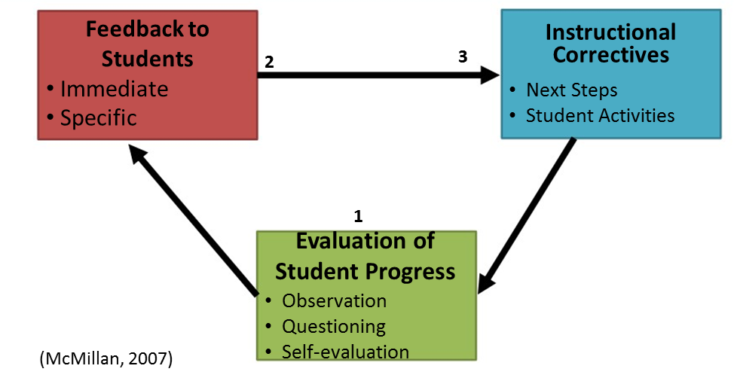
Delivering Formative Assessment
Make learners aware of the outcome
Determine current status of students
Move students closer to the outcome

Slide 17
How will Teachers Do It?
Formative Assessment is effective when teachers are clear about their intended learning outcomes for a lesson.
Teachers should focus on what students will learn.
Teachers should share the learning outcomes (or actively create it with the students), at the beginning of the lesson.
Practice sets and initial drafts are done first until the students are rated in the demonstration of the outcomes.

Slide 18
Sample Lesson Flow
  Outcome
  Pre-assessment (asynchronous) – formative or summative
  Motivation (asynchronous) – formative or summative
  Lesson Proper (asynchronous) – formative or summative
  Assessment (asynchronous) – formative or summative
  Reteaching (asynchronous) – formative or summative
  Assessment (asynchronous) – formative or summative
  Synchronous (reteaching-Provide feedback) – formative or summative
  Final Assessment (synchronous, Asynchronous) – formative or summative
We are focusing on feedback in students work so that they will become successful in the task.

Slide 19
Formative or Summative?
The teacher provides drills and exercises in math after demonstrating the addition of decimals for practice. After checking, the addition is taught again for the learners who could not get the correct answer.
The teacher gave several short stories to be read by learners. In each story, the figure of speech was identified. Students who could not identify the figure of speech well are provided with additional learning materials.

Slide 20
Formative or summative?
After several exercises on problem solving involving factoring of polynomials, 95% of the learners are able to execute the task. They are given a task to determine if they are ready to move to the next learning competency.
The teacher in PE allows to the students to practice the folk dance and feedback is provided.
After practicing how to play tennis, the students are informed to have a final demonstration of the sport.

Slide 21
Formative or summative?
Students submitted the draft of their essay and feedback with corrections are indicated by the teacher. The students were requested to revised the essay based on the feedback.
After the students have revised the teacher’s correction on their science investigatory report, the work is checked using a rubric.

Slide 22
Marking formative and summative
Formative
Summative
Google forms/MS forms/exam.net
Items directly made in the LMS (IVLE, Moodle, blackboard, canvass)
Assessment with right and wrong answers – automatic scoring
Open responses (essay, short answer) – teacher checks using rubric
Feedback is sent via discussion board or during synchronous session
Students progress can be tabulated
Print modules: answer key is provided to the parents and parents can check.
Google forms/MS forms/exam.net
Items directly made in the LMS (IVLE, Moodle, blackboard, canvass)
Assessment with right and wrong answers (video monitoring)– automatic scoring
Open responses (essay, short answer) (video monitoring) – teacher checks using rubric
Print modules: The task is submitted to the teacher in designated stations

Slide 23


Assessment Principles
Principle 3: Assessment should become more like instruction.

Slide 24
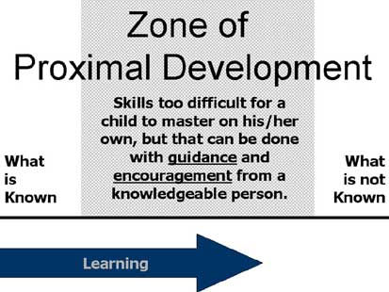
Zone of Proximal Development
Unity of instruction and assessment

Slide 25
Practices
Work out with a realistic number of outcomes for the semester.
Focus on contents that will support learners demonstrate the outcomes. Take out the contents that don’t.

Slide 26
CO1: Choose contents relevant for the outcome
Course Outcome | Contents | Requirements/Assessment
CO1: Design a syllabus for a subject in K to 12 | How to make a syllabus? Parts of the syllabus What to put in each part of the syllabus? What is the use of a syllabus? Using the K to 12 curriculum guide | Performance-based assessment: Students will make a syllabus where the targets are based on the K to 12 curriculum guide. Learners need to follow the format provided The learning activities and assessment are aligned on the learning competencies.

Slide 27
CO2: Choose contents relevant for the outcome
CO2: Make a learner-centered lesson plan for a selected list of objectives in the syllabus | Learner-centered principles How to make a lesson plan? What are the parts of a lesson plan? Indicators of a good lesson plan Consistency of the lesson plan and syllabus | Performance-based assessment: Students will make a lesson plan for a selected learning competencies from the curriculum guide. The learning activities need to follow the LC principles The format provided was followed The learning experience and assessment are anchored on the learning competencies stated.

Slide 28
CO3: Choose contents relevant for the outcome
CO3: Evaluate the effectiveness of the instructional design | Indicators of an effective instructional design Methods in conducting an evaluation Tools used for conducting evaluation | Performance-task: Students will evaluate the instructional design they made using one model of evaluation. Data is gathered at each level of the evaluation model A report is submitted on the evaluation conducted Recommendations are provided to improve the instructional design.

Slide 29
Practices
The culminating demonstration of the outcome need not be at the end of the semester all the time:
  The parts of the requirements can be broken into parts and progressively accomplished from the start until the end of the semester (e. g. research report).
Give more time for students to demonstrate the outcomes rather than spend more time lecturing. Lectures can be read during asynchronous learning. Slide presentations can be given during the asynchronous.
Use the synchronous time to give feedback on students work.

Slide 30
Practices
Synchronous
  Students should have accomplished the formative assessment before the scheduled online meeting
  Process the answers your have seen from the formative assessment
    Point out the common mistakes
    Point out the expressions that needs to be corrected
    Point out ideas that needs further elaboration
  Do not repeat the lecture you provided in the asynchronous. If you like to lecture (1) refer students to read it again, (2) upload your video lecture and tell students to watch again, (3) refer students to read a specific page of a reference.
  Do not use ppt slides to present during the synchronous (not effective), If you have ppt, upload it as part of the asynchronous.
  Synchronous:
    Feedback on students work (what needs to be improved?)
    Process the answers
    Entertain their questions and clarifications
    Show more examples
    Tips on study strategies
    Summative assessments
    Reminders for the next task
    Reminders on the schedule
We are focusing on feedback in students work so that they will become successful in the task.

Slide 31

Assessment Principles
Principle 4: Assessment results needs to be used by teachers to help students learn better.

Slide 32
Assessment for flexible learning
AfL: Using assessment to make students want to learn
AfL: Using assessment results to improve instruction
AfL: Using assessment to support students achieve the learning targets (learning competencies/objectives/outcomes)
New aspect (AfFL):
  Making quality assessment accessible at various modes of instructional delivery
  Using assessment to continuously improve the delivery of flexible learning

Slide 33


Assessment Principles
Principle 5: Assessment is NOT used to threaten and intimidate students.

Slide 34
Mistaken Beliefs about assessment
Mistaken beliefs about how to use assessment to support school improvement:
High-stakes tests are good for all students because they motivate learning
If I threaten to fail you, it will cause you to try harder
If a little intimidation doesn’t work, use a lot of intimidation

Slide 35
Mistaken Beliefs about assessment
4. The way to maximize learning is to maximize anxiety
5. It is the adults who use assessment results to make the most important instructional decision.

Slide 36

Assessment Principles
Principle 6: The teacher should encourage the learning community to engage in assessment.

Slide 37
The Professional Learning Community
Driving the initiative, followed by inevitable implementation problems, the conclusion that the reform has failed to bring about the desired results, abandonment of the reform, and the launch of a new search for the next promising initiative.
Big Idea 1: Ensure that students learn
Big idea 2: A culture of collaboration
Big Idea 3: Focus on Results

Slide 38

Assessment Principles
Principle 7: Assessment is a technical competency.

Slide 39
Technical competencies
Utilizing assessment to make decisions about the instruction, learners, and the school
Interpreting assessment information
Identifying appropriate indicators of learning
Communicating assessment information to stakeholders
Recognizing unethical procedures in assessment

Slide 40
What to think about in assessing outcome?
OBE is not Time-Based: Are we still required to submit grades for the prelim and midterms?
Assessing outcomes requires much performance-based tasks: Are we still required to submit test papers requiring right and wrong answers?
Outcomes are suppose to facilitate success until the students perfects the demonstration, are there still students failing at the end of the semester?
  When was assessment conducted?
  When was the requirement assigned?
  Was feedback provided after they submitted?
  Was time provided for the revision process?

Slide 41
End of the presentation

