Slide 1
Portfolio Development as assessment tool in the ARTS

Slide 2
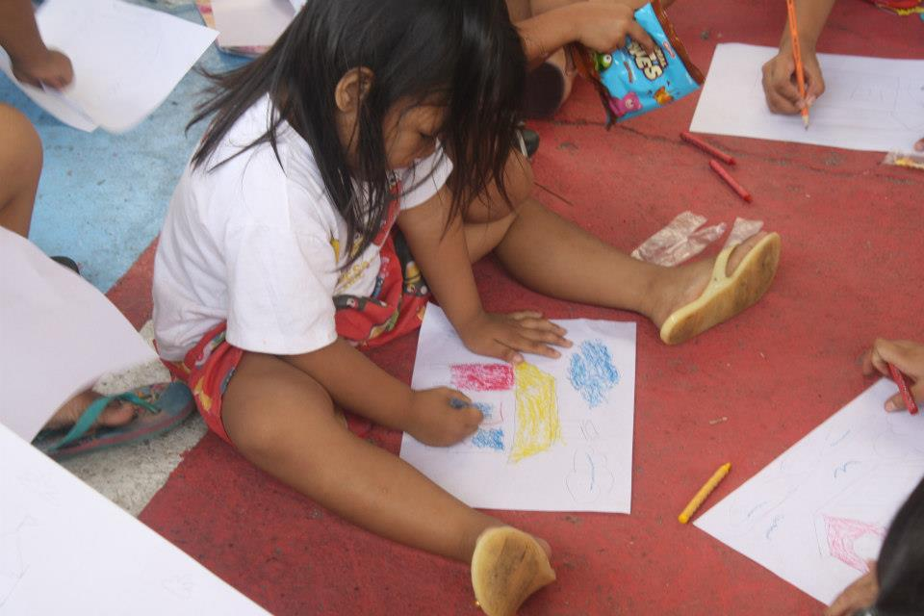
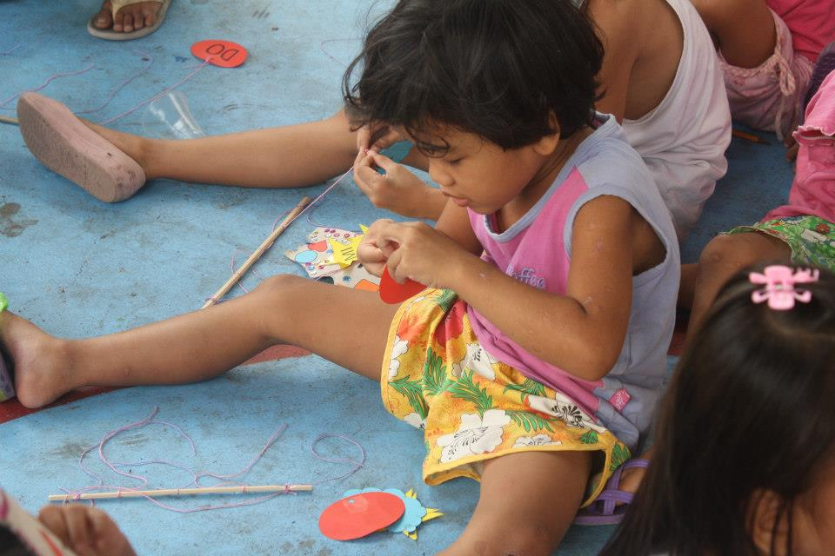
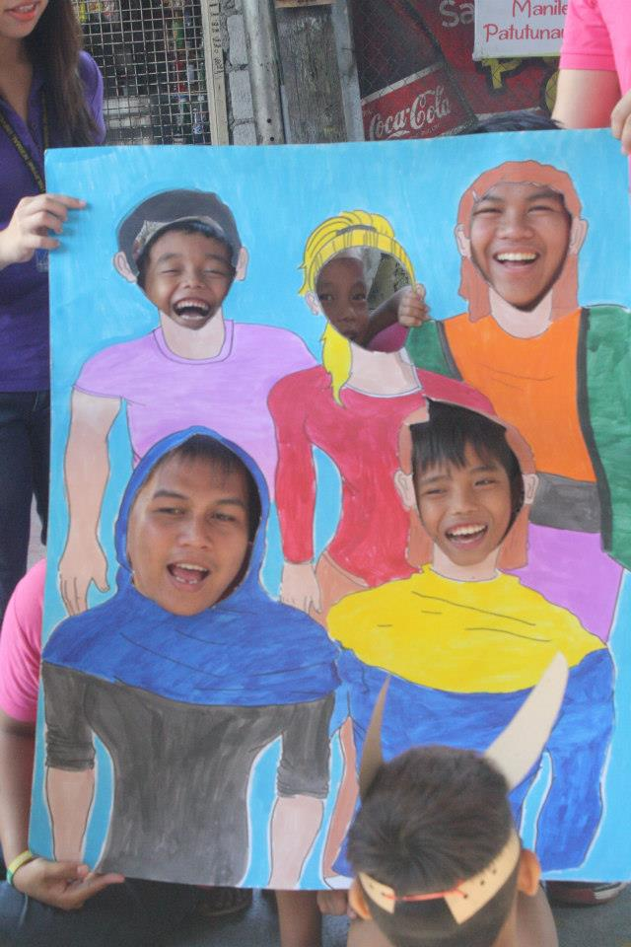
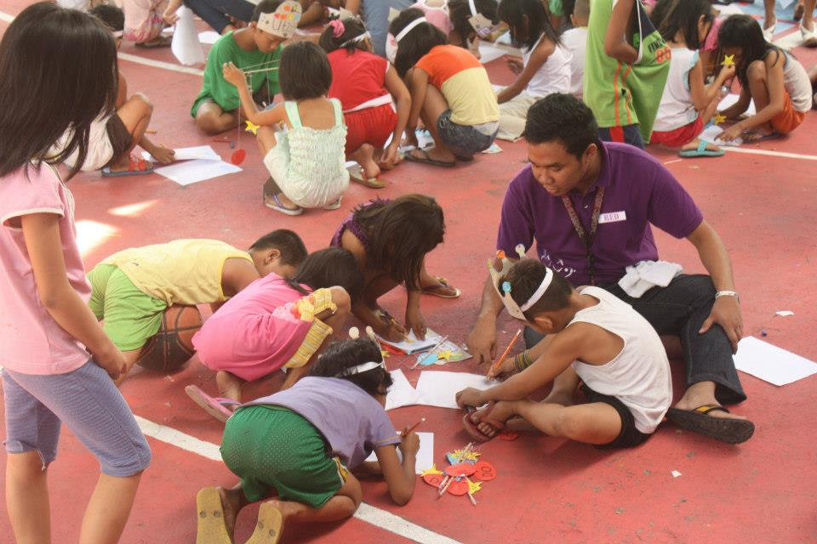
“Tell me & I’ll forget;
Show me & I may remember;
Involve me & I’ll understand”

Slide 3
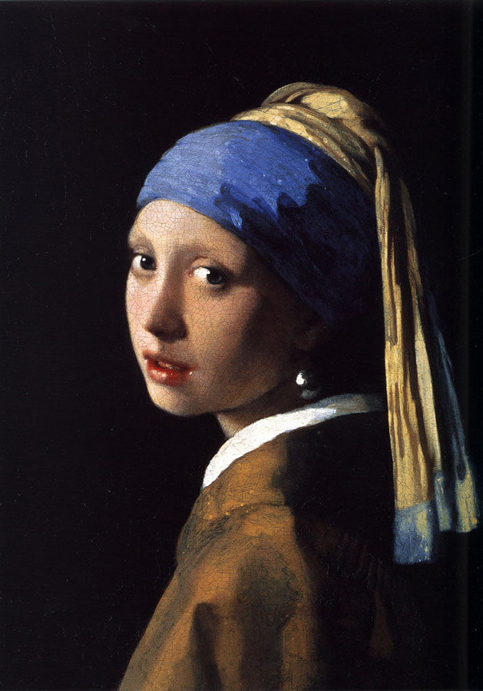
☺ Let us EXPLORE!
Get a piece of paper & draw as many kinds of lines that you can think of.
Straight
Hills
Dots
Zigzags
Dashes
Clouds
Castle
Loops
Mouse Ears
Swirl
Wave
Lightning
Circle
Chain
Shapes
Long &
Short
Diamond
Broken
Line

Slide 4
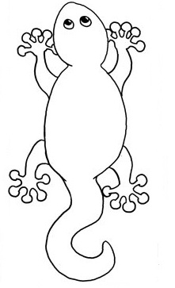
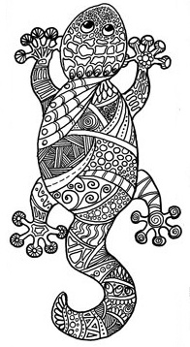
☺ Let us EXPLORE!
Draw a gecko and covered it with lines.

Slide 5
Write 5 words that will describe your experience in doing the activity
Write 5 words that will describe how you feel after you finish designing the gecko

Slide 6
Let us explore the mystery of
ART

Slide 7
“Suprematist Composition: White on White”
(oil on canvas)
Kazimir Malevich, 1918
Malevich's believed that Suprematist art would be superior to all the art of the past, and that it would lead to the "supremacy of pure feeling or perception in the pictorial arts."

Slide 8
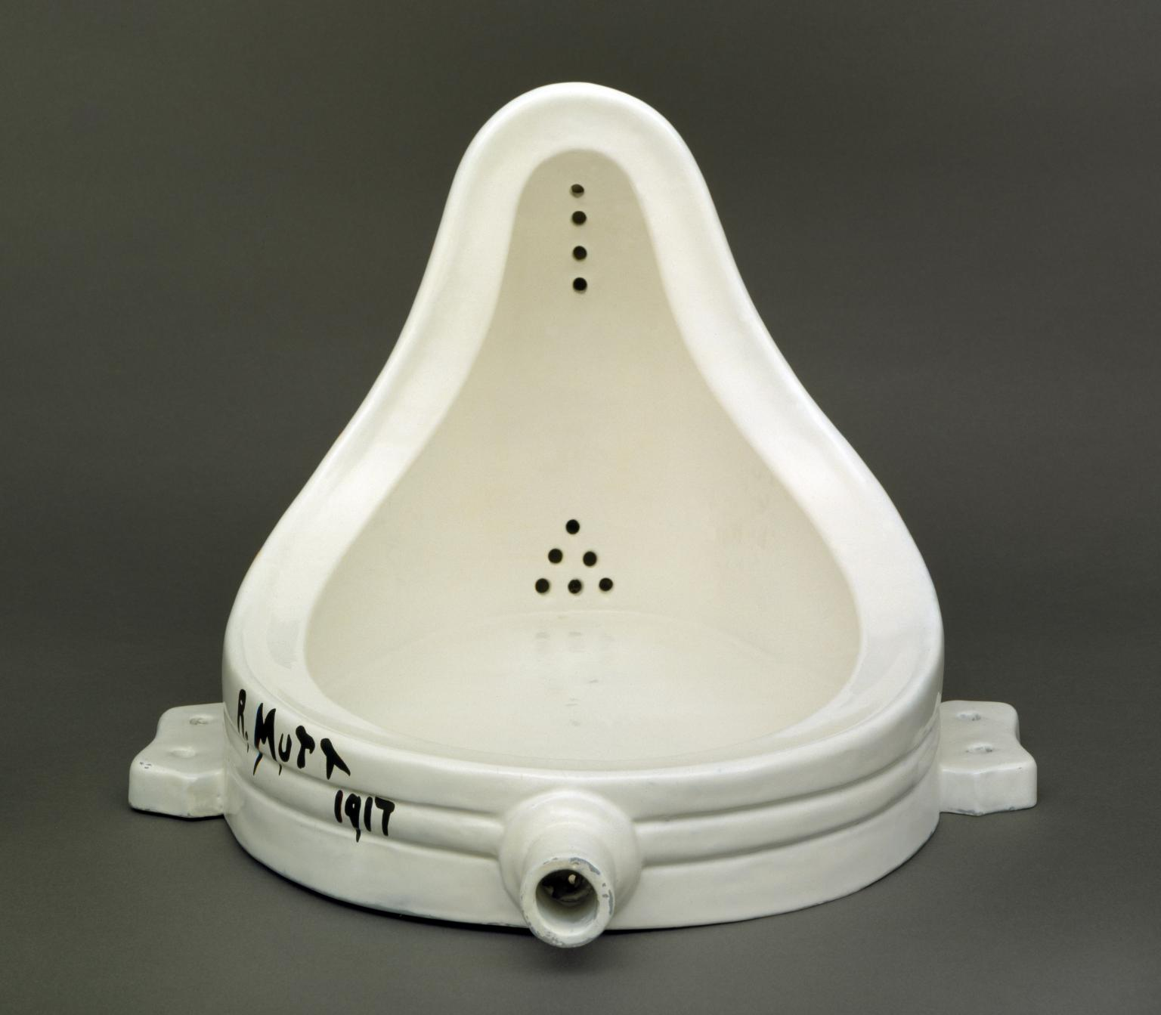
Duchamp’s readymade art asserted the principle that what is art is defined by the artist. Choosing the object is itself a creative act, cancelling out the useful function of the object makes it art, and its presentation in the gallery gives it a new meaning
“Fountain”
Marcel Duchamp, 1917

Slide 9
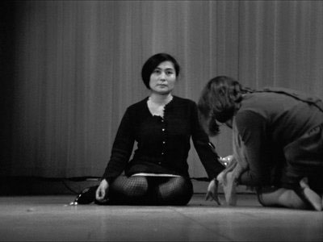
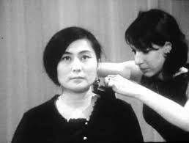
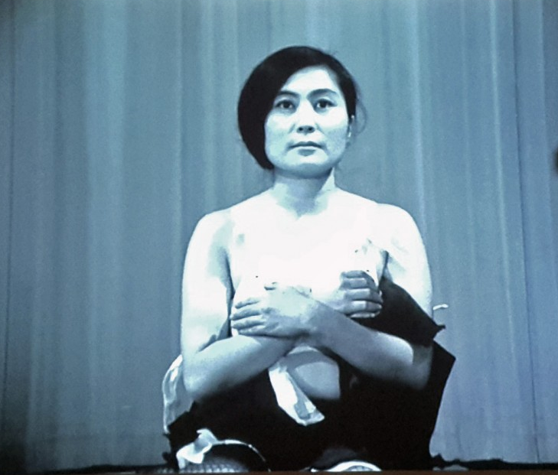
Performance art is a genre in which art is presented "live" usually by the artist but sometimes with collaborators or performers.
In performance art, the artist’s medium is the body, and the live actions he or she performs are the work of art.
“Cut Piece”
Yoko Ono, 1964

Slide 10
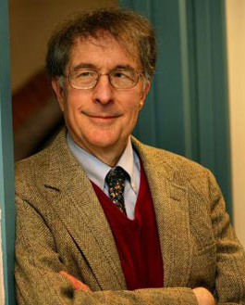
Howard Gardner (1987) said that the arts is difficult to assess because…
personal meaning
deal with emotional content
artistic expression
often very subjective
aesthetic
growth

Slide 11
Portfolio Assessment

Slide 12
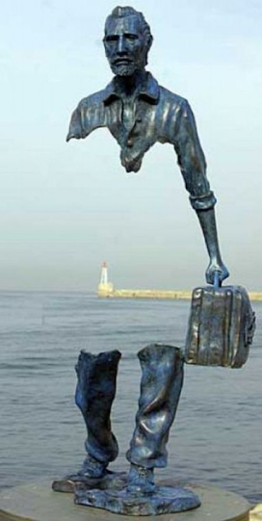
Portfolio assessment is a systematic collection of students’ works
It is a way to assess experiential learning to discover the meaning of experience
Articulation
Organization
Documentation
Must be structured to identify the difference between what is learned & what is done
It is a method of displaying skills & accomplishments

Slide 13
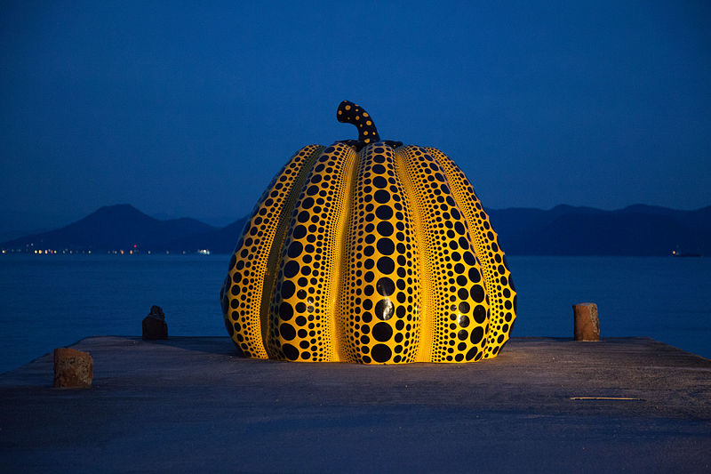
Portfolio Development as Personal Exploration
It provides opportunity to explore individual development as learners.
It serves as a self-reflective process of what is done, is being done, & how it can remold their perceptions.
It reflects the relationship between
understanding & action.

Slide 14
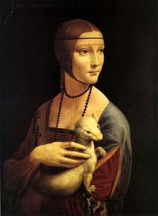
Framing Experience
Appreciating art is experiencing art
CREATING
Identify & demonstrate in the present what has been learned from prior experience.
Engage in reflective participation & demonstration.
Develop individual identity as learner who has the ability & confidence to learn independently.

Slide 15
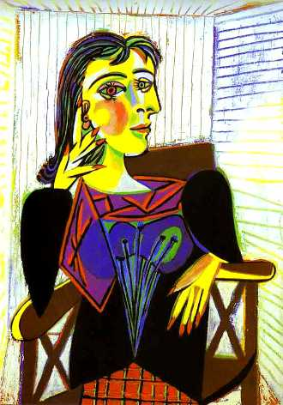
Abilities as Framework for Learning
Learners should be guided in identifying the abilities & skills that they have developed in the context of their prior learnings & experiences.
Ex. The learners can exhibit & demonstrate the learning competencies in music & art.
Learners should be guided in the development of ability framework to enable the reflection of individual development as a result of prior learnings & experiences.

Slide 16
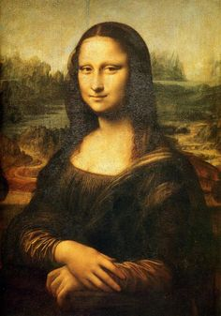
Types of Portfolio
Showcase Portfolio – learners select their best works & reflect thoughtfully on their quality.
Documentation Portfolio – displays the learners changes & accomplishments. It highlights the development & improvement of learners during a given period of time.
Process Portfolio – it is a purposeful collection of student work that documents student growth from novice to master. Its purpose is to promote student reflection and ownership over the learning process.

Slide 17
Types of Portfolio
Product Portfolio – similar to process portfolio except that its focus is on the end product rather than the process in which the product was developed. There in no information about the steps that was used in crafting the product.
Standard-based Portfolio – its focus is on specific learning standards. Evidence of accomplishments are gathered & presented.

Slide 18
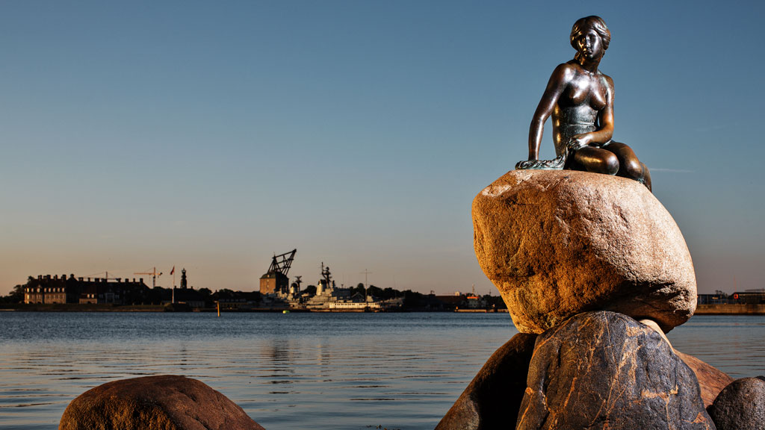
Learning from Experience Worksheet
Experience
Time Spent
in the Activity
Description of
Duties, Tasks,
& Activities
Description of
Learning Outcomes & Competencies
Documentation
Reflection

Slide 19
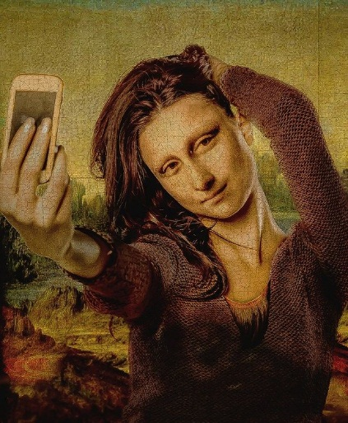
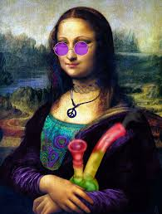
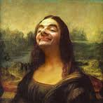
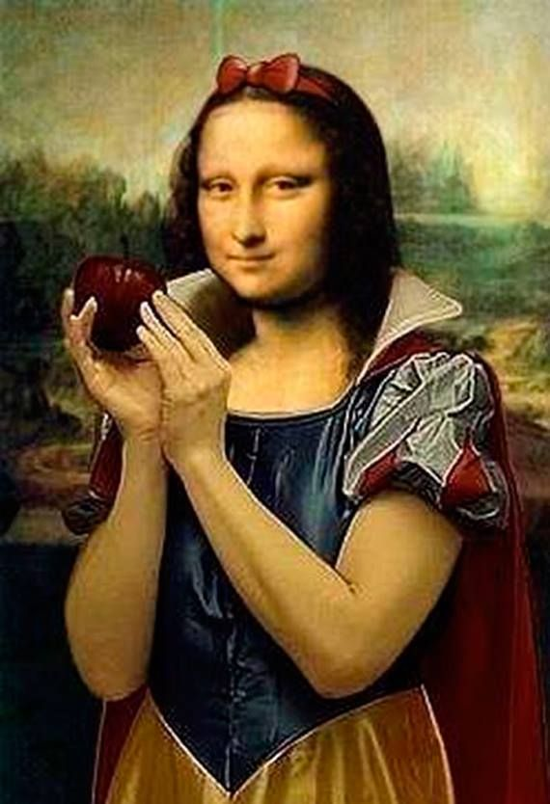
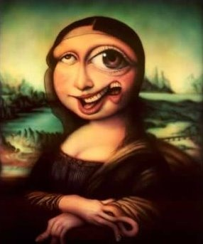
ART
could serve to make the world fresh and strange,
ART
could make us look at the world in new ways.

Slide 20
Maraming salamat po

