Slide 1
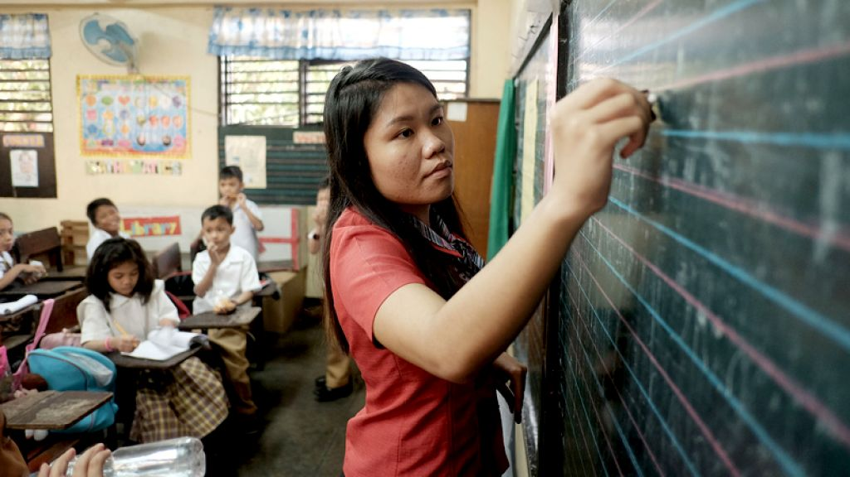
Raising the bar of teacher quality: LICENSURE EXAM PERFORMANCE
Dylan Dellosa Philippine Business for Education

Slide 2
Rationale
Guide consumers
in their choice of TEI
Create demand-side pressure for TEI improvement
Inform policy development
for teacher quality
Maintain a database for TEI performance monitoring

Slide 3
Key findings
Dismal overall
LET performance
Significant
regional disparities
TEIs consistently
good or bad
More graduates
falling behind

Slide 4
Recommendations
Revamp
the LET
Rethink
teacher development
Hold TEIs
accountable
Pre-service admission
In-service
development
Test development
and administration
Sanctions for non-performance
Funding
public TEIs

Slide 5
Methods
PRC data for the past 16 LET instances encoded, tallied
TEIs sorted: number of takers, passing rate, name
Results interpreted, conclusions drawn

Slide 6
Limitations/Assumptions/Trends
Variance in number of TEIs due to:
Disparities in TEI names/codes as written by applicants
TEI information limited to undergraduate degree of applicants, regardless of track (full program vs. CTP)
Recent TEI closures

Slide 7
Limitations/Assumptions/Trends
Units of measurement: Passing rates, TEIs
Disaggregation: Level (elementary [BEEd], secondary [BSEd]), region, score quintiles*
Scores for first-time takers are generally better than their overall (i.e., first-time takers plus repeaters) counterparts.
Data pertain to first-time takers only, unless otherwise specified. As such, findings already depict best-case scenarios.
Scores for BEEd are generally better than their BSEd counterparts.

Slide 8
Teacher education is as popular as ever
Enrolment, priority disciplines,
AY 2015-2016
CHED 2017, NEDA 2011

Slide 9
Teacher education is as popular as ever
HEIs with teacher education programs,
AY 2015-2016
50%
CHED 2017, NEDA 2011
Notes:
Total HEIs = 1934 (2388 if with SUC satellite campuses)

Slide 10
National passing rates have been consistently low
Licensure passing rates,
all disciplines
53% PDP 2016 target
CHED 2017, NEDA 2011

Slide 11
LET performance, however, has been dismal…
Average licensure passing rates,
priority disciplines, 2009-2017
53% PDP 2016 target
CHED 2017

Slide 12
…and is even further declining
Elementary

Slide 13
…and is even further declining
Secondary

Slide 14
At least half of TEIs have been performing
below the national passing rate
50%
Notes:
ANPR
Elem FT 53.5 OA 29
Sec FT 57.1 OA 33.9

Slide 15
In at least 11 regions,
poor performers outnumber good ones
50%
Notes:
From 2016: At least 10 regions

Slide 16
In at least 11 regions,
poor performers outnumber good ones
50%

Slide 18
First-time taker scores are normally distributed…

Slide 19
…while overall scores
are skewed toward poor performance

Slide 20
With each LET instance,
more graduates are falling behind
Notes:
ANPR
Elem FT 53.5 OA 29
Sec FT 57.1 OA 33.9

Slide 21
There is consistency in TEI performance--
both good and poor

Slide 22
Top performers are the usual stars...
Elementary | No. of passers | Passing rate
Philippine Normal University-Manila* | 1,666 | 94.82
University of Santo Tomas | 906 | 98.05
Xavier University | 730 | 90.23
University of the Philippines-Diliman* | 435 | 99.54
Bohol Island State University-Tagbilaran* | 421 | 90.93
De La Salle University-Manila | 293 | 98.65
*Government-funded schools.
PRC 2009-2017, PBEd 2017
Notes:
From 2016: Miriam College, 274, 95.47%

Slide 23
Top performers are the usual stars...
Secondary | No. of passers | Passing rate
Philippine Normal University-Manila* | 5,788 | 93.05
University of Santo Tomas | 1,569 | 91.75
University of the Philippines-Diliman* | 1,100 | 96.24
University of the Philippines-Los Baños* | 573 | 99.31
De La Salle University-Manila | 394 | 98.75
*Government-funded schools.
PRC 2009-2017, PBEd 2017
Notes:
From 2016: Siliman University, 329, 90.38%

Slide 24
Top performers are the usual stars...
Average national passing rate

Slide 25
…just as poor performers are the usual offenders
Elementary | Performance instance
 | Below 20% | At 0%
Marawi Capitol Foundation College | 16 | 7
Marawi Islamic College | 16 | 4
Mindanao Islamic Computer College | 16 | 2
Pacasum College | 16 | 3
Gani L. Abpi Colleges, Inc. | 15 | 9
Lapak Agricultural College-Siasi* | 15 | 7
Southern UPI College | 10 | 7
Southern Negros College | 6 | 6
La Consolacion College-Daet | 5 | 5
Camarines Norte State College-Labo* | 4 | 4
*Government-funded schools.
PRC 2009-2017, PBEd 2017

Slide 26
…just as poor performers are the usual offenders
Secondary | Performance instance
 | Below 20% | At 0%
Hadji Butu School of Arts and Trades* | 16 | 16
Lanao National College of Arts and Trades* | 16 | 13
Tawi-tawi Regional Agricultural College* | 16 | 12
Lapak Agricultural College-Siasi* | 14 | 14
Jamiatu Muslim Mindanao | 14 | 8
Shariff Kabunsuan College | 13 | 13
Libacao College of Science and Technology* | 12 | 11
Datu Mala Muslim Mindanao Islamic College | 11 | 11
Southwestern Mindanao Islamic Institute | 10 | 10
*Government-funded schools.
PRC 2009-2017, PBEd 2017

Slide 27
…just as poor performers are the usual offenders
Secondary | Performance instance
 | Below 20% | At 0%
Unda Memorial Agricultural School* | 9 | 9
East Pacific Computer College | 9 | 7
Cali Paramedical College Foundation | 8 | 8
Shepherd's College | 8 | 8
Romblon State College-Sta. Maria* | 8 | 7
Agro-industrial Foundation College | 7 | 6
La Consolacion College-Biñan | 4 | 4
Southway College of Technology | 4 | 4
*Government-funded schools.
PRC 2009-2017, PBEd 2017

Slide 28
Conclusions
Dismal overall
LET performance
Significant
regional disparities
TEIs consistently
good or bad
More graduates
falling behind

Slide 29
Recommendations
Revamp
the LET
Rethink
teacher development
Hold TEIs
accountable
Pre-service:
TEI admission
In-service:
Professional development
Test development
and administration
Sanctions
for poor performance
Funding
public TEIs

Slide 30
Recommendations
Scrutinize the LET:
validity testing,
item analysis
Involve TEIs
in test development
Revive the three-strike
test-taking rule
Limit TEI admission
to top 20%
of graduating
high school batch
Consider portfolio-based certification
Revamp
the LET
Rethink
teacher development
Close down consistently
non-performing TEIs
Fund public TEIs
based on LET performance
Hold TEIs
accountable
Close down consistently
non-performing TEIs
Fund public TEIs
based on LET performance

Slide 31
Recommendations
Scrutinize the LET:
validity testing,
item analysis
Involve TEIs
in test development
Revive the three-strike
test-taking rule
Limit TEI admission
to top 20%
of graduating
high school batch
Consider portfolio-based certification
Revamp
the LET
Rethink
teacher development
Close down consistently
non-performing TEIs
Fund public TEIs
based on LET performance
Hold TEIs
accountable
Scrutinize the LET:
validity testing, item analysis
Involve TEIs
in test development
Revive the three-strike
test-taking rule

Slide 32
Recommendations
Scrutinize the LET:
validity testing,
item analysis
Involve TEIs
in test development
Revive the three-strike
test-taking rule
Limit TEI admission
to top 20%
of graduating
high school batch
Consider portfolio-based certification
Revamp
the LET
Rethink
teacher development
Close down consistently
non-performing TEIs
Fund public TEIs
based on LET performance
Hold TEIs
accountable
Limit TEI admission to top 20%
of graduating high school batch
Consider portfolio-based certification

Slide 33
Recommendations
LET scrutiny
(“test the test”)
TEIs in test development
Three-strike
test-taking rule
Stringent
TEI admission
Portfolio-based certification
Revamp
the LET
Rethink
teacher development
Closure of non-performing TEIs
Performance-based funding for public TEIs
Hold TEIs
accountable

Slide 34
Raising the bar of teacher quality: LICENSURE EXAM PERFORMANCE
Dylan Dellosa Philippine Business for Education

